Slide 1
Water management
Partner: Spolek absolventů a přátel zemědělské školy v Chrudim z.s.

Slide 2
Objectives & Goals
At the end of this module you will be able to:
understand of the necessity of water saving and retention,
know saving water and it recycling at household,
know what is a water revitalization,
knows the difference between a domestic sewage treatment plant and a root water treatment plant are,
know the importance of natural features in the garden – small garden lakes, rain bed,
know the meaning and use of aquaponics and hydroponics,
know irrigation systems,
know the use of vertical gardens,
know sampls for rainwater harvesting in the garden,
know the concept of water retention and give examples,
know several methods of allowing water to soak in around houses.

Slide 3
Index
Unit 1 Water shortage
Section 1: Water shortage in Southern Europe
Section 2: Groundwater shortage in Central Europe
Section 3: Household water saving, recycling
Section 4: Do and don´ts
S
Unit 2 Water revitalization
Section 1.Water revitalization in the landscape, native rivers, meanders
Section 2.Water revitalization in populated areas, artificial embankments, wastewater treatment plants-biological treatment
Section 3. Root water treatment plants, domestic sewage treatment plants.
Section 4: Do and don´ts

Slide 4
Unit 3 Urban islands
Section 1. Water features (fountains, artificial lakes)-city
Section 2. Ponds and Fire Ponds- villages
Section 3 Home garden lake, rain bed, aquaponics and hydroponics
Section 4: Do and don´ts
Unit 4 Irrigation
Section 1: Irrigation and plant maintenance in populated areas and around houses
Section 2: Irrigation of vertical walls and green roofs
Section 3: Vertical gardens
Section 4: Do and don´ts
S
Unit 5 Water retention in the landscape
Section 1. Wetland creation, polders
Section 2. Water retention in urban areas
Section 3 Collection and retention of water in the surroundings of family houses
Section 4: Do and don´ts

Slide 5
1 Water shortage
Water shortage in Southern Europe
Climate change affects all regions of the world. Glaciers in the Arctic and Antarctic are receding, sea levels are rising. In some regions, extreme weather events and precipitation are becoming more frequent, while in others people are dealing with more intense heat waves and periods of extreme drought. Climate action must therefore be taken now, otherwise the impacts of climate change will be exacerbated.
Climate change affects all regions of the world. Glaciers in the Arctic and Antarctic are receding, sea levels are rising. In some regions, extreme weather events and precipitation are becoming more frequent, while in others people are dealing with more intense heat waves and periods of extreme drought. Climate action must therefore be taken now, otherwise the impacts of climate change will rise.
According to the European Drought Observatory (EDO), about half of Europe's water catchment shows signs of drought. Some southern European countries such as Spain, Bulgaria or Greece have limited per capita consumption of drinking water. This situation is being addressed by desalination of seawater and the construction of desalination plants such as the 'Valencia Desalination Plant'.
At the same time, almost all rivers in Europe have extremely low flows. According to forecast models, the situation will not change significantly and the drought could get worse. Drought not only affects individual people, but also river transport, agriculture, energy production, basic infrastructure such as medical facilities. As the climate warms, precipitation patterns change, evaporation increases, glaciers melt, and sea levels rise. All these factors affect the availability of fresh water.
More frequent and severe droughts and rising water temperatures are expected to cause water quality to decline. These conditions encourage the growth of toxic algae and bacteria, which will exacerbate the problem of water scarcity, which is largely caused by human activity.
The quality and quantity of fresh water available will also be affected by a greater occurrence of cloudbursts (sudden extreme rains), as storms can cause untreated sewage to enter surface waters.

Slide 6
Groundwater shortage in Central Europe
In 2017, the Czech Hydrometeorological Institute, Climate Change Department, reported that Central Europe is relatively well off in terms of water, with annual rainfall remaining the same. The problem is the distribution of rainfall over the year and especially the higher evaporation associated with higher temperatures, which affects low groundwater levels and extremely low flow rates in almost all European rivers. Euro-barometer survey shows that almost three quarters of Europeans think that the European Union should propose further measures to tackle Europe's water problems. A total of 62% of citizens also feel that they are not sufficiently well informed about the issue. European rivers usually originate in mountainous regions, and 40% of Europe's fresh water comes from the Alps. However, changing snow and glacier dynamics and precipitation regimes may lead to temporary water shortages across Europe. Changes in river flows caused by drought can also affect inland water transport and hydro-power generation.
Household water saving, recycling
The above shows the need for water conservation and that every citizen should be responsible for saving and consuming water at home. However, the Euro barometer survey shows that 62% of citizens feel that they are not sufficiently well informed about the environmental consequences of water consumption.
Examples of water saving in the household:
1. Changing habits has a very effective impact on water saving.
-Turning off the tap while brushing teeth can save up to 9 litres of water per minute
- reducing the length of a shower by 2 minutes a day can save up to 19 litres of water per day and 7000 litres of water per year
2. use the water from washing fruit to water plants
3.use a water-saving percolator on taps
4. use the dishwasher and washing machine correctly - use the capacity
5. use dual flush toilets
6. do not rinse dishes under running water and
7. boil a reasonable amount of water in a kettle

Slide 7
Recommendation
Do’s and don’ts
1. Reducing the length of a shower by 2 minutes a day can save up to 9 litre.
2. Use the water from washing fruit to water plants.
3. Use a water-saving percolator on taps.
4. Use the dishwasher and washing machine correctly - use the capacity.
5. Use dual flush in toilets.
1. Don´t let the water running while brushing the teeth.
2. Don´t rinse the dishes under running water.
3. Don’t waste the water accumulate from rain.
4. Boil a reasonable amount of water in a kettle.
5. Don’t use the toilet as wastebasket and don¨t flush it unnecessarily.

Slide 8
2.Water revitalization
Water revitalization in the landscape, native rivers, meanders
In the context of revitalization, pools, meanders, streams are being returned to the landscape. A revitalised Landscape retains water and increases biodiversity. Revitalisation projects are based on knowledge of river morphology and the relevant river pattern (hydro-morphological type) and aim to design watercourse shapes and dimensions corresponding to this type, e.g. "Revitalisation of the Bukovka watercourse in Živanice".
Water revitalization in populated areas, artificial embankments, wastewater treatment plants - biological treatment
Dams, gullies, canals, etc. are typical of water conditions in post-communist countries. These are man-made works, the oldest dating back to the 14th century, and have fed water into ponds, irrigated meadows and also made it possible to float timber or run water mills. Today, wastewater treatment plants are used to treat municipal, agricultural, and industrial water. The treatment process uses activated sludge, i.e. biological treatment.
Root water treatment plants, domestic sewage treatment plants
Any citizen who is not able to connect to a sewerage system can use domestic sewage treatment plants. The efficiency of treatment is 97%. The treated water can be discharged into watercourses, used for watering gardens or as domestic water.

Slide 9
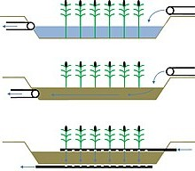
Root water treatment plant
Root water treatment plants
Schemes of root treatment plants: horizontal flow through water tanks, horizontal flow under the surface, vertical flow through the treatment plant
Most often wetland are planted, which can grow quickly and produce large amount of biomass. Another criterion is the ability to make maximum use of available nutrients. Plants are very important for providing sufficient oxygen for aerobic removal of organic matter in the roots.
The most commonly planted species are: common reed, broad-leaved sedge (Typha latifolia), narrow-leaved sedge (Typha angustifolia), reed canary grass (Phalaris arundinacea), lake scabious (Schoenoplectus lacustris), decomposing reed (Juncus effusus).

Slide 10
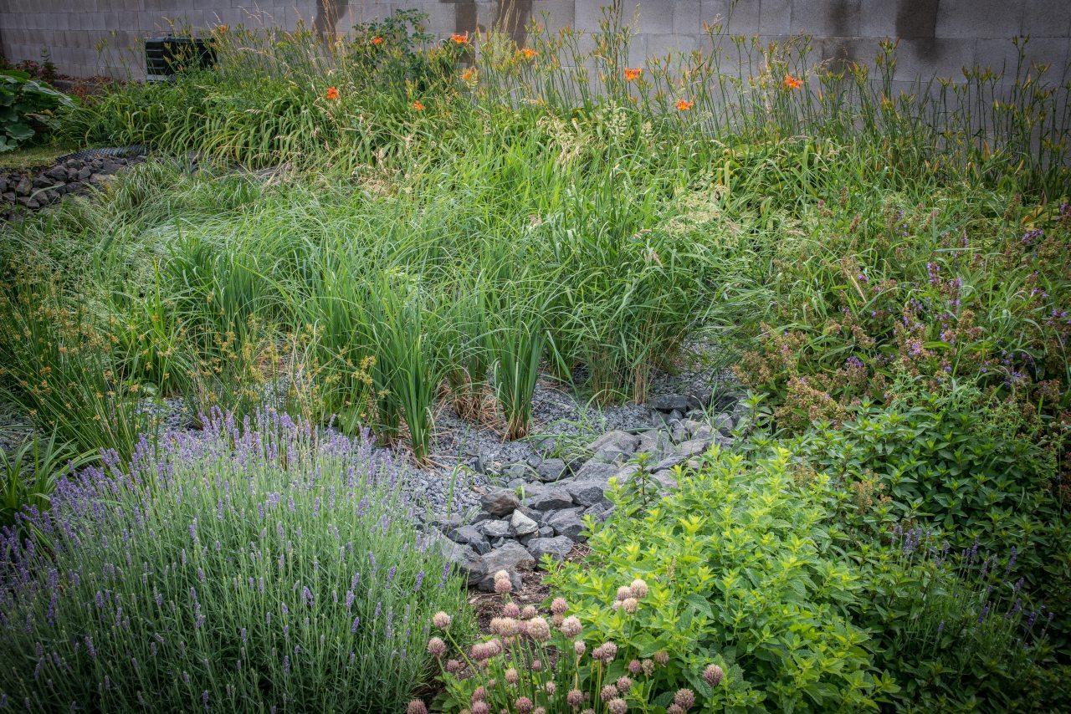
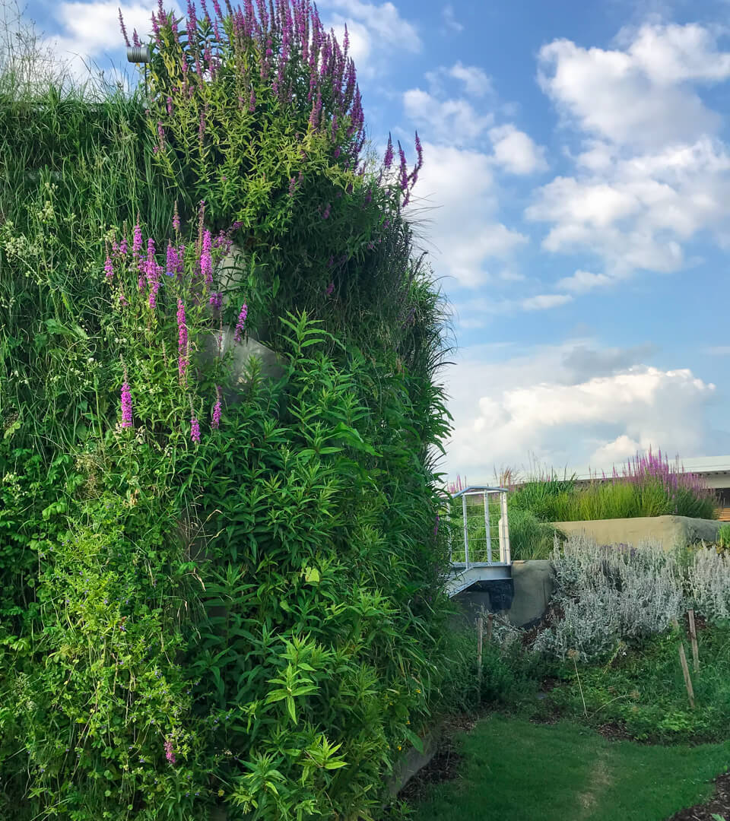
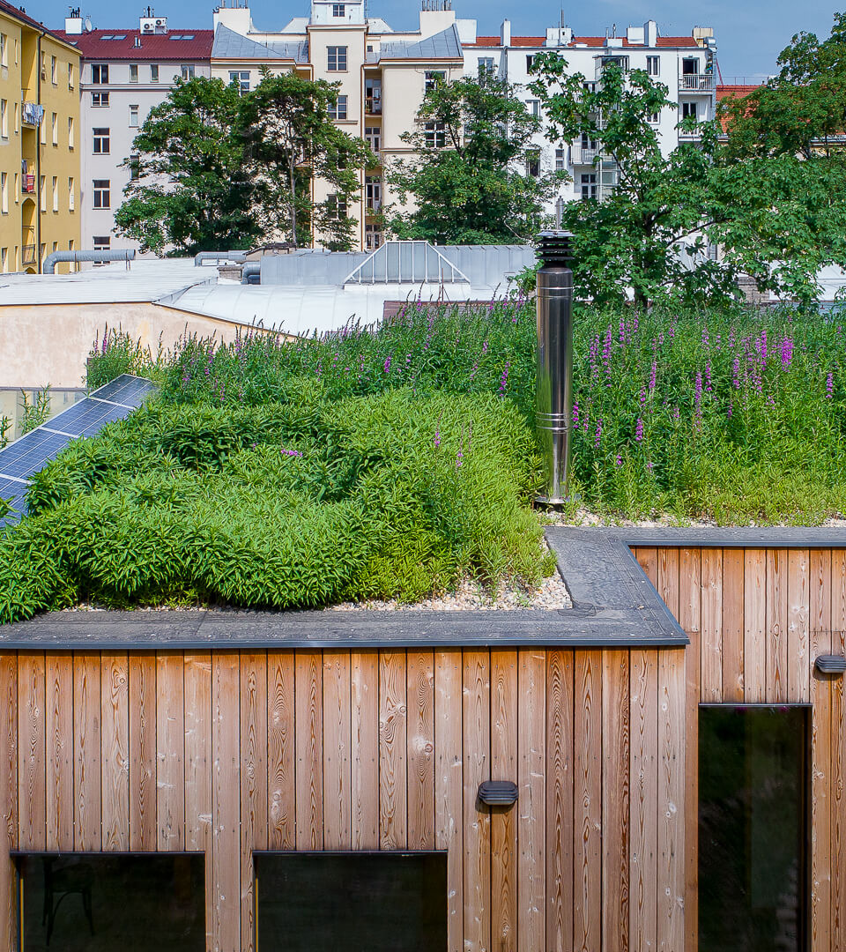
Root cleaning plant
Advantages of root cleaning are:
Minimal maintenance root treatment plant needs less care unlike the mechanical biological treatment which require frequent supervision,
lower operating cost which is five times to ten times lower compared to mechanical biological treatment plants,
long service life with a good maintenance the filing purifier can last 30 to 40 years.
Wetland roofs and facades
The wetland roof is a unique system connecting a green roof with a root treatment plant. The roof can thus be used for cleaning the wastewater produced in the house.
Another alternative that can clean the water on your house is a wetland facade. It can be designed either separately or together with a wetland roof.
The advantage of combining a green roof and a facade with a purifier is the creation of a green roof with a low weight, which does not place too high demands on the statics and load-bearing capacity of the roof.
Another advantage is the solution to the frequent problem of green roofs, which lies in a lack or, on the contrary, a large amount of moisture. This problem is most often solved with green roofs by increasing the substrate layer, which, however, places higher demands on the statics of the roof.
A waste water recycling system with the help of a roof root treatment plant is also beneficial, which will contribute to reducing drinking water consumption by up to half.
In addition, the green surface of the roof or facade will bring moisture and a favorable climate to the locality, which the owners and the surrounding area will appreciate especially in the hot summer months.

Slide 11
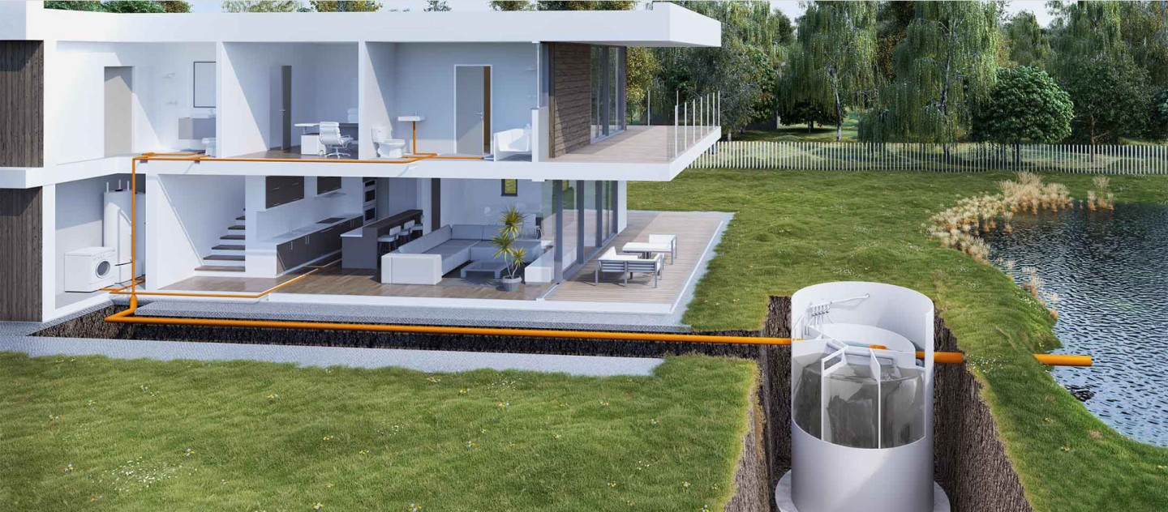
Domestic sewage treatment plants
It is suitable for cleaning wastewater from bathrooms, social facilities, automatic washing machines, kitchens, etc. It replaces outdated septic tanks, both in terms of efficiency and cost, and is in line with the requirements of modern living. The domestic wastewater treatment plant is very powerful and easy to operate. The technical layout of the wastewater treatment plant better handles uneven and intermittent inflows. The cleaning plant is equipped with a float trap. Domestic sewage treatment plants can be placed in the ground as embedded or semi-embedded, they can also be installed above ground level.
Advantages of a domestic wastewater treatment plant
- easy operation
- minimum operating costs depending on the selected mode (weekend operation, holiday, etc.)
- quality workmanship, long usiness.
By using root treatment plants and wastewater treatment plants, you will not only increase biodiversity, but also save money on water consumption and ensure a more efficient and economical use of wastewater.
Domestic sewage treatment plant

Slide 12
Recommendation
By using root treatment plants and wastewater treatment plants, you will not only increase
biodiversity, but also save money on water consumption and ensure a more efficient and
economical use of wastewater.
Do’s and don’ts
1. Inappropriate modifications of water ecosystems - for example, changes of water level, straightening of streams, acceleration of runoff, disposal of riparian vegetation.
2.Don´t use water to clean sidewalks and driveways-sweep them instead.
3. After cooking, do not pour the water out of the pot - pour it into a large container and reuse it to water your plants.
1. By using root and waste treatment plants, a long-term and low-cost
operating system can be created.
2. Take care of your septic tank. Check it every year and let it drain in 3 to 5 years.
3. Take care of your septic system. Inspect it every year and get it pumped out to every 3 to 5 years.

Slide 13
3.Urban islands
Water features (fountains, ponds)-city
Temperature is higher in the built environment. The micro climate is improved by plenty of greenery and water features such as fountains, drinking fountains, misters. They increase humidity, purify the air and reduce extreme temperatures. They are also an aesthetic feature of public spaces and, in the case of drinking fountains, offer a simple source of drinking. Water features are increasingly popular, often increasing biodiversity and enlivening urban spaces.
Historic ponds and fire ponds-villages
In the landscape, a pond is perceived as a landscape element, individual or forming groups of independent ponds or ponds connected to each other by watercourses into a so-called pond system.
Functions of ponds:
1. Flood protection and water retention - the nature of the ponds, their number and area allows for the capture of a huge amount of water in flood situations,
2. Water supply in the landscape, influence on the micro climate - they retain and accumulate flowing surface water and create a water supply in the landscape, serving all living organisms. Thanks to this ability, ecosystems with rich flora and fauna are created around the ponds,
3. Purification of surface water - accumulated water in the pond and its surroundings represents a stable environment in which a specific chain of biochemical processes occurs. At the same time, storage and decomposition processes, transformation of nutrients and substances take place here, food chains and mutual relations in the hierarchy of organisms living here are established. A special case is the so-called biological or stabilization ponds, which are built only for the purpose of purifying surface water.
Fire reservoirs were built in places of high accumulation of houses and water was used to extinguish fires in the inner city, but also outside it, e.g. when fighting forest fires.

Slide 14
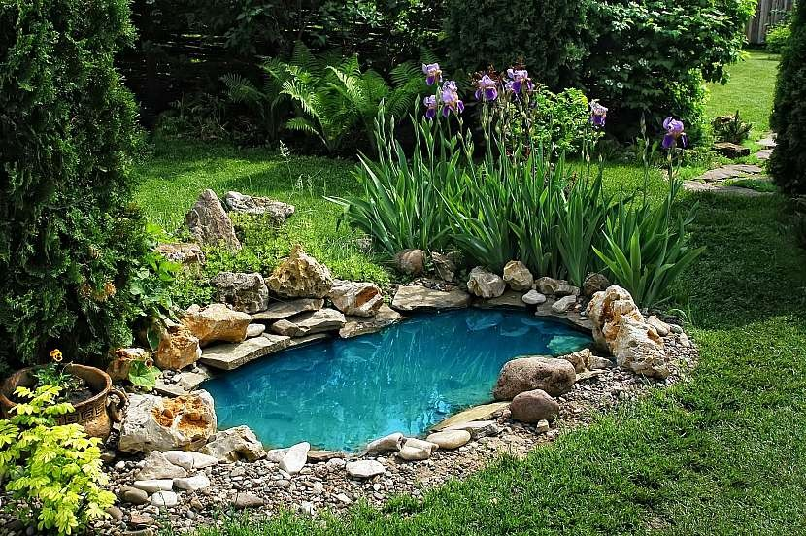
Home small lakes, rain bed, aquaponics and hydroponics
Home-made natural small lakes
are becoming increasingly popular, often replacing "blue pools". They increase the biodiversity of the environment, improve the micro-climate and often provide a pleasant swimming experience. The main reason people get a garden pond is that it brings life into the garden. With a body of water, various small animals will soon move into your garden, which in turn will attract larger animals.

Slide 15
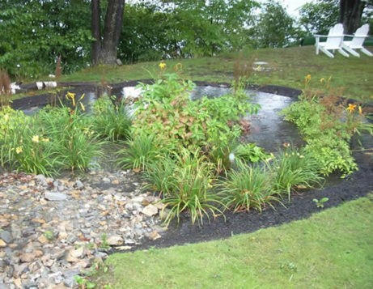
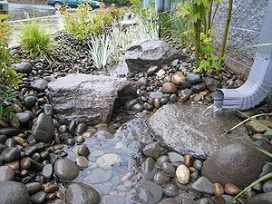
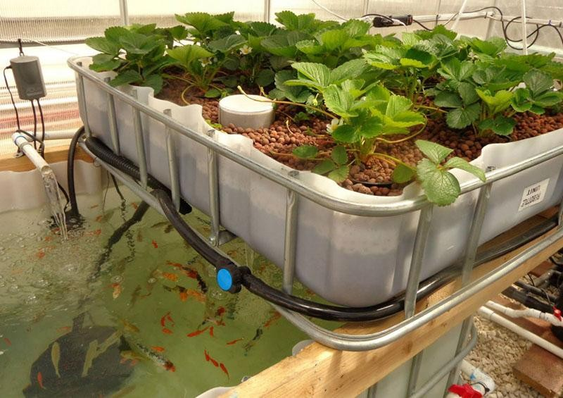
Rain bed
A rain bed is a natural or man made in the landscape where the excess water from the roofs, pavements and paved areas runoff during the rainfall. The soil in the bed should be very permeable so the excess standing water is absorbed as soon as possible. The rainwater will be cleansed by the plant roots and the soil will reach the ground without contamination.
Aquaponics, hydroponics
Aquaponics is the deliberate breeding of fish and the subsequente use of the water to grow plants. Hydroponics is the growing of plants in aqueous solution. The use of the water for the food production is maximiazed. The principle is to combine aquaculture,i.e. fish farming and hydroponic cultivation meaning growing plants in a nutrient solution.
The production of plants and fish is several times higher than under normal conditions. The principle is to combine aquaculture, i.e. fish farming, and hydroponic cultivation, i.e. growing plants in a nutrient solution. In aquaponics we also make beneficial use of micro-organisms that help with the transformation of substances and thus enable the two systems to be linked. This symbiosis is beneficial for the coexistence of all these organisms. With aquaponics we can keep both food and ornamental fish. The same applies to growing plants, we can grow plants for consumption such as lettuce, tomatoes, cucumbers, herbs or ornamental flowers. From a global point of view, the most common combination is the cultivation of Nile tilapia in combination with the cultivation of salads or herbs.

Slide 16
Recommendation
Do’s and don’ts
1. The establishment of garden ponds and rain beds increases the biodiversity of the environment, improves the micro climate and prevents water runoff.
2. With the help of aquaponics and hydroponics, we can have a productive garden even in city apartments and on balconies.
3. Tanks, lakes, ponds increase air humidity, clean the air and reduce extreme temperatures in urban areas.
1. Elimination of small water areas (wetlands and waterlogged habitats) as a result of land reclamation.
2. A large amount of water in the landscape (garden) can oversaturate the sorption capacity of the soil and cause it becomes more permanently wet.
3. Don´t use containers that were previously used to store chemicals to collect rainwater.

Slide 17
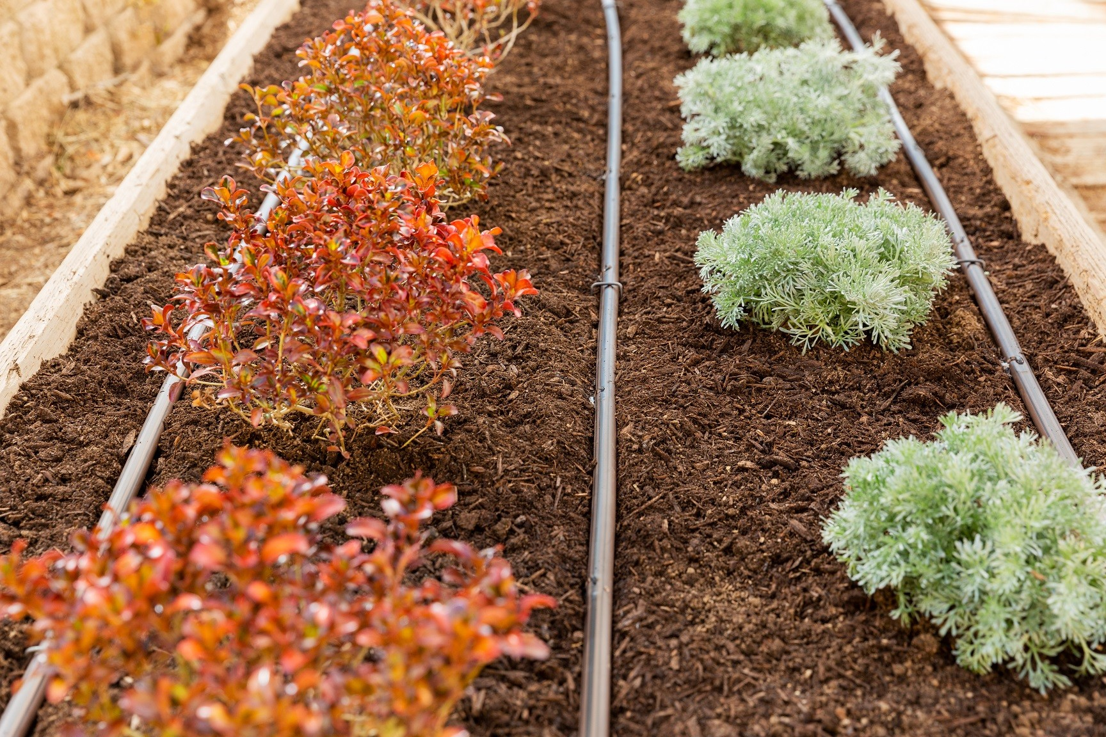
4 Irrigation
Irrigation and plant maintenance in populated areas and around the houses
When irrigating public areas and parks, an automatic irrigation system is most often used to irrigate lawn areas, shrub plantings and trees. Irrigation is now a common feature in city or castle parks. The irrigation in house gardens is part of automatic system, where it complements a system of pull-out sprinklers. The overhead drip line is placed on the surface, usually under mulch bark. In any revitalisation or renovation of public spaces, an automatic irrigation system is quite commonly designed as part of the whole, where the public green space becomes unsustainable without this item (sufficient irrigation).
The most common method is drip irrigation, which brings water directly to the individual plants and delivers the required amount of water to the plant, tree or shrub by slow dripping.
It is commonly part of automatic irrigation systems in house gardens, where it complements a system of pull-out sprinklers. The overhead drip line is placed on the surface, usually under mulch bark.

Slide 18
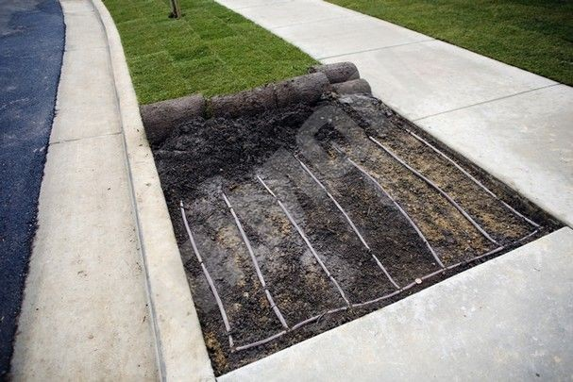
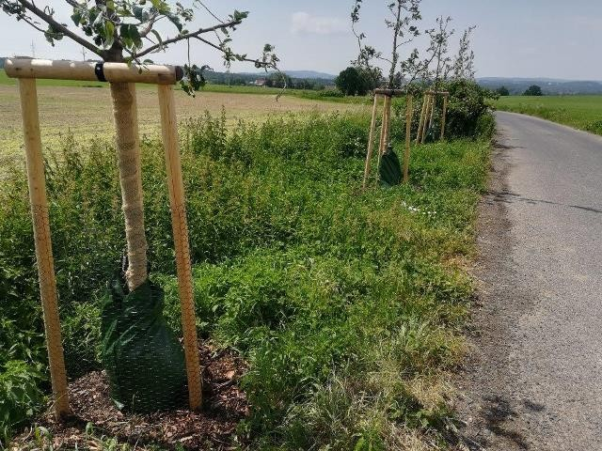
Another method of irrigation is trough underground drip pipes. This method of irrigation is very efficient, the water goes directly to the root zone of the turf and there is not evaporation of water during irrigation. The underground line is also suitable for irrigating narrow strips of lawn. The most common method of automatic irrigation of lawn areas of gardens of family houses is sprinkler irrigation using extendable sprinklers. Spray and rotary sprayers are mainly used in gardens.
Another option is irrigation bags for maintaining urban greenery, planting around traffic roads or in orchards. With a capacity of 55 and 75 litres, they can water even a very thirsty tree and give it exactly the moisture it prefers.The tree watering bags release water doses between 6 and 10 hours. Watering is thus regular and controlled. They are particularly suitable for trees in dry locations, for example in the shelter of a larger tree, and for all newly planted trees as well as trees growing on a slope.

Slide 19
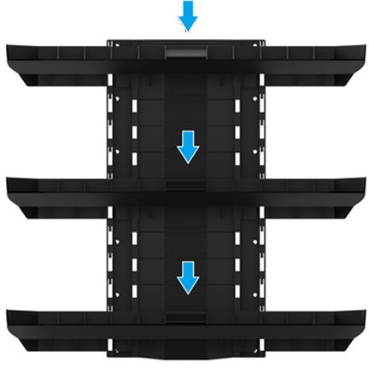
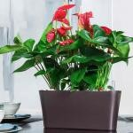
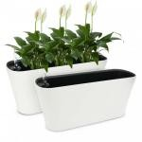
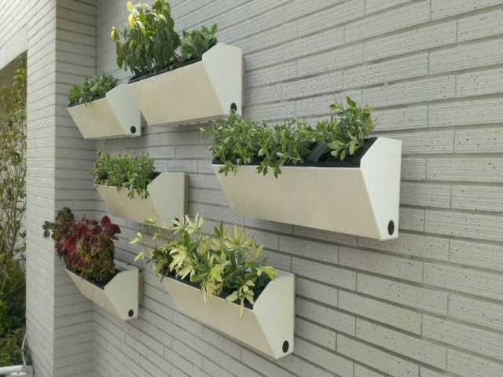
Irrigation of vertical walls and green roofs
Green walls have become an increasingly popular addition in recent public years, corporate and private spaces. A wall made of real,living plants has an unquestionable aesthetic effect in addition to positive effects. It makes staying in its vicinity very pleasant, proving purifies the air, improves the microclimate in the room. It consists of basic irrigation water safely flows safely in the defined space.
Vertical gardens
Another way to make your home more pleasant with herbs, annuals or fruit is to use Hydro falls. They can be kept as individual self-watering planters in the kitchen, for example, and can be stacked individually in a space or hung on top of each other on the wall to create a vertical garden. In this case, you won't need a water source or an electrical outlet, just a simple watering can.
Self-watering pots are suitable for the home or for the terrace, balcony or garden. You can grow plants of any kind in self-watering pots in several different ways.
The most recommended are:
a)growing in good quality soil
b) growing in mineral substrate
c) growing in coconut substrate

Slide 20
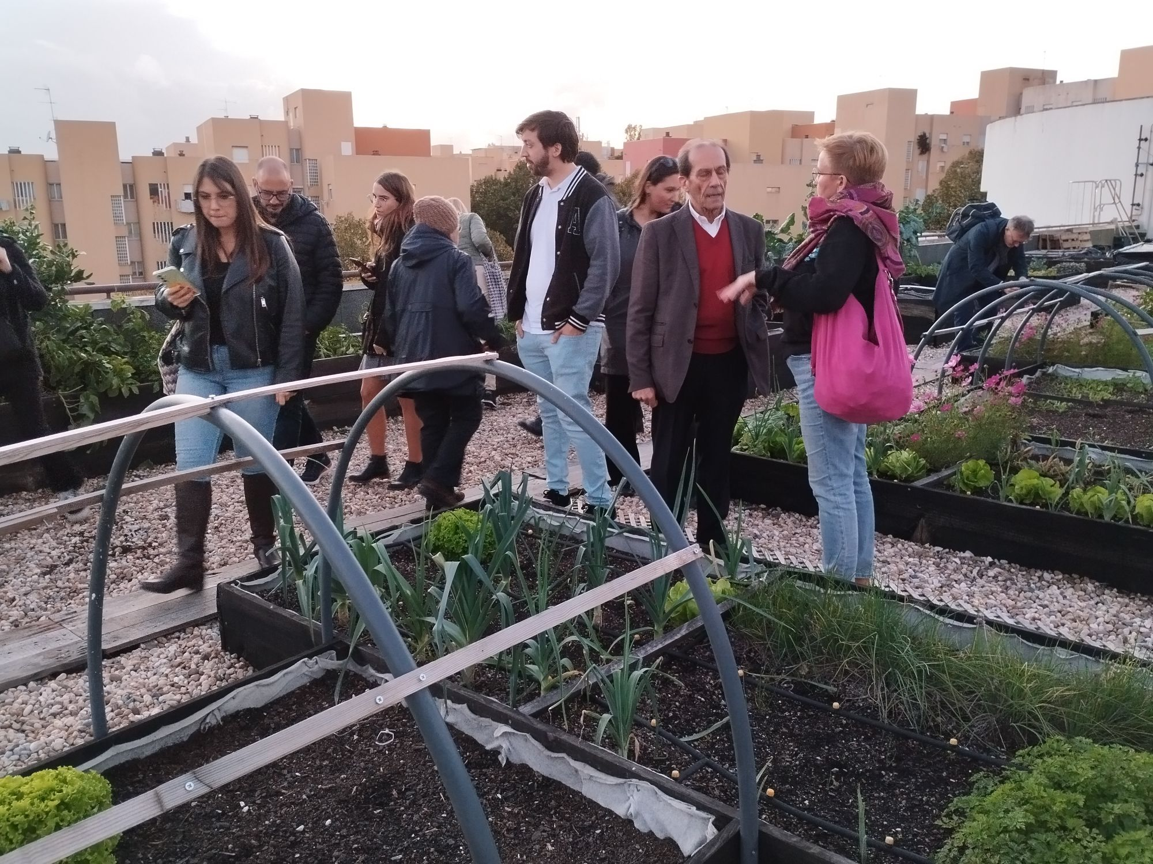
Green roofs usually require a minimum of water and nutrients due to the well-thought-out composition of the vegetation. An intensive green roof has a richer plant composition that requires a higher substrate layer than extensive green roofs.
An intensive green roof has a richer plant composition that requires a higher substrate layer than extensive green roofs. The height of this layer can vary between 30 and 100 centimeters to create enough space for larger roots. A higher height of the substrate means a higher retention capacity (the system can retain water very effectively) and thus creates a sufficient reservoir for the plants. Especially in a state saturated with water, it is then necessary to take into account a much greater weight, which burdens the roof structure much more than in the case of extensive green roofs.

Slide 21
Recommendation
Do’s and don’ts
1. Every citizen can save water by using self watering flower pots in city apartments.
2. In the case of family houses, everyone can use vertical wall as an aesthetic addition to their garden.
3. Irrigation bags used for trees provide enough water to the trees slowly and steadily.
1. Don’t water your lawn during hot, partly cloudy days - you will reduce water loss through evaporation.
2. Don´t allow rainwater to run off your property unnecessarily.
3. Don’t use potable water for irrigation, only utility and rainwater.

Slide 22
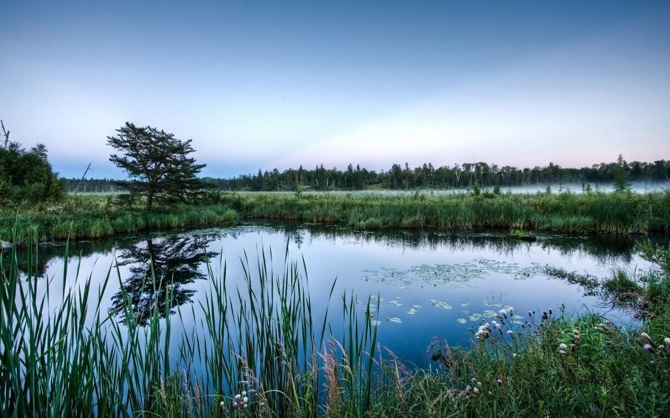
5 Water retention in the landscape
Wetland creation, polders
Wetlands are considered a transitional environment, which is attributed to the fact that certain times of the year it is an aquatic system and another time completely terrestrial, for this reason it is classified as a mixed ecosystem. It is considered to be an ecosystem rich in biodiversity of plant and animal species, which makes it one of the areas with the greatest environmental concern.
Wetlands are considered the most important ecosystems within the entire environmental system, it is the perfect balance between its various elements that allow the development of the organisms and development of life. This ecosystem is considered to be one of the largest reserves of biodiversity of fauna such as birds, fishes and many others. Most of these species consider it an ideal environment for their continuous development thanks to the constant influence of water.
Polders are grassy depressions with dikes, serve when a flash flood comes. The water is collected here and then gradually drains away. People can use it, for example, for watering by
creating damming watercourse, but behind the dam, under normal conditions, water either does not accumulate at all (dry reservoir or dry polder) or the volume of the reservoir is only partially filled (semi-dry reservoir or semi-dry polder). The accumulation of water occurs during floods, which transforms the flood wave, which can lead to less or no damage. Polders are water works that prevent flooding. They can be dry or semi-dry.
A dry polder or also a dry protection tank or a dry retention tank is a water structure used for flood protection. The name dry polder is appropriate because there is no water there most of the time. Together with wetlands, they allow water to be retained in the landscape while increasing biodiversity.

Slide 23
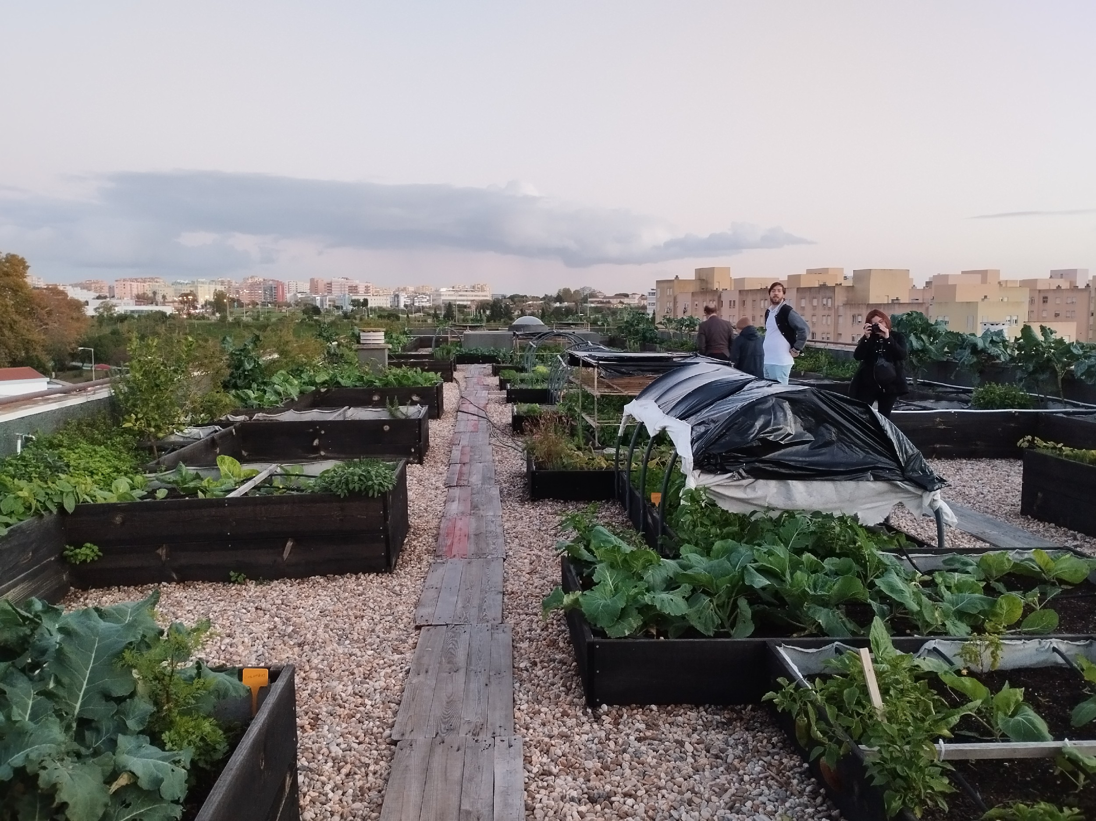
Water retention in urban areas
Throughout history, there has always been an effort to divert water away from cities and towns. Modern constructions for retaining rainwater are currently encouraged. The occurrence of floods caused by extreme rainfall has become frequent in Lisbon, mainly around rivers, thanks to the increasing occupation of land and climate change. This problem is solved, for example, by the "Lisbon General Drainage Plan (LDMP)".
Green roofs are design as urban landscapes where the sewage is overloaded with paved surfaces. This problem is solved by a vegetated roof, which, with its retention properties, reduces the pressure on the sewage system. Part of the water captured in the formation naturally evaporates back into the atmosphere, whereby the green roof helps to maintain the natural water cycle where it has been disturbed by human activity. Green roofs contain a drainage system that captures and drains excess water. The correct function of this system is a basic prerequisite for the reliability and long life of the roof.

Slide 24
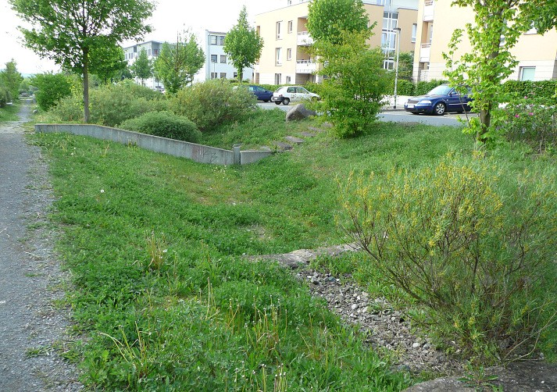
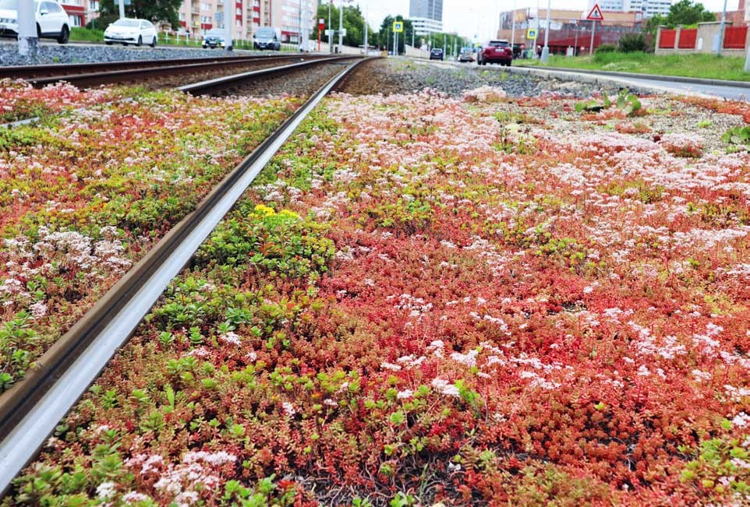
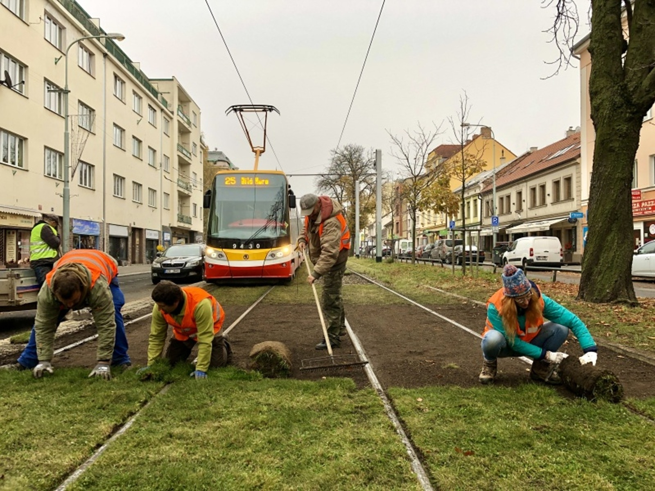
Soakaways (swales)are an engineering feature used to retain rainwater from roads. Mainly from roads and pavements. In essence, they are small artificial wetlands that prevent water from running off quickly and facilitate the permeability of water to plant roots. We can distinguish between so-called horizontal, sloping and sloping swales.
Green carpets In addition to the aesthetic element, they improve the micro climate, reduce heat load and dust, provide a permeable layer for rainwater absorption and absorb noise from tram traffic compared to asphalt surfaces. At the same time, they create a refuge for insects and invertebrates.

Slide 25
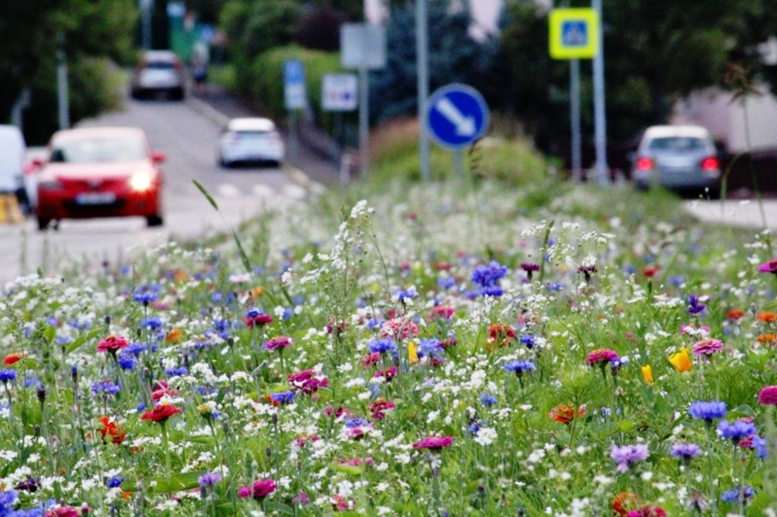
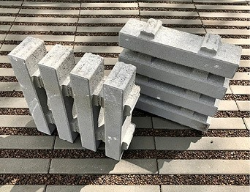
Flowery meadows cities and municipalities are currently dealing with problems related to climate change, lack of water in the soil, or its excess in the case of torrential rains. One of the measures that will ensure the slowing down of the water, its absorption and the protection of houses at the same time, is the sowing of flowery meadows. Flowery meadows replace low-cut lawns, thereby increasing the biodiversity of the given location, lowering the temperature and retaining more water in the landscape.
Permeable paving water-permeable concrete paving elements can be used as a water-permeable reinforced surface of roads wherever the goal is to use rainwater economically and also to slow down the flow of rainwater into the sewage system and partial retention in urban agglomerations, in parks, on large parking areas, sidewalks, cycle paths , outdoor paved areas and apartment buildings, and in the industrial areas. Water-permeable concrete paving elements can be used as a water-permeable reinforced surface of roads wherever the goal is to use rainwater economically and also to slow down the flow of rainwater into the sewage system and partial retention in urban agglomerations, in parks, on large parking areas, sidewalks, cycle paths , outdoor paved areas in family and apartment buildings, but also industrial areas.

Slide 26
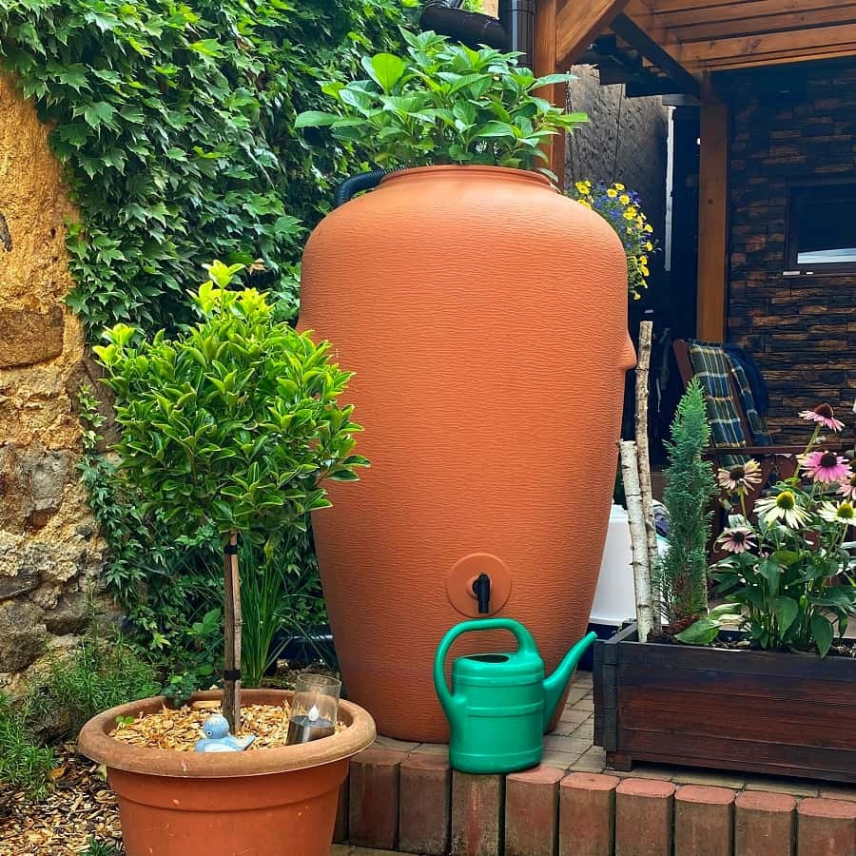
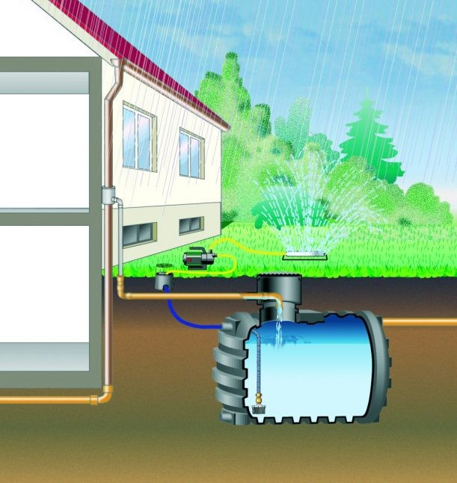
Collection and retention of water in the vicinity of family houses
Collecting rainwater is an economical method that saves drinking water resources and provides plants with high-quality, chlorine-free watering. There is now a wide choice of underground and above ground water tanks. Collecting rainwater is is an efficient and sustainable practice that brings many benefits. First and foremost, it helps to conserve and preserve the freshwater resource, which can help reduce water costs as well as reduce the burden on the on-site water resource. Rainwater provides essential nutrients and does not contain chlorine or fluoride often found in treated water, which can lead to improved plant health and vigor. Therefore, if you use it to water your garden, it can improve soil health by preventing the build-up of substances that could damage plant roots and soil structure. It will also improve plant growth and health because rainwater is soft and slightly acidic, making it an ideal choice for most plants.
Mulches keep the rainwater in your garden or prevent from drying out. Mulch will keep humidity and soil temperature and also prevents weed growth. Mulches are divided into organic and inorganic.
Inorganic mulches stones and pebbles drain perfectly and do not wash down the slope in the event of rain as organic mulches do. They are therefore ideal for mulching slopes, rockeries, around ponds, around paths or for creating pathways. The great advantage of inorganic mulch is its long-lasting durability.
If you have walkways or driveways in your garden, you may want to consider using permeable pavers. These will reduce water runoff and encourage water absorption.

Slide 27
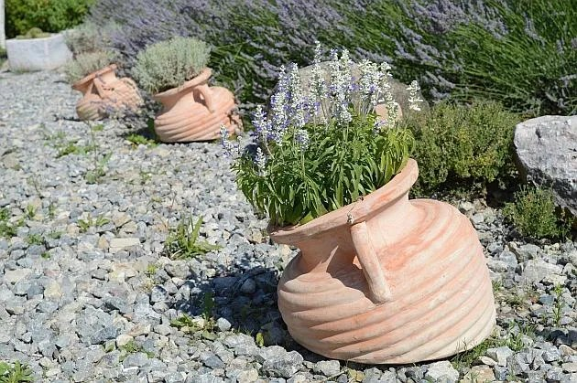
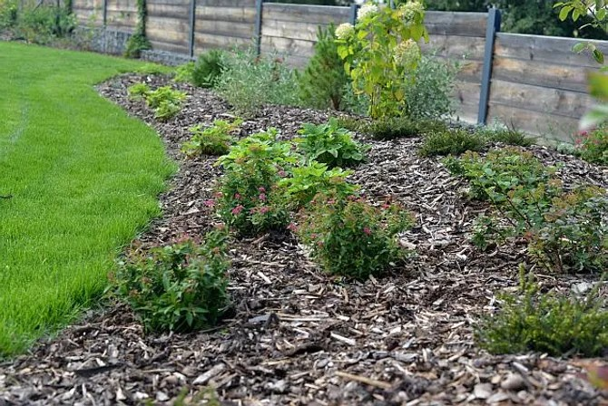
B) Organic mulches can serve several functions. In particular, bark performs an excellent ornamental function. Furthermore, organic mulches prevent weed growth, retain moisture in the soil and act as a thermal insulation.
When does the soil dry out the most
- mowing and clean excavated surfaces,
- the grain of the material on the surface of the surfaces. The coarse-grained structure with air cavities does not allow water to evaporate so easily. Conversely, the finer the grain of the surface, e.g. mud or clay, the more the capillary action of water is applied. The surface then dries quickly and cracks. In addition, granularity is closely related to soil aeration.
The aforementioned mulching, which shades the soil, aerates it, prevents water evaporation, and at the same time decomposes the substrate and manure, is widely used against unwanted drying out in the natural garden. It also slows down weed growth to some extent.

Slide 28
Water retention in urban and natural vegetation
Plants are a very important component, interfering with the cycle of water between the soil and the atmosphere. Vegetation takes water from the soil and thereby dries it out, but at the same time it moistens its surroundings with its own vapour. The amount of water that plants evaporate into the air is determined by many factors.
Evaporation is mainly influenced by
- the amount of water in the soil (the wetter the location, the greater the evaporation can be),
- the air temperature (the higher the temperature, the higher the evaporation),
- the intensity of the air flow (with a strong flow, the evaporation is higher), the type of plant , her age and other factors.
Urban air is always drier than the air in the surrounding countryside due to compact high-rise buildings and paved surfaces. Soil evaporation of water changes, rainfall is diverted to the sewers. Plants affect the water cycle in nature by slowing it down. They enable better absorption of water into the soil and soil evaporation. In natural stands that successfully survive the dry season, there are always species of plants with ground rosettes of leaves, such as plantains, creeping clover, daisies, pigweeds, rushes, dandelions, sedges, hawks bills or daisies. These species shade the space around the plant and thus reduce water evaporation.
In a natural garden, with minimal maintenance required, areas with these plants will stay green longer than intensive lawns. In the dry season, the area remains green even after mowing thanks to the ground leaves of the plants. If the mowed lawn contains only grass species, it willdry out very quickly without watering.

Slide 29
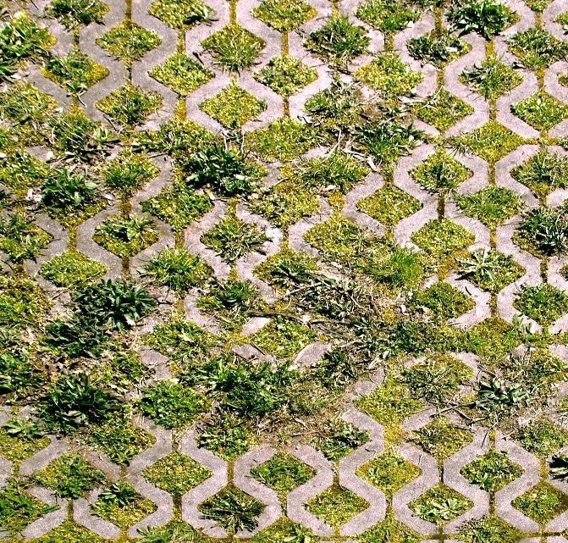
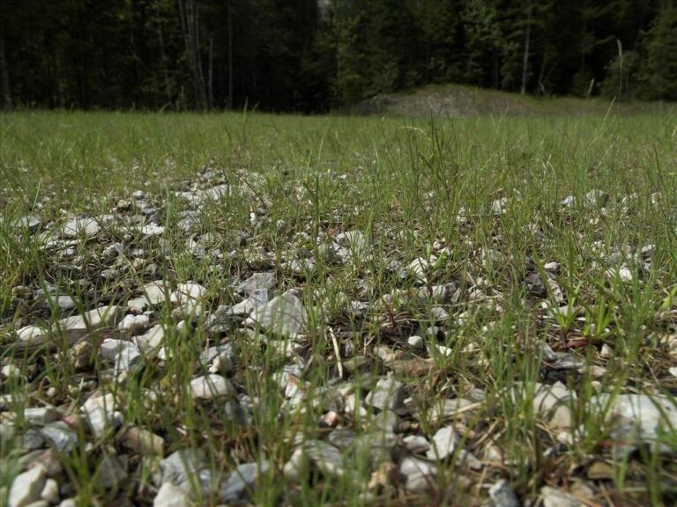
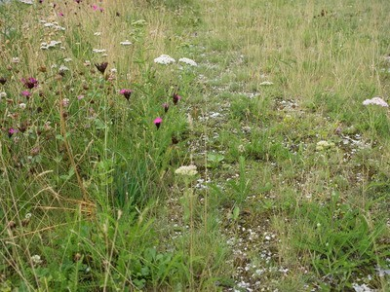
Permeable paving it is designed to allow rainwater to infiltrate into the soil and aquifer, or to be trapped underground and then released at a controlled rate to surface water .Its properties make it particularly suitable for urban developments, car parks and wherever accessible areas with conventional minimum gaps are desired. It is also well suited for areas around houses.
Gravel lawns are the new trend of today. It is a walk-on or mobile lawn based on a layer of a mixture of gravel and soil, where the vegetation itself consists of a mixture of selected grasses and herbs. It can act as a driveway or parking area in the city or in the countryside. Gravel turf is becoming popular due to its ecological, economic and, last but not least, aesthetic advantages. It improves the micro climate, increases the water capacity and permeability of the site. The rich species diversity of the grass mix creates a habitat for animals. It is a relatively simple structure and this brings lower acquisition costs. Last but not least, gravel lawns contribute to the expansion of 'green spaces' in the very inner city of our cities.
Gravel turf has excellent features and benefits (when done well):
- water does not stand on it as on a larger concrete area,
- makes less noise when driving over it than on a paved or concrete surface and allows for more green space,
- it is cheaper and more accessible,
- easier to construct and
- you don't need to build any additional drainage or sewerage.

Slide 30
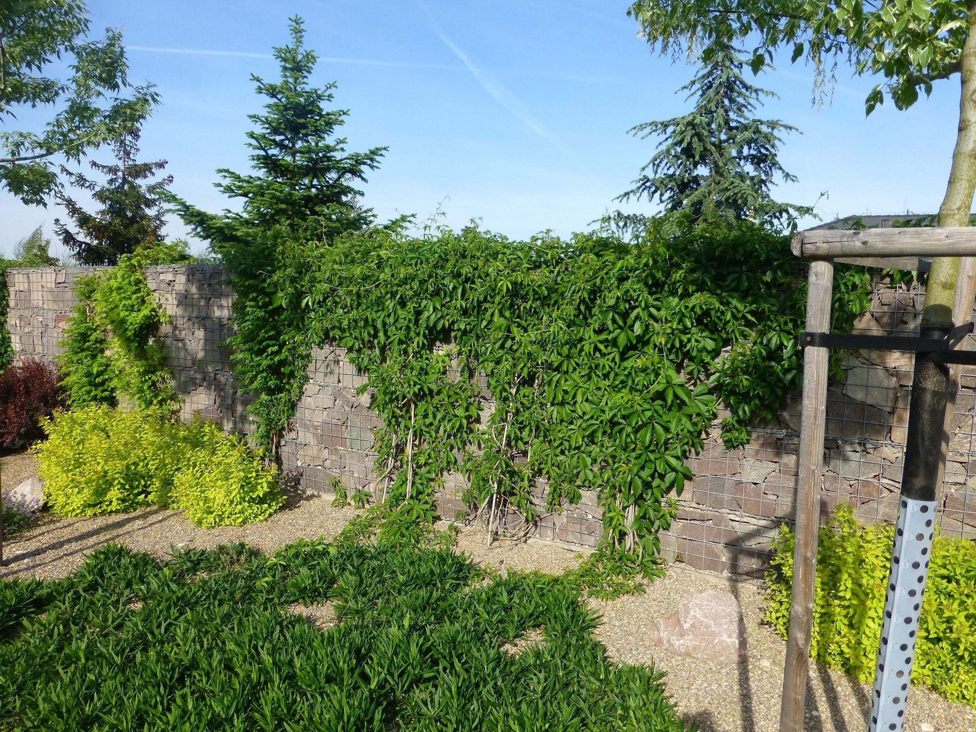
Gabions
during the establishment of gabion walls, foundation strips of gravel are built under the gabion structures, which support water retention in the urban environment. There they form groundwater "reservoirs" for the surrounding trees - after heavy rainfall, they provide time for the soil horizon to absorb rainwater more perfectly. Together with the adjacent threshing roads, they form infiltration collectors from which trees and bushes draw water that would otherwise be transferred to the city sewer via surface drainage. suitable example of use is “Protective gabion wall in Teplého street, city of Pardubice – Dukla”.

Slide 31
Recommendation
Do’s and don’ts
1. Every citizen who owns land can choose a method of retaining and collecting water according to their financial capabilities.
2. Mulching has an effective impact on water conservation and is also an aesthetic element in the garden.
3. Permeable paving is a good solution for urban development, as it allows rainwater to soak into the soil.
4. The use of gabions will support water retention in the urban environment.
1. Don´t layer the mulch too deeply. Deep a layer prevents the access of necessary oxygen to the soil and causes suffocation of the roots.
2. Don’t use impervious materials such as concrete to reinforce commercial surfaces.
3. Don’t mow often the lawns on hot summer days, soil and nutrients would be washed away from the surface.

Slide 32
Summing up
Water shortage
Natural homemade garden
According to the World Economic Forum, a water shortage is one of the five global risks and already affects a quarter of the world's population. Water also exists in rivers and lakes, ice, water vapor as well as in fauna and flora and of course in us. Only 2.5 % of the total amount of water is fresh water but this does not mean that all the fresh water available and it can be used to make drinking water.
Creating our own natural homemade garden with the garden ponds and the rain beds will help improve the biodiversity of the environment, the microclimate and prevent the water runoff.
Saving water
Every citizen can save water by using self-watering flower pots in the city apartments. Everyone who owns a piece of land can choose a method of retaining and collecting water according to their financial capabilities. Therefore, it is essential that we are informed, educated and learnt to retain water in the landscape and learn to manage water, save, clean and recycle it.
Water revitalization alternatives
By using the root treatment plants and the wastewater treatment plants, you will not only increase biodiversity, but also save money on the water consumption and ensure a more efficient and the economical use of the wastewater.

Slide 33
Thank you!
Partner: Spolek absolventů a přátel zemědělské školy v Chrudim z.s.

