Slide 1
Cities for People
Partner: EDU.IN

Slide 2
General Objective
Empowering citizens with knowledge that enables them to become aware of urban ecology problems and take active action to protect the environment and improve living conditions.
Specific Objectives
Explaining the city ecosystem, in its main components
Describing the environmental impacts associated with architecture and construction.
Analysing transportation systems in cities and metropolitan areas.
Relating features of the market economy with its impact on cities.
Identifying the possibilities for democratic participation of citizens in the planning
and management of cities.

Slide 3
Index
Module 1: Cities for People
Unit 1: People-centered urban planning
Section 1: What is a city
Section 2: Housing density and accessibility
Section 3: Public space
Unit 2: Architecture and Construction
Section 1: Sustainable building
Section 2: Low footprint building materials
Section 3: Innovative technologies

Slide 4
Unit 3: Mobility and Accessibility
Section 1: Public transport networks
Section 2: Limitations on polluting individual transport
Section 3: Cycle paths and pedestrian zones
Unit 4: Production and consumption
Section 1: Trade and consumption
Section 2: Social life and consumption
Section 3: The 3R: Reduce, Reuse, Recycle
Section 4: Degrowth
Unit 5: Citizen’s participation
Section 1: Local participation
Section 2: Participation in political-administrative bodies
Section 3: Continuous participation in defining and monitoring evolution
Section 4: Citizenship and community

Slide 5
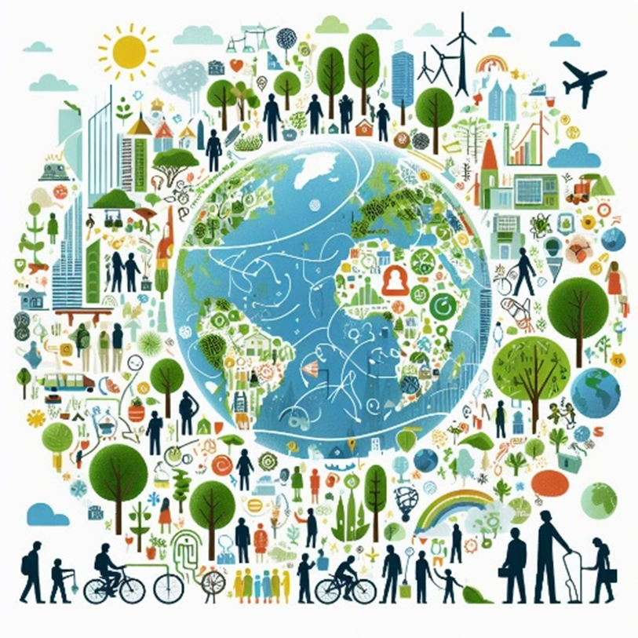
Module 1: Cities for People
Unit 1: People-centred urban planning
In 2020, 56.2 per cent of the world’s population lived in urban areas, rising to 60.4 percent in 2030 and 70 percent in 2050, according to UN estimates.
The environmental sustainability of the planet depends to a large extent on the cities operation, which are major pollution issuers and at the same time suffer severe consequences of the climate threat (air pollution, floods and heat waves).
If cities are a major part of the problem, they must also be a major part of the solution by maximizing their potential.
The city of the future, whether built from scratch or regenerated, will have to be a climate-resilient space, designed for people to live in safety and in harmony with biodiversity.

Slide 6
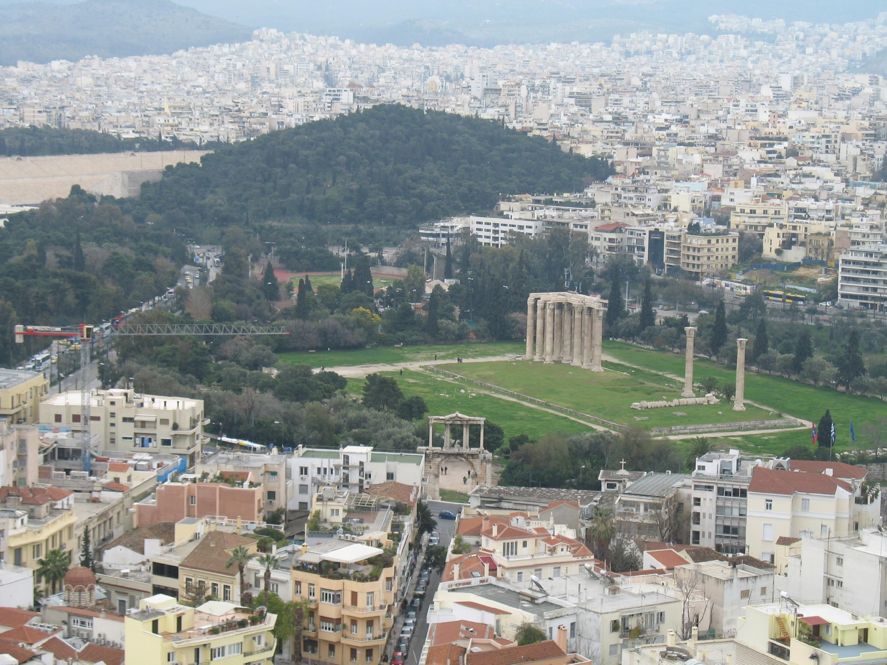
Module 1: Cities for People
Unit 1: People-centred urban planning
Section 1. What is a city
Homo sapiens has been living in expanding cities for around 7,000 years, with more people and greater consumption of resources and energy.

Slide 7
Module 1: Cities for People
Unit 1: People-centred urban planning
Section 1. What is a city
Urban ecosystems are complex, with different components that interact and correlate:
Natural elements: geomorphology, native and adapted flora and fauna;
Human elements: population and its activities, constructed infrastructures and urban services;
Sociopolitical elements: economic activities, governance and public administration institutions, sociocultural activities;
Environmental elements: air and water quality, waste management, noise and visual pollution.
Technological elements: communication infrastructures and smart city solutions.
The city ecosystem is like a living being in which all the organs are interconnected and the malfunctioning of one organ has a detrimental effect on the health of the whole. Today’s cities are sick ecosystems, suffering from diseases that cause illness and death in their inhabitants and affect the health of the planet.
The total surface area of all cities is 2 percent of the planet’s surface, but they consume 75 per cent of all energy produced and pollute with 60 percent of greenhouse gas emissions (GHG).

Slide 8
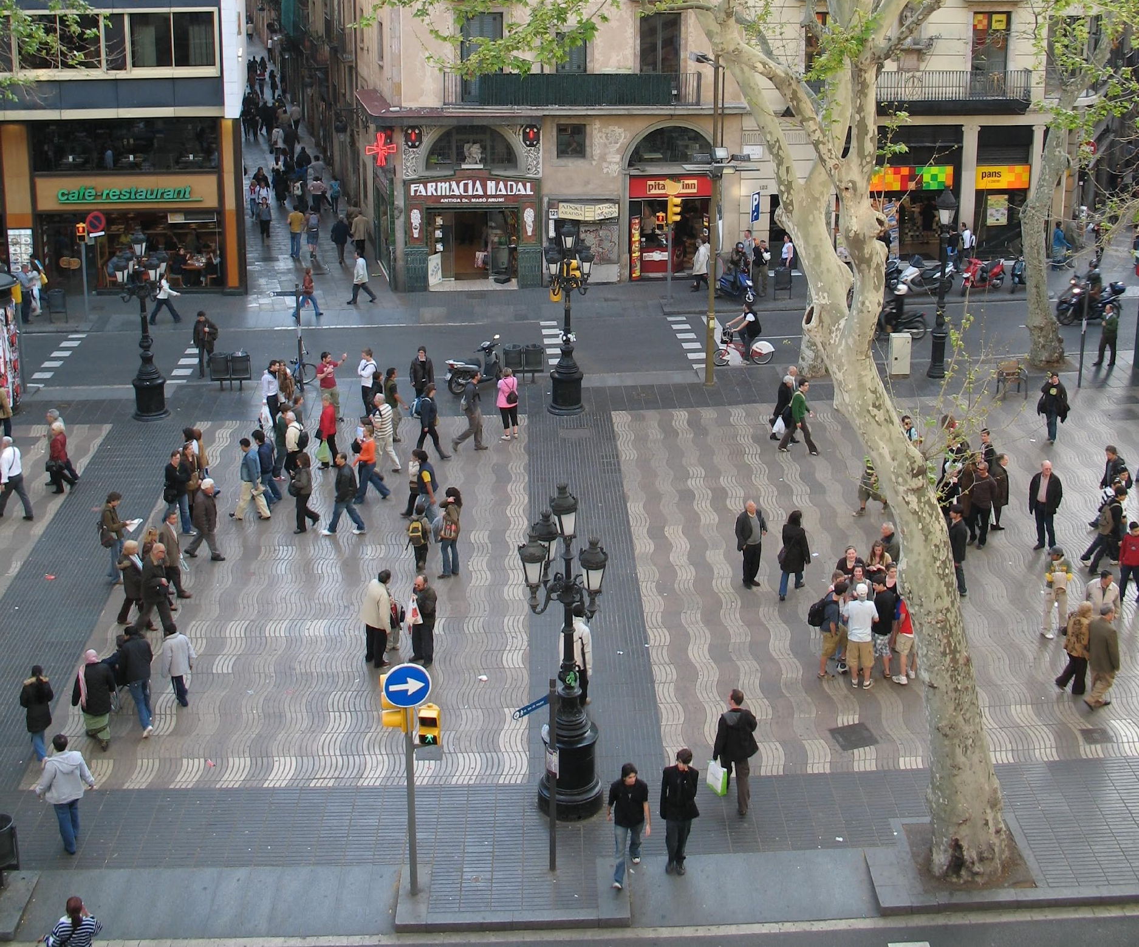
Module 1: Cities for People
Unit 1: People-centred urban planning
Section 2. Housing density and accessibility
The growth of urban areas, correlated with the increase in the number of inhabitants, has led to the need for car travel, mainly for individual use.
During the 20th century, urban design was adapted to the dominance of the car in public spaces to the detriment of human scale and other ways of transport.
The circulation of cars has become a major factor in the pollution and dysfunction of cities and metropolitan areas.

Slide 9
Module 1: Cities for People
Unit 1: People-centred urban planning
Section 2. Housing density and accessibility
Faced with the threat of climate change, urban planning has sought solutions that strike a balance between territorial expansion and densification, as both have different environmental impacts (e.g. higher density with taller buildings requires less land but consumes more energy and has a greater heat island effect).
“Cities 15 Minutes” is one of these trends, consisting of urban planning in units of a size where all the main components of urban life are within a 15-minute walk from the centre.
“Liveable Cities” and “Smart Cities” are also urban planning trends for adapting and mitigating the threat of climate change, the former more related to quality of life, the latter to technology and innovation.

Slide 10
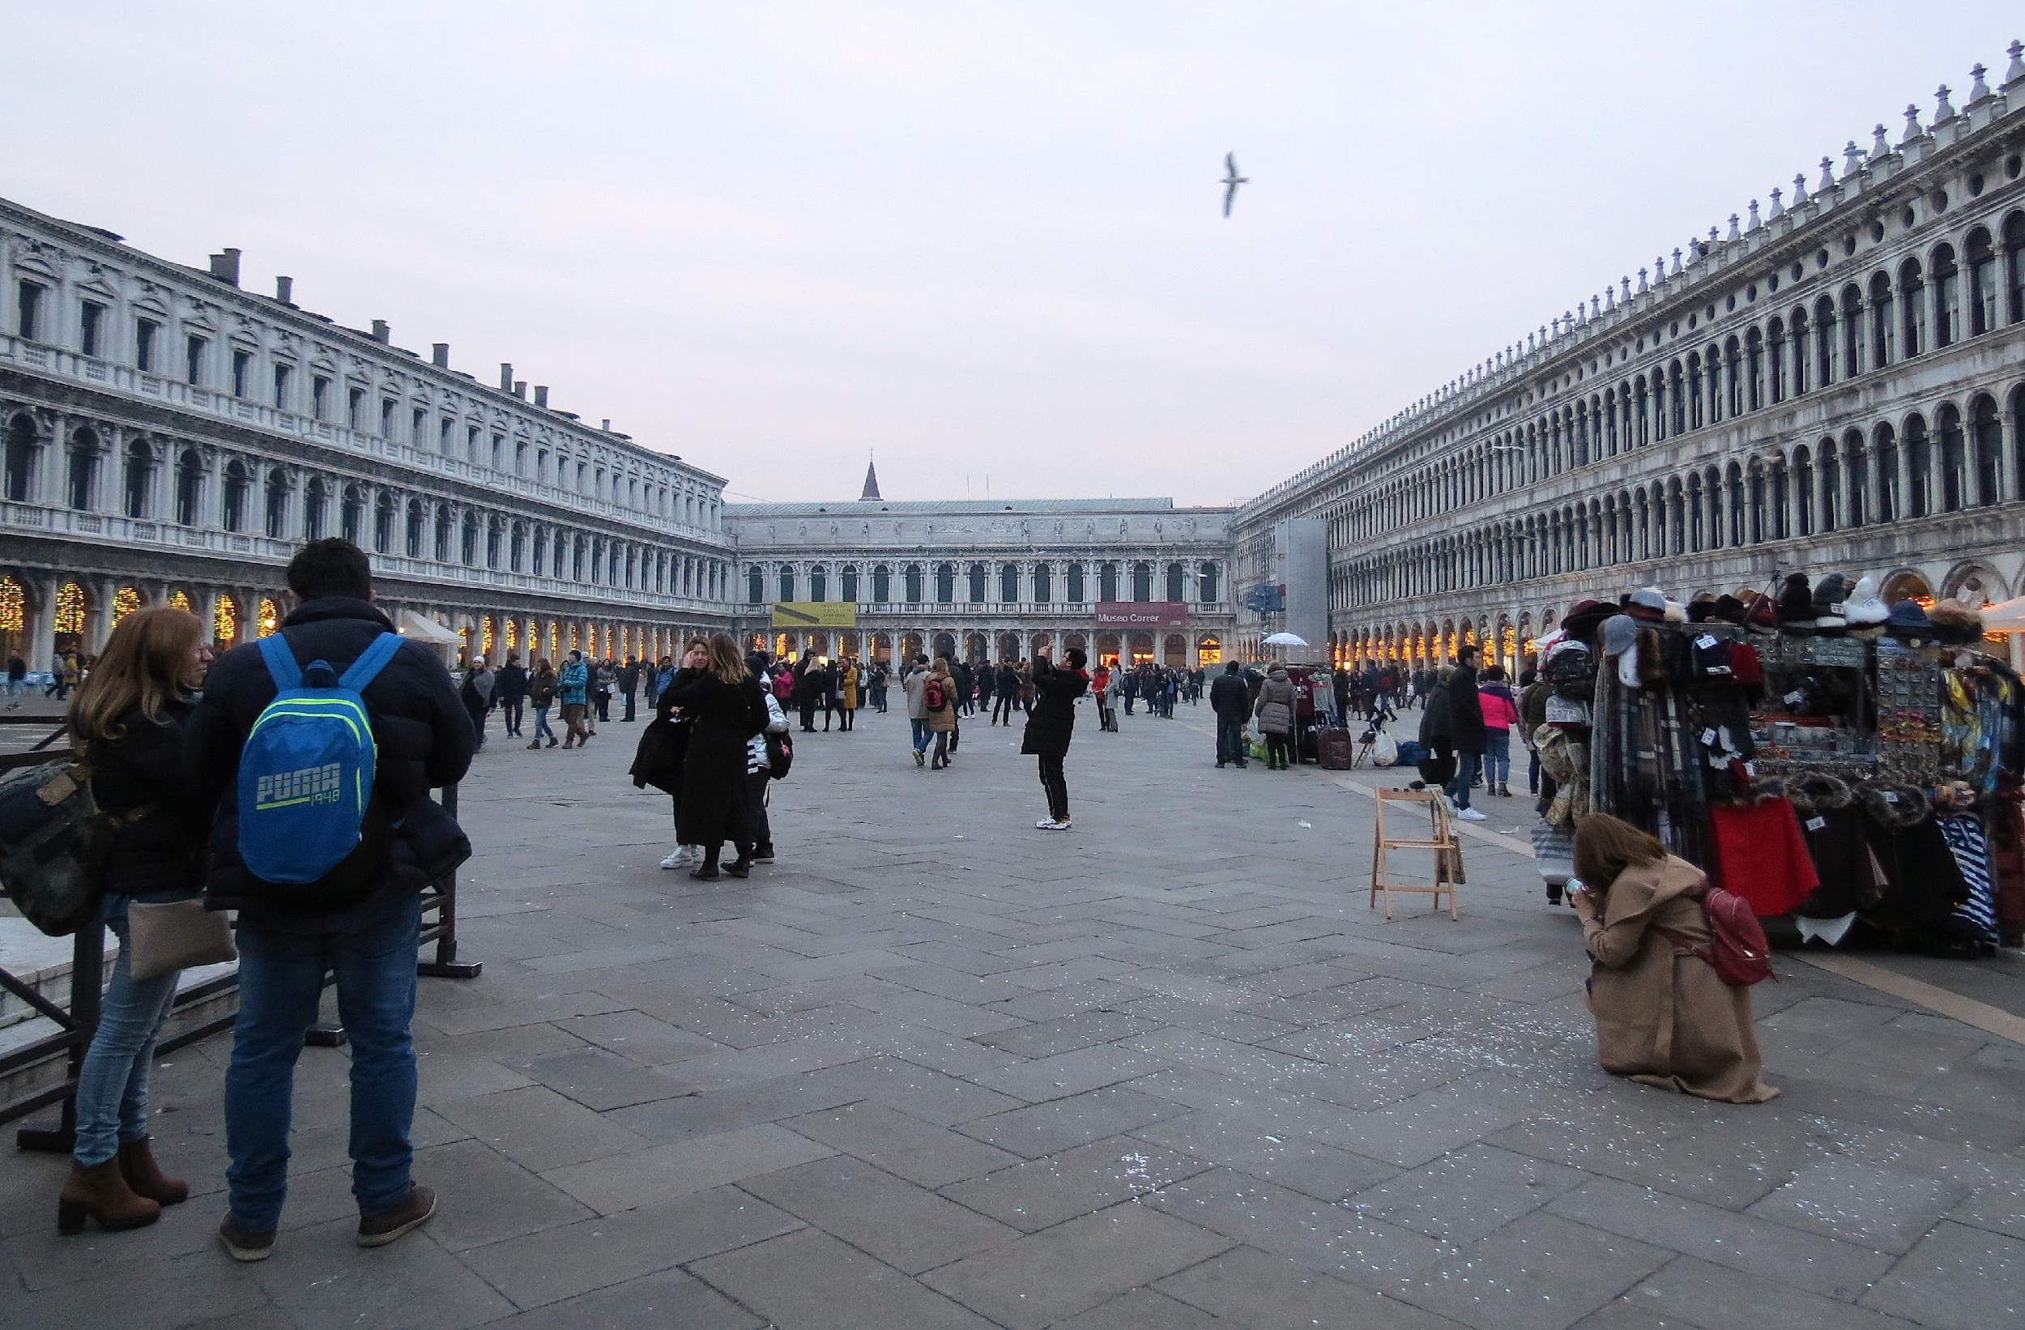
“Cities for People” is a people-centred urban planning concept developed by Jan Gehl, inspired by Jane Jacobs, which aims to:
Create and reclaim public spaces that encourage social interaction.
Design the city to encourage walking and cycling.
Build infrastructures and buildings that respect human scale and perspective.
Module 1: Cities for People
Unit 1: People-centred urban planning
Section 3. Public space
Reduce the dominance of motorized vehicles and give priority to public and non-motorized transport.
Integrate green spaces and recreational areas into the urban tissue.
Plan neighborhoods that provide easy access to essential services and employment opportunities.
Implement sustainable practices that reduce environmental impact.
Build infrastructures to cope with climate change and natural disasters.
Encourage the participation of citizens in the urban planning process to ensure that solutions meet their needs and aspirations.

Slide 11
Module 1: Cities for People
Unit 1: People-centred urban planning
Do’s and don’ts
1. Promote active and sustainable mobility
2. Plan multifunctional neighborhoods
3. Create and revitalize public spaces
4. Adopt urban practices that are resilient to climate change
5. Encourage citizen participation in urban planning
1. Don’t overdo urban densification without considering quality of life
2. Don’t ignore the maintenance of existing public spaces
3. Don’t focus exclusively on the economic growth of cities
4. Don’t favored individual motorized transport
5. Don’t isolate vulnerable communities or disregard equity

Slide 12
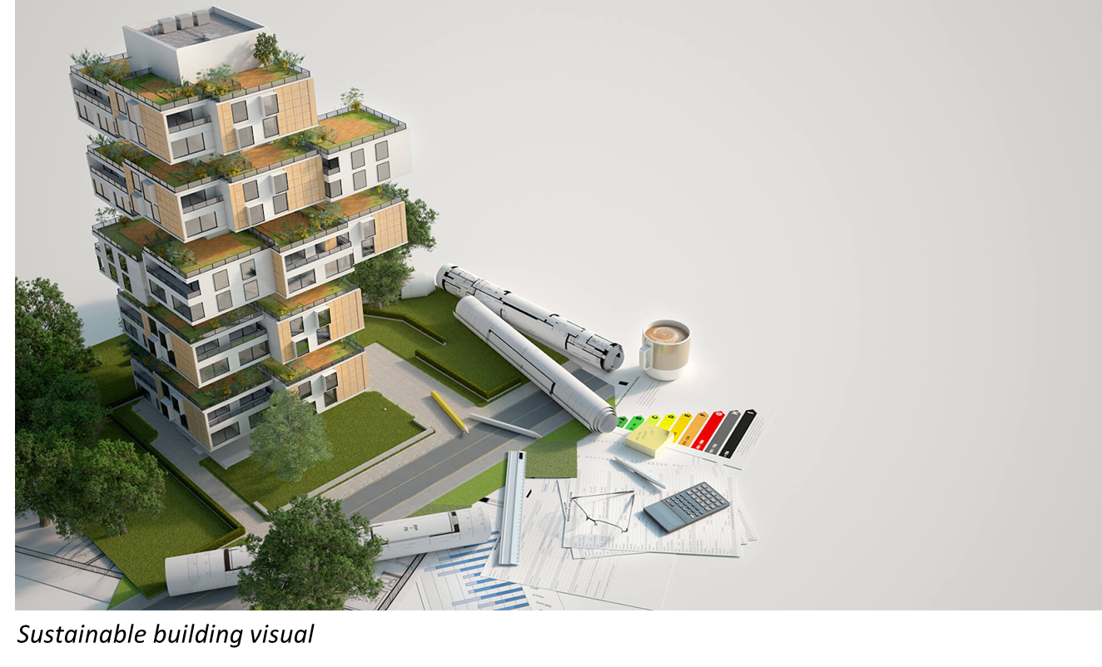
Module 1: Cities for People
Unit 2: Architecture and Construction
Sustainable architecture and construction play a crucial role in reducing negative environmental impacts and promoting the conscious use of resources. The process of creating a building begins with architectural design and conception, a fundamental stage where decisions are made that will influence the sustainability of the building, its performance and the health of its occupants.

Slide 13
Module 1: Cities for People
Unit 2: Architecture and Construction
Adaptable and flexible structure
Internal spaces with removable or flexible walls allow the design of the building to be modified as the needs of the occupants change over time. This makes the structure more durable and avoids the need for major alterations or demolition, extending the life of the building and reducing the waste of resources.
Durable insulation
Energy efficiency is one of the most important aspects of sustainable building, good thermal insulation is essential to achieve it. As well as keeping the internal temperature stable, it reduces the need for heating or cooling and energy consumption.
Section 1. Sustainable building
The concept of sustainable buildings has gained relevance in the current context of the urgent need to reduce negative environmental impacts. Constructing buildings with adaptable and flexible structures reduces the need for future renovation and demolition, minimizes construction waste and saves materials. The main characteristics of sustainable buildings are as follows.

Slide 14
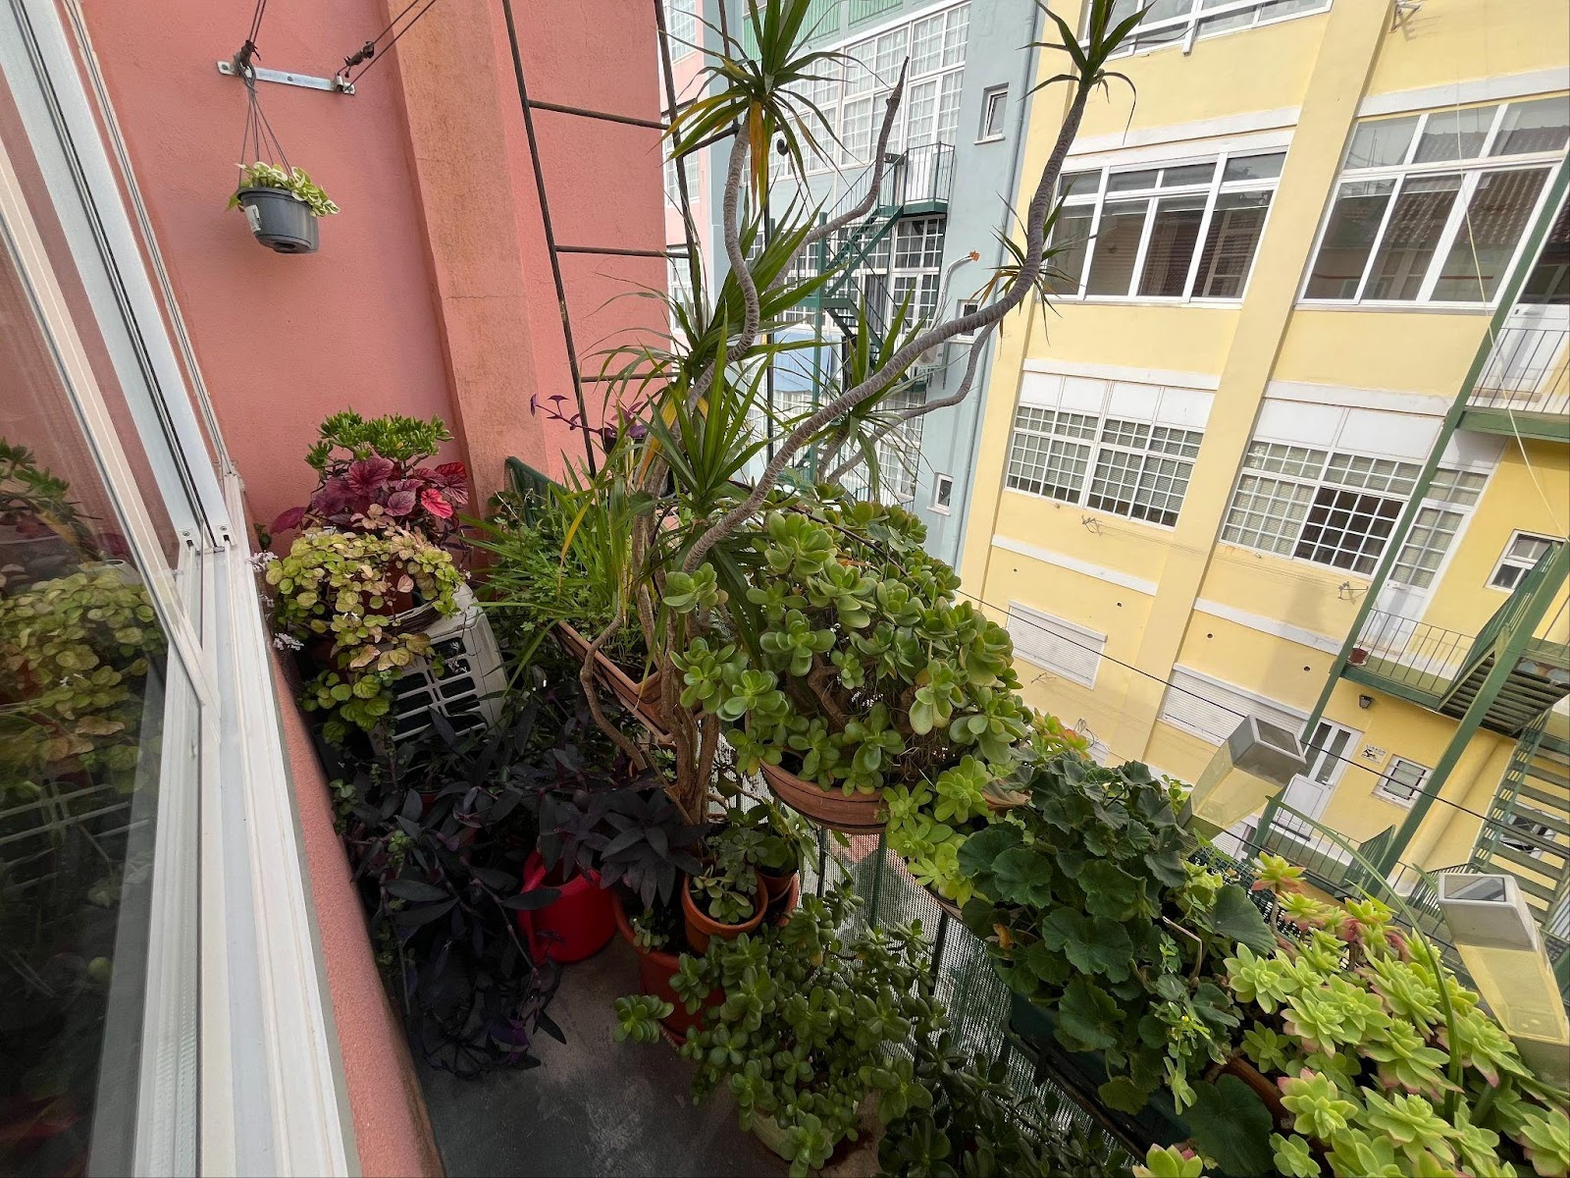
Module 1: Cities for People
Unit 2: Architecture and Construction
Section 1. Sustainable building
Insulation and natural lighting
To take advantage of solar gains for thermal comfort and lighting in buildings, it is important to know the duration of solar exposure and the different paths of the sun during the day throughout the year, restricting or favouring its entry. In the northern hemisphere, a south-facing orientation is preferable as it takes advantage of solar gains in winter, keeping the building warm and lit.
In summer, the use of shading systems contributes to better thermal performance, and the incorporation of vegetation throughout the building, such as plants on balconies and windows, provides a natural filter for solar radiation and enhances local biodiversity.
Balcony with plants to act as natural filter for solar radiation

Slide 15
Module 1: Cities for People
Unit 2: Architecture and Construction
Section 1. Sustainable building
Natural ventilation
There are various natural ventilation solutions that allow air circulation and reduce the need of air conditioning, such as: i) cross ventilation: with openings in opposite or adjacent walls, which renews the air and reduces the internal temperature; ii) induced ventilation: with openings that allow cold air to enter, which pushes hot air upwards to the vents
Accessibility for all
A sustainable building must be accessible to everyone, regardless of age or mobility. This includes the installation of ramps, suitable lifts, wide doors, and other elements that make the space usable by people with different needs, thus ensuring the longevity and inclusive use of the structure over time.

Slide 16
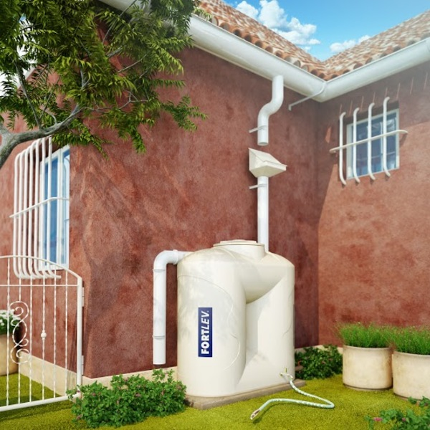
Module 1: Cities for People
Unit 2: Architecture and Construction
Section 1. Sustainable building
Water conservation
Efficient water management is another essential component of sustainable buildings. The installation of rainwater harvesting systems and grey water reuse systems (from showers and sinks) reduces the use of potable water for purposes such as watering gardens and flushing toilets. In addition, the use of low flow taps, showers and toilets helps to reduce water consumption in the building.
Section 2. Low footprint building materials
The use of low impact building materials contributes to a healthier environment and a more sustainable economy. These materials have significantly lower carbon emissions, reduce energy consumption, and prevent the depletion of natural resources. Sustainable materials emit fewer harmful chemicals, such as volatile organic compounds, which improves indoor air quality, making spaces healthier and more comfortable, with benefits for human health.
Water conservation device

Slide 17
Recycled wood
Recycled wood is an effective solution for combating deforestation and can be used, for example, in flooring, structures and doors. By reusing wood from demolition or construction leftovers, we avoid felling new trees that retain carbon dioxide, helping to reduce climate impact. Although the process of recycling wood has some environmental impact, it is significantly less.
In many cases, old wood gains strength as it ages, which makes it as strong as or stronger than new wood and because has already undergone drying and curing processes over the years, it tends to be more stable, requiring fewer chemical treatments to increase resistance.
Module 1: Cities for People
Unit 2: Architecture and Construction
Section 2. Low footprint building materials
Sustainable building materials
Steel
Steel is extremely flexible in design and construction, making it easy to renovate and adapt existing buildings. For example, wide-span steel beams allow open spaces to be created without the need for supporting columns, giving greater freedom in interior design. In addition, the lightness of steel makes it possible to add floors or structures without overloading existing foundations, which is particularly useful in renovations or extensions.
One of the greatest benefits of steel is that it can be recycled after a building demolition. It can be separated from other materials and reused in new construction projects without quality loss. Its use minimizes the generation of waste because steel by-products, such as slag, can be reused.
Lime mortar
Aerial lime mortar hardens by absorbing CO2 from the atmosphere. This process allows the CO2 released during the production of lime to be reabsorbed into the material, acting as an air purifier. Compared to cement, the production of aerial lime requires less energy, as the calcination of the limestone takes place at around 900°C, opposed to the 1400°C required for cement.

Slide 18
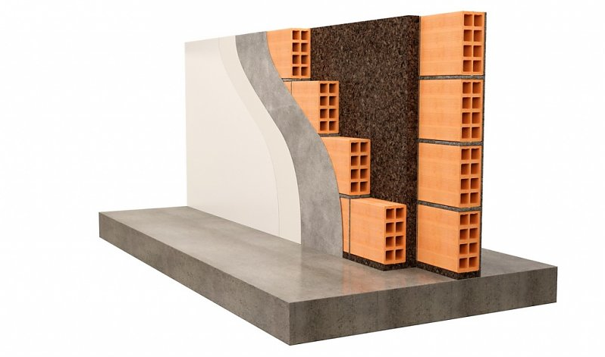
Rock wool
Rock wool, made from basalt rock, is one of the most effective options for thermal and acoustic insulation. It is durable, vibration resistant and non-carcinogenic. However, its installation can be complex and requires the use of qualified professionals.
Thermal bricks
Thermal bricks are more porous, allowing better regulation of internal temperature. Made from materials such as raw earth or ash, these bricks can be recycled or reused at the end of a building's life cycle.
Module 1: Cities for People
Unit 2: Architecture and Construction
Section 2. Low footprint building materials
Insulation materials
Cork
Cork, obtained from the bark of the cork oak (Quercus suber), is a renewable material with excellent thermal and acoustic insulation properties. However, it is a scarce resource as it can only be harvested when the tree has reached a certain maturity (25 to 30 years) and every 9 years. Its higher cost can be a disadvantage, but the benefits in terms of energy efficiency and sustainability are significant.
Considering the life cycle
When choosing sustainable building materials, it's crucial to consider what happens at the end of their useful life. Recyclable or biodegradable materials, such as steel and wood, have an advantage over those that end up in landfill. Integrating the concept of the life cycle into the choice of materials contributes to greener and more responsible construction.
Cork insulation

Slide 19
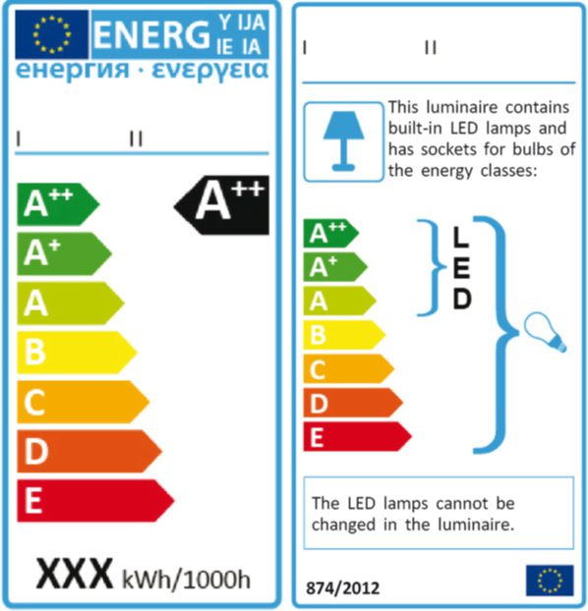
Module 1: Cities for People
Unit 2: Architecture and Construction
Section 3. Innovative technologies
When you are planning to build or buy a home, it is important to consider innovative technologies that can improve the comfort, efficiency, and sustainability of the property. Here are some of the key technologies to consider.
Building Management Systems
Control and monitor the use of energy in buildings, automatically adjusting lighting, heating, cooling, and ventilation based on occupancy and weather conditions. This optimizes energy efficiency and reduces energy waste.
LED Lamps
Light Emitting Diode (LED) lamps are highly efficient, using up to 80 per cent less energy and having a much longer life, meaning fewer replacements and lower long-term costs. They also provide more natural lighting and can be adapted to suit diverse needs and decorating styles.

Slide 20
Module 1: Cities for People
For outdoor lighting, there is a wide range of LED lights with integrated batteries and solar panels.
Unit 2: Architecture and Construction
Smart sockets
Section 3. Innovative technologies
There are several types of power sockets that allow you to remotely and temporally control the appliances connected to them, and to programme switching off household appliances and devices that use energy even in standby mode, such as televisions, computers and chargers.
Motion sensors lighting
Installing motion sensors that switch lights on or off depending on the presence or absence of people in passageways such as corridors, garages, and bathrooms, prevents lights from being switched on unnecessarily. This saves energy and increases comfort and safety, especially in hard-to-reach areas. In addition, intelligent lighting systems can be programmed to adjust light levels according to the time of day, optimizing comfort and savings.
Rainwater harvesting systems
Easy-to-install systems are available to collect and store rainwater for domestic use. The collected water can be used to water the garden, wash the car or even flush the toilet, reducing the use of potable water and providing a sustainable alternative.
Energy storage systems
By installing a battery, the energy generated by photovoltaic panels during the day can be stored for night use. This maximizes the use of solar energy and reduces dependence on the grid.

Slide 21
Module 1: Cities for People
Unit 2: Architecture and Construction
Do’s and don’ts
1. Design buildings that facilitate future adaptations.
2. Maximize the use of natural light and ventilation.
3. Use sustainable and recyclable materials.
4. Implement water saving systems.
5. Use energy efficient technologies.
1. Don't ignore the need for sustainable buildings.
2. Don't use poor quality building materials.
3. Don't use poor quality insulation.
4. Don't ignore the quality of the air inside buildings.
5. Don’t neglect accessibility for people with reduced mobility.

Slide 22
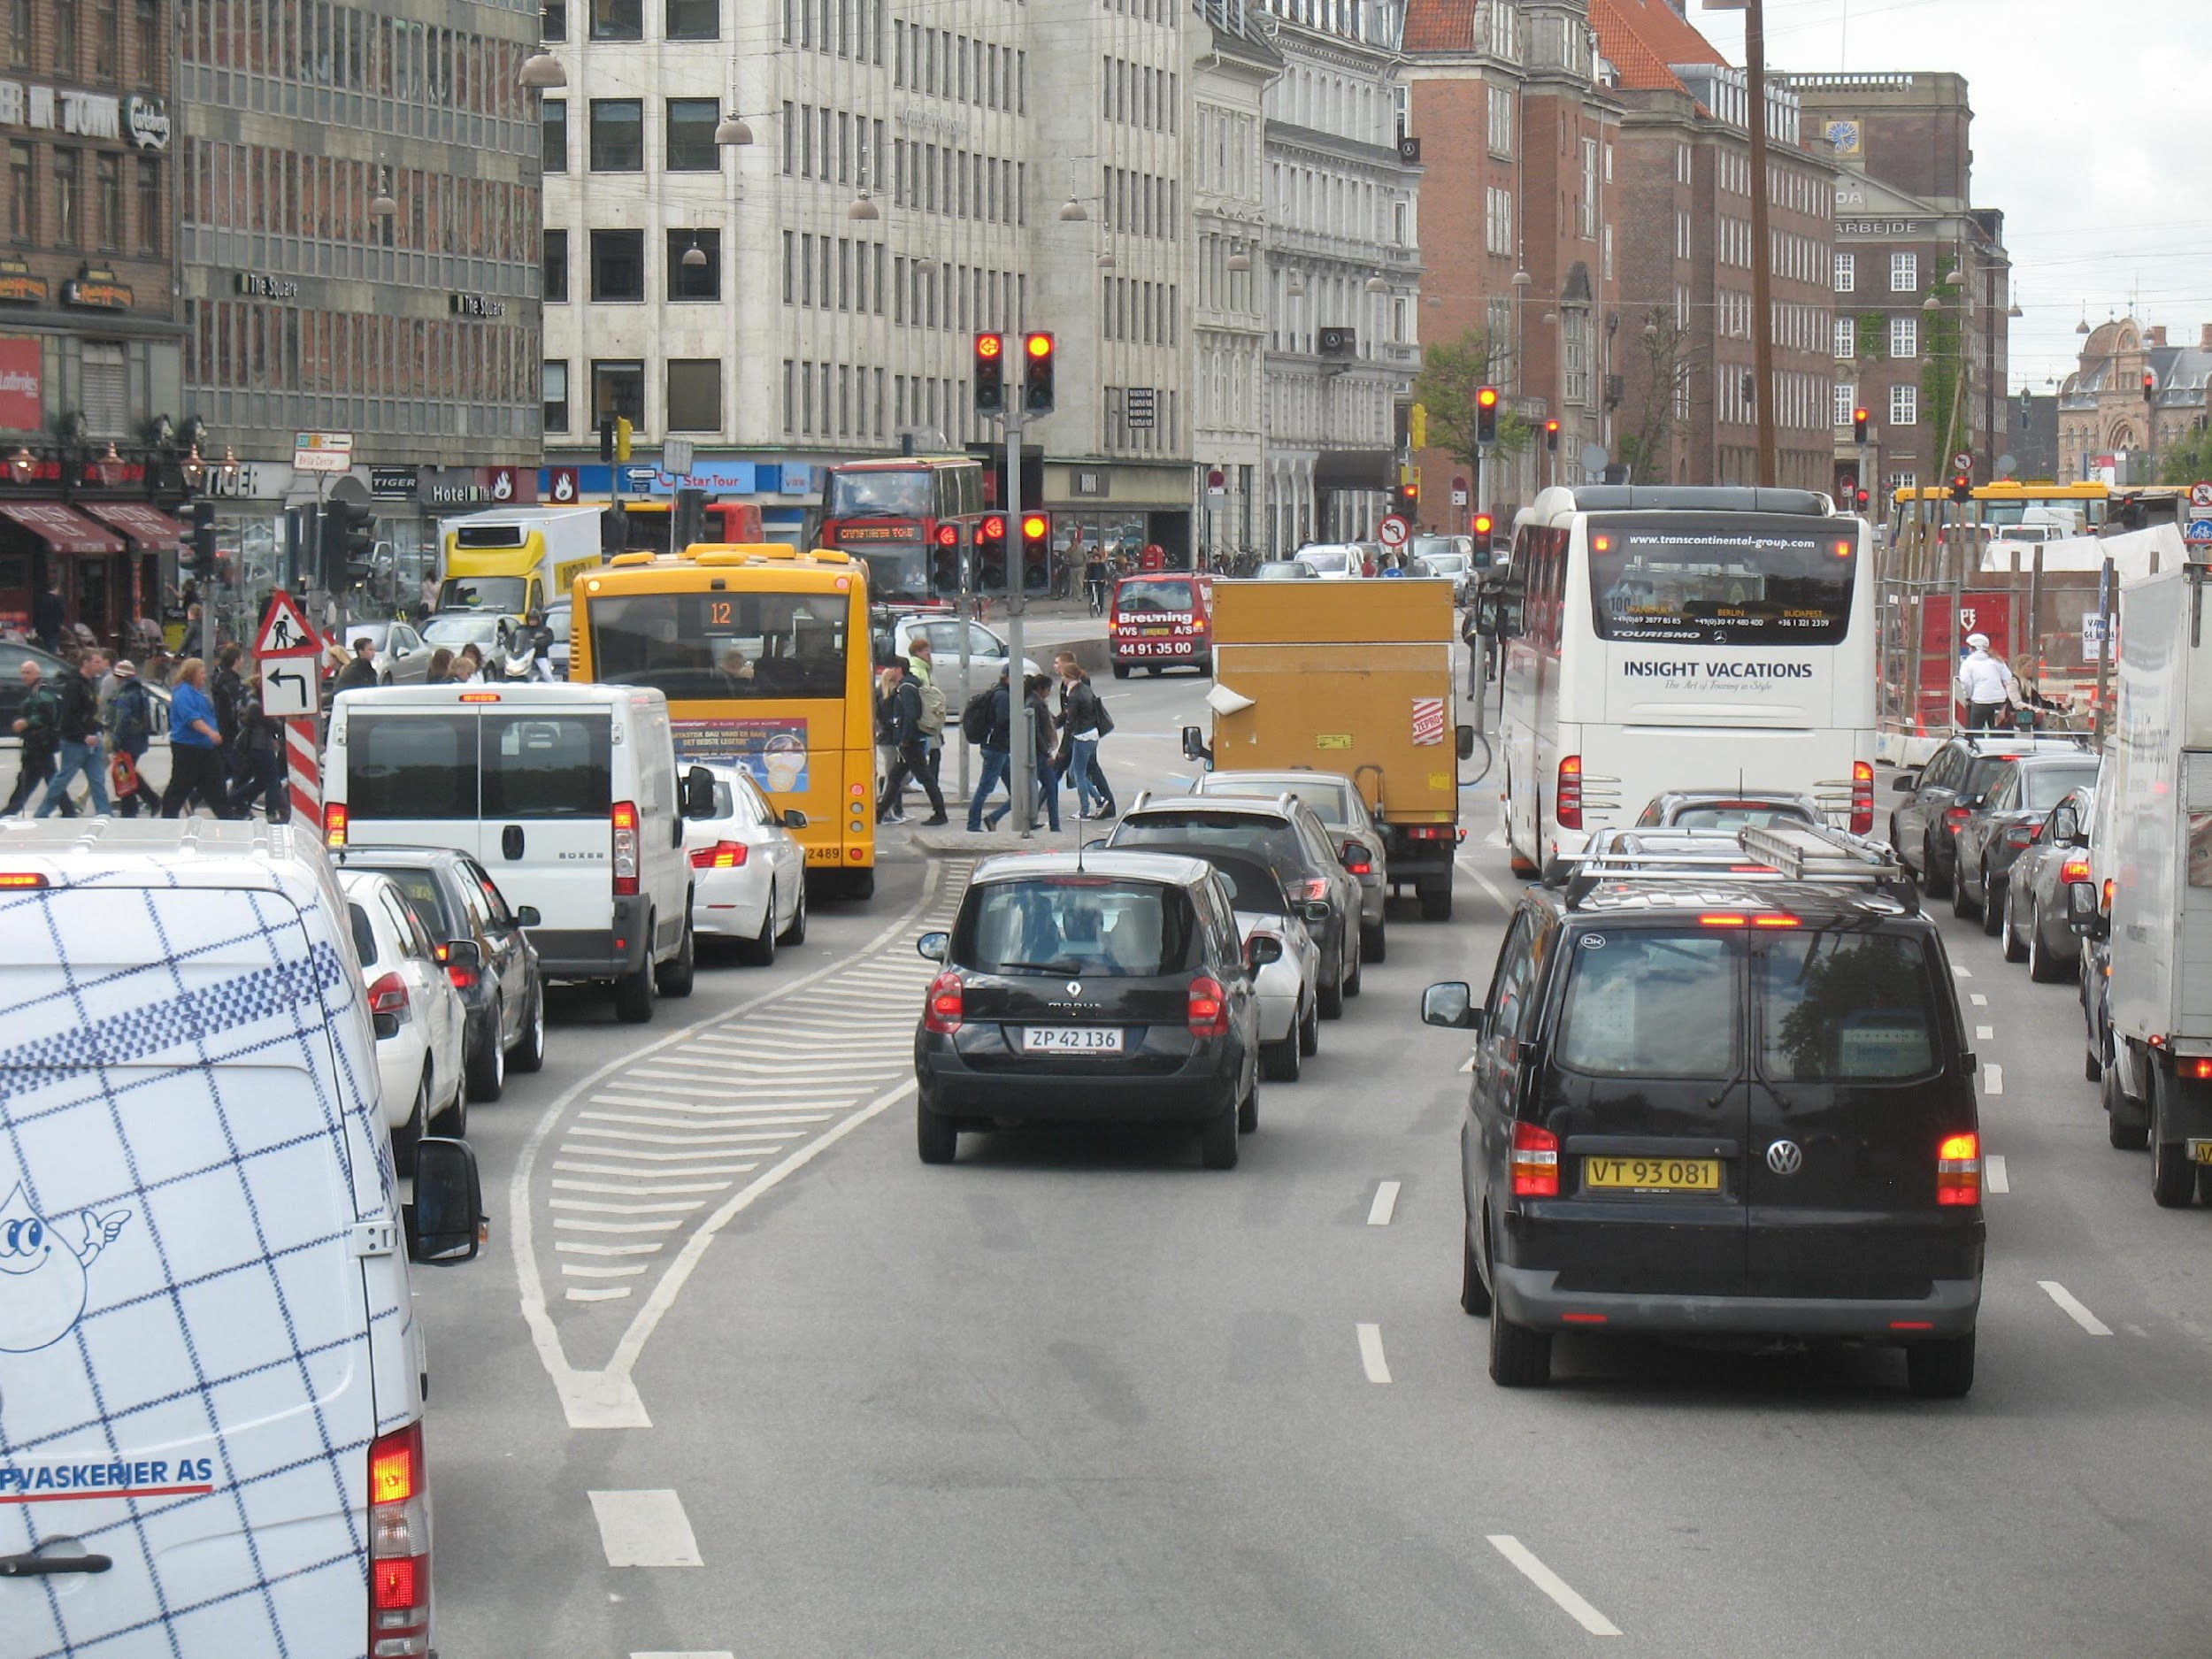
Module 1: Cities for People
Unit 3: Mobility and Accessibility
In the context of the increasing urbanization and urban population growth, accessible transport systems and infrastructures play a crucial role in reducing the environmental footprint and improving life quality. By promoting alternatives to private transport, such as integrated public transport networks, cycling and pedestrianization, cities can reduce carbon emissions.

Slide 23
Cost savings
Using public transport is financially advantageous, especially for regular journeys, as people save on fuel, parking and car maintenance costs.
Traffic reduction
Increased use of public transport reduces the number of cars on the road, resulting in less congestion and shorter journey times for everyone.
Health benefits
People who use public transport tend to walk more, whether to get to the stop, station or final destination. This extra physical activity has health benefits.
Community benefits
Public transport fosters a sense of community by providing a space for people interaction.
Module 1: Cities for People
Unit 3: Mobility and Accessibility
Section 1. Public transport networks
Public transport networks are essential for mobility in modern cities, providing a sustainable and efficient way for the urban and suburban population to travel, allowing people to move between different points within a city, a metropolitan area or region, with great benefits.
Reduced carbon footprint
One bus can replace dozens of cars and one train can replace hundreds, reducing pollution and contributing to better air quality.

Slide 24
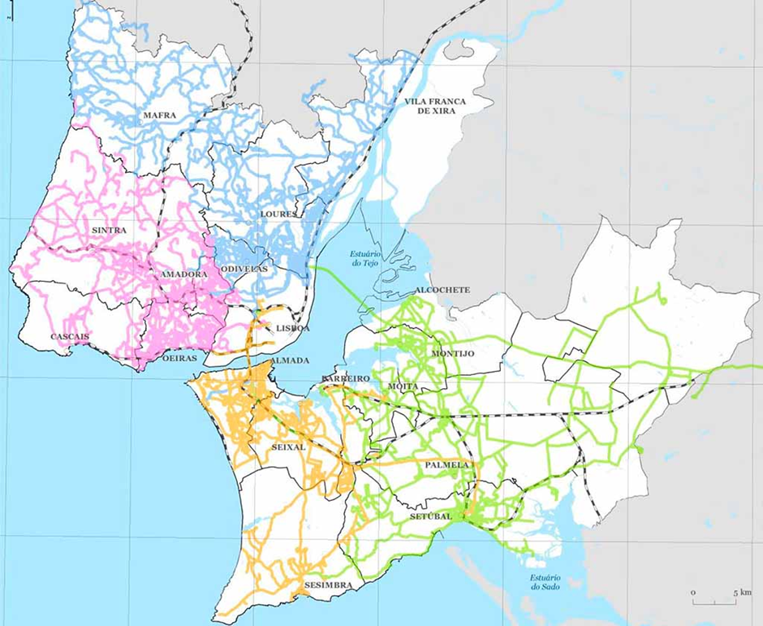
One example of this approach is Carris Metropolitana de Lisboa, which is working to unify the metropolitan bus network. Previously, several companies operated independently in specific areas, often without coordination between them.
The creation of a single metropolitan bus network has made possible to: i) better coordinate timetables and routes; ii) extend coverage, reaching areas that were previously poorly served or required several tickets to be reached; iii) reduce administrative costs; iv) facilitated access to information.
Module 1: Cities for People
Unit 3: Mobility and Accessibility
Section 1. Public transport networks
How to Facilitate the Use of Public Transport
There are several strategies that can be used to make the transition to using public transport easier.
Integrated metropolitan networks
The bigger cities and metropolitan areas have public transport networks that cover large areas and serve thousands of passengers every day. To make these networks more efficient and accessible, many cities have integrated the services of several road transport companies into a single network and improved their links with rail and maritime transport in an integrated mobility perspective.
Carris Metropolitana Coverage in the Lisbon Metropolitan Area

Slide 25
Module 1: Cities for People
Tools and resources
Unit 3: Mobility and Accessibility
Maps, mobile apps and websites are useful tools for finding information on routes, timetables and real-time updates. Many cities have specific apps to help you plan your journey, although Google Maps is also a good tool.
Section 1. Public transport networks
Fare solutions
The availability of daily and monthly passes saves money to those visiting the city for a few days and to those who live there and need to get around every day. Passes also make travelling more flexible and convenient as you don't have to buy tickets for every journey.
Integrated metropolitan networks offer passes for all transport in a given area and have discounts for families, with a maximum amount to be paid, making family budgeting much easier and more organized. They also offer discounts or free passes for people of certain ages and conditions, such as young and old people or students.
Planning routes
Identifying the closest stop to your destination, checking schedules, understanding connections, and considering total travel time will make getting around easier and save you time.
Create a routine
For those who use public transport daily, it's important to create a routine that makes it easier to use. Reading, listening to music or podcasts can make the journey more enjoyable.

Slide 26
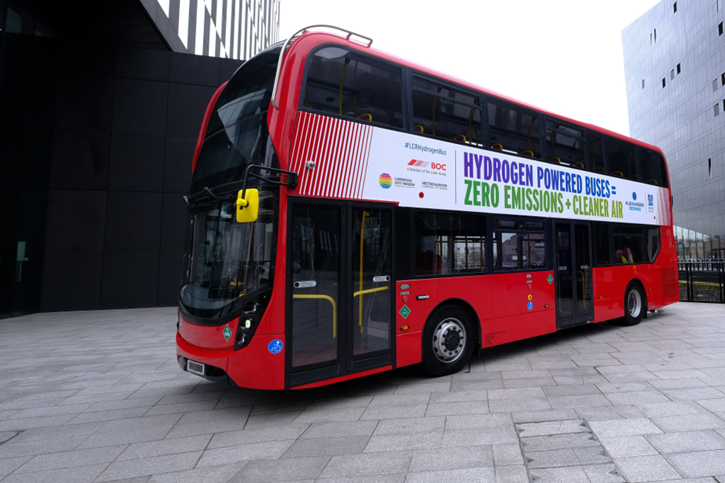
Sustainability in Public Transport
There are several innovative initiatives in the area of public transport, incorporating sustainable technologies and solutions.
Compressed natural gas buses (CNG) Many European cities, such as Lisbon and Madrid, have adopted CNG buses that emit fewer pollutants than diesel buses, improving air quality. However, the extraction, production and transport of the gas increases methane emissions.
Electric buses Cities like Paris and Berlin have invested in integrating electric buses into their public networks, contributing to a significant reduction in combustion gas emissions. However, lithium mining to create batteries is usually carried out in open air, causing a strong intrusion into the natural landscape.
Hydrogen buses Cities such as London and Oslo have introduced hydrogen buses, which emit only water vapor, into their public transport fleets. This technology represents a significant advance towards a truly sustainable transport system.
Module 1: Cities for People
Unit 3: Mobility and Accessibility
Section 1. Public transport networks

Slide 27
Module 1: Cities for People
Unit 3: Mobility and Accessibility
Section 2. Limitations on polluting individual transport
Low Emission Zones (LEZs) and Zero emission zones (ZEZs)
Many European cities have implemented Low Emission Zones (LEZs) to restrict the entry of polluting vehicles into central areas, usually the most congested and with the worst air quality. In London, for example, vehicles that don't meet certain emissions standards are forced to pay additional fees to enter the city, such as heavy-duty diesel vehicles and other petrol and diesel vehicles that don't meet Euro 4 and Euro 6 emissions standards.
In other cases, such as in some areas of Amsterdam, Zero Emission Zones (ZEZs) have been created where only fully electric or non-polluting vehicles can circulate.
The growing urbanization and the consequent increase in the number of private vehicles led to significant parking and traffic problems in large cities, affecting urban mobility and causing air and noise pollution. Tackling these problems requires the implementation of various regulations and policies, as well as the development of more efficient and sustainable public transport systems.
Emission standards
One of the most effective strategies for reducing pollution from cars is to impose emission standards. In Europe, for example, the Euro standards (Euro 0, ..., Euro 7, etc.) set limits for pollutants emitted by vehicles, and each new version of these standards is more stringent.

Slide 28
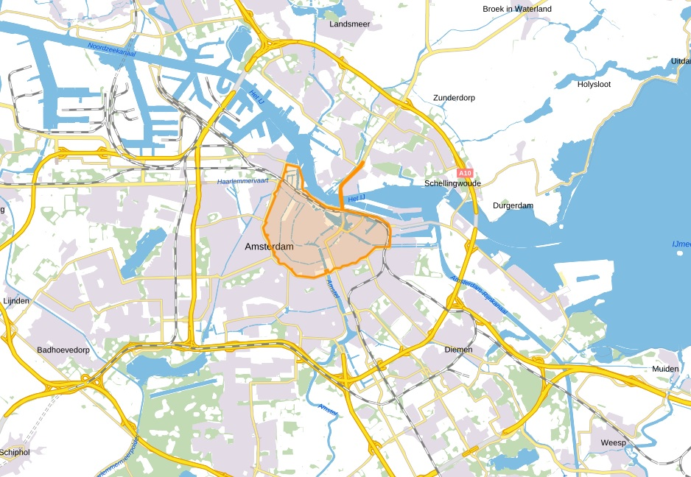
Making parking more difficult for non-residents
An effective measure to discourage excessive car use in urban areas is to make parking more difficult and expensive for non-residents. Making parking more difficult encourages drivers to use public transport or alternative ways of transport.
Peripheral car parks
The creation of car parks on the outskirts of towns and cities, near rail or maritime terminals, can relieve parking pressure in urban centers. However, the implementation of this solution faces challenges related to the availability of space and the cost of building car parks.
In Sintra, Portugal, as the location of the two peripheral car parks is far from the railway station connecting to Lisbon, the City Council provides a free shuttle bus.
Carbon taxes and fuel taxes
By implementing carbon and fuel taxes, governments put pressure on the transition to cleaner ways of transport, such as bicycles and electric vehicles, and to public transport.
Module 1: Cities for People
Unit 3: Mobility and Accessibility
Section 2. Limitations on polluting individual transport
Amsterdam’s Zero Emission Zone

Slide 29
Module 1: Cities for People
Unit 3: Mobility and Accessibility
Section 3. Cycle paths and pedestrian zones
How to implement
To implement cycle paths and pedestrian zones effectively, it is crucial to integrate these infrastructures with existing roads. An effective approach is to convert some carriageways into cycle paths or pedestrian zones, ensuring connectivity to key destinations such as schools and public transport stations. Safety is also essential with the implementation of measures such as dedicated lanes, adequate lighting, clear traffic signs and speed bumps to protect pedestrians and cyclists.
It is also essential to promote zoning laws that prioritize infrastructure for pedestrians and cyclists, as well as offering incentives such as tax breaks or subsidies for the purchase of bicycles and safety equipment.
The excess of motor vehicles in cities leads to congestion, pollution and an environment that is not conducive to quality life. Cycle paths and pedestrian zones have emerged as essential solutions for transforming urban areas into healthier and sustainable spaces by combating sedentary lifestyles and making a significant contribution to reducing carbon emissions.
In areas where cycling and walking are well implemented, stress and anxiety levels are significantly reduced and there is an incentive to create green spaces, increasing biodiversity and promoting a more pleasant environment.

Slide 30
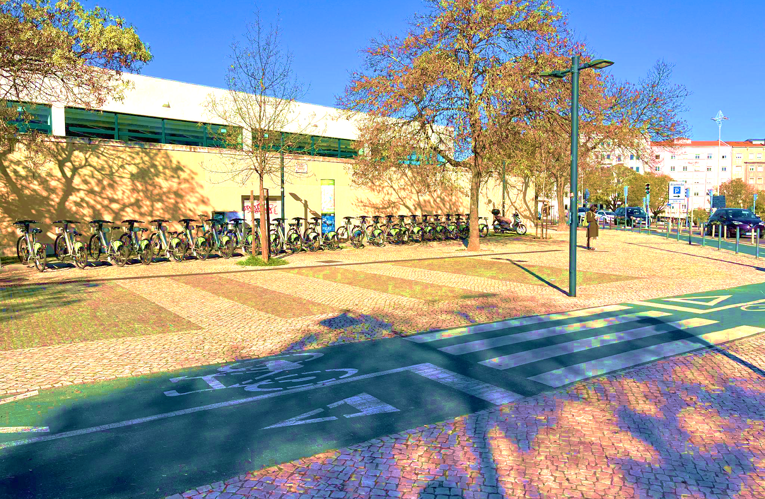
Shared bicycle systems
The shared bicycle system is a service that allows the temporary use of bicycles at a reduced cost. The bikes are made available at strategically located stations, where users can pick up a bike, use it to get around and return it at another station.
This system reduces the need to own a bicycle, encourages more people to use this sustainable way of transport, especially for short journeys or as a supplement to public transport.
Module 1: Cities for People
Unit 3: Mobility and Accessibility
Section 3. Cycle paths and pedestrian zones
Overcoming challenges
To be truly effective, cycle paths and pedestrian zones need to be accessible to all people, regardless of age or physical ability, ensuring that people with reduced mobility can benefit from these areas.
Another challenge is to ensure that cycle paths and pedestrian zones are equitably distributed across the city, so that all communities have access to safe and healthy places to get around.
Bicycle lanes with shared bike system in the background

Slide 31
Module 1: Cities for People
Unit 3: Mobility and Accessibility
Do’s and don’ts
1. Use and promote public transport.
2. Avoid the laziness of polluting private transport.
3. Integrate active mobility into daily life.
4. Use public transport passes and discounts to save money
5. Plan optimized and sustainable journeys to save time and resources.
Don't ignore public transport.
2. Don't rely solely on individual transport solutions.
3. Don't ignore the restrictions imposed on the circulation of individual vehicles.
4. Don't disregard the safety of citizens choosing soft mobility.
5. Don't fail to demand improvements in public transport from the competent authorities.

Slide 32
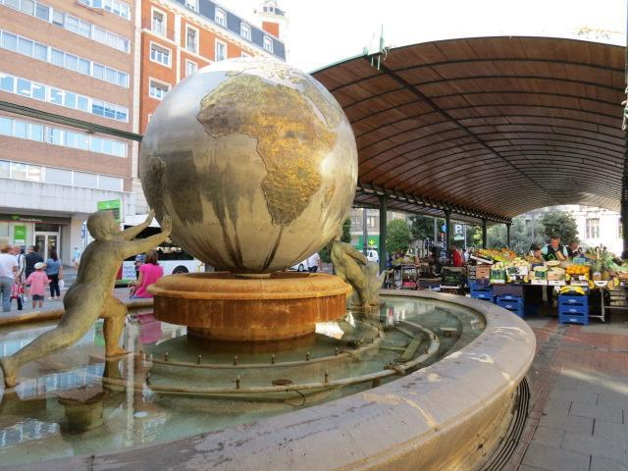
Module 1: Cities for People
Unit 4: Production and consumption
All the things that we buy and use have different impacts on the environment:
- In their production
- In transporting them to the place where we shop
- In their use
- In the waste that they produce at the end of their life.
It’s important to consider all these aspects when buying a product, so that we choose the one that has the smallest carbon footprint in its life cycle and meets our use needs.
Consumers have the power to choose what they buy and also the power not to buy it. It is by exercising this power that the consumer becomes a responsible citizen: by carefully choosing goods with a lower environmental impact; and by buying only what they need, without succumbing to the manipulations of marketing and advertising.

Slide 33
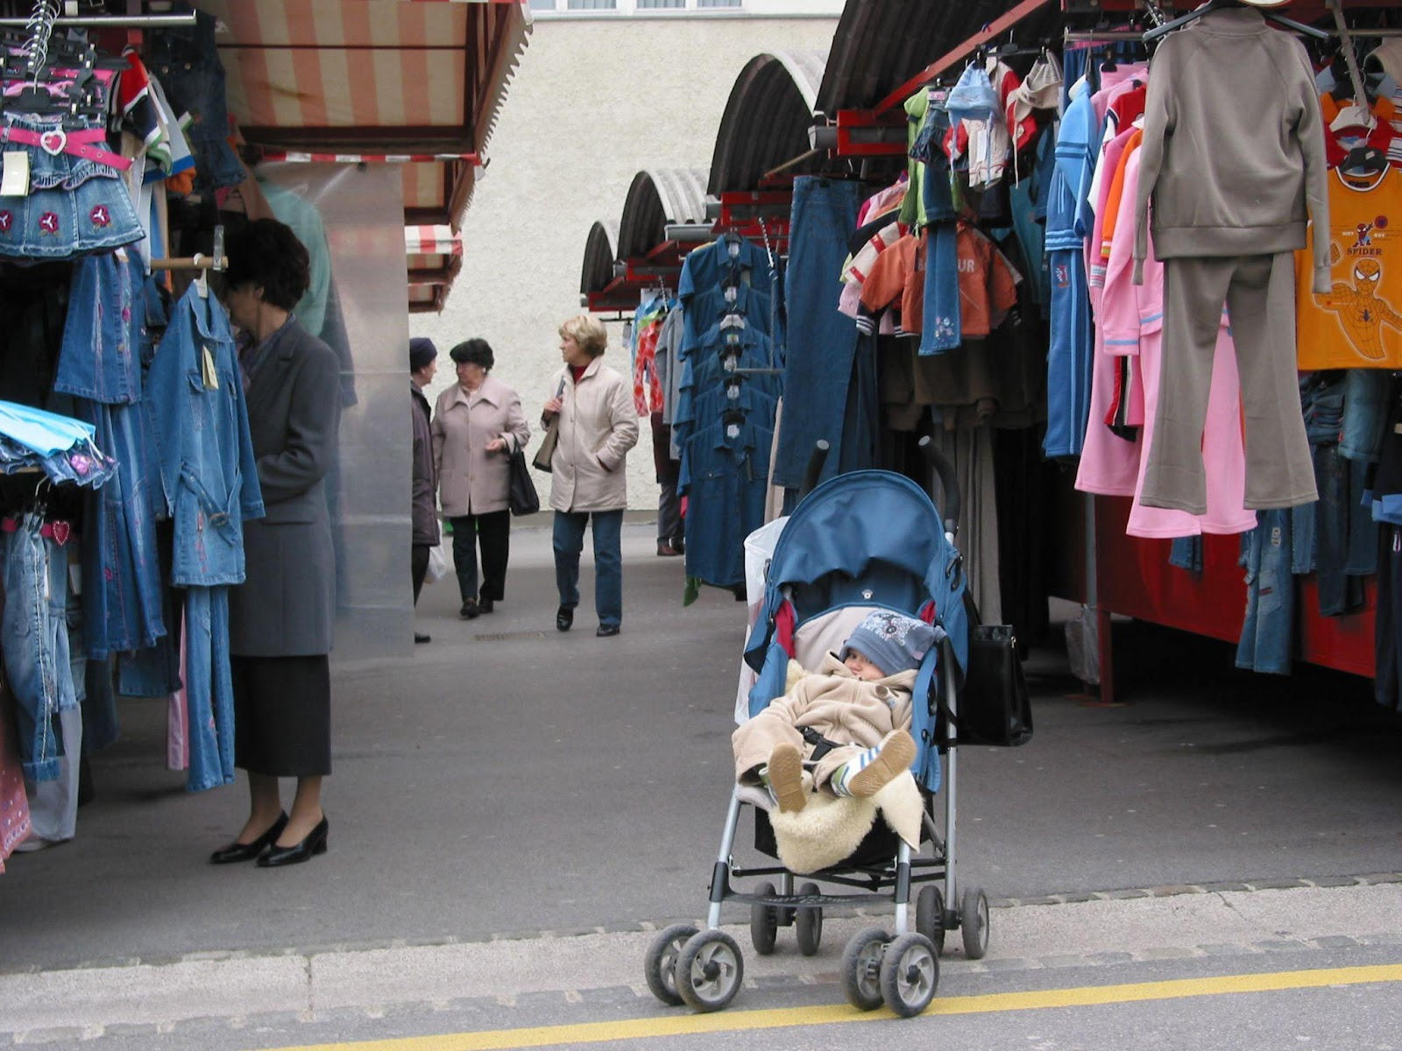
Module 1: Cities for People
Unit 4: Production and consumption
Section 1. Trade and consumption
Commerce is a fundamental part of the urban ecosystem. However, its circulation and intensity are major contributors to urban pollution, mainly through the transport and the waste generated.
Buying goods produced as close to home as possible is the first objective of a conscious consumer. The second is to buy from local shops rather than distant big stores. Both reduce the impact of transport and energy consumption.
In Europe, most products must be labelled with information about their components, production characteristics, use and recycling. Reading these labels carefully is essential for making informed choices.
Another important consideration is the type of packaging. Conscientious shoppers should reduce their use of plastics, preferring recycled and recyclable packaging, use their own bags and containers and buy in bulk where possible. Some foods, such as leguminous, cereals, fruit and vegetables, can be up to 30 percent more expensive when bought packaged.

Slide 34
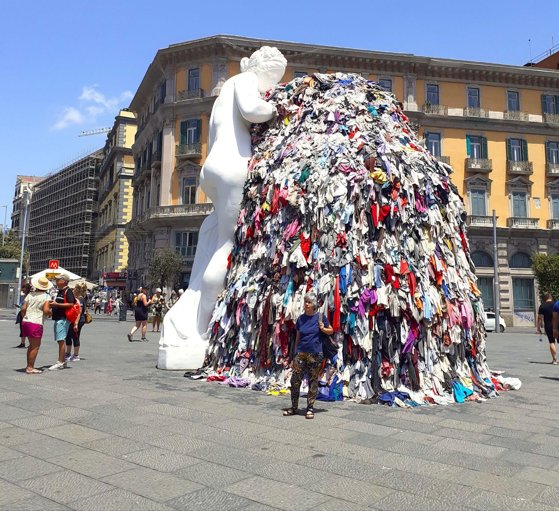
The Great Venus of Rags, a sculpture by Michelangelo Pistoletto criticizing consumerism (Piazza del Municipio, Naples)
Module 1: Cities for People
Unit 4: Production and consumption
Section 2. Social life and consumption
Cities are, by their very nature, environments of intense socialization, where citizens are constantly interacting in countless activities of all kinds, with diverse and ever-increasing energy consumption.
Many of these activities require citizens to travel from one place to another in polluting means of transport. A basic principle for avoiding urban environmental degradation is to avoid unnecessary travel.
Another principle is to avoid attending events with large concentrations of people, which consume a lot of energy and generate large amounts of polluting waste.
A conscious consumer is one who buys only what he needs, without succumbing to the manipulations of marketing and advertising, which impose unnecessary and polluting consumer fashions.
One of the most polluting industries on the planet is the clothing industry, which produces low-quality and disposable clothing that is consumed quickly and continuously – a social habit known as “fast fashion”.

Slide 35
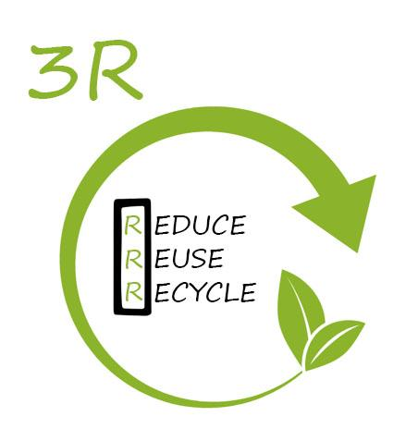
Module 1: Cities for People
Unit 4: Production and consumption
Section 3. The 3R: Reduce, Reuse, Recycle
The 3Rs is a sustainable development practice that reduces negative environmental impacts and enables consumers to save money.
Reduce means buying fewer goods, buying consciously and without waste, and using resources efficiently such as water and energy.
Reuse means giving new life to materials and products by selling or donating them, and buying used goods instead of new ones, which are more expensive.
Recycle is the final step in minimizing the negative impacts of the production and consumption of goods through the deposit and selective collection, processing and reintroduction of their waste into the production chain.

Slide 36
Module 1: Cities for People
Unit 4: Production and consumption
Section 4. Degrowth
The concept of degrowth has been proposed and discussed in opposition to sustainable development. Degrowth theorists believe that the use of the development adjective, is a mask for the economic growth that has brought the planet and humanity into the current situation of unsustainability.
Degrowth is essentially a proposal for a controlled reduction in production and consumption, based on principles that can be summarized as follows:
Environmental sustainability: Reducing the depletion of natural resources and the emission of pollutants.
Social well-being: Valuing quality of life and people’s well-being over the accumulation of material goods.
Post Growth Game
Social justice: Reducing economic and social inequalities through the fair distribution of resources.
Local economies: Strengthening local economies by reducing dependence on global markets.

Slide 37
Module 1: Cities for People
Unit 4: Production and consumption
Do’s and don’ts
Buy from local markets and small shops rather than big stores.
2. Use reusable bags or containers to avoid single-use plastics.
3. Choose quality over quantity, especially in clothing, and avoid “fast fashion”.
4. Plan purchases to avoid impulse spending and waste.
5. Sort waste selectively and dispose of it properly.
Don’t throw away goods in good condition instead of trying to repair or give them to people who can use them.
2. Don’t buy disposable or short-lived products.
3. Don’t make consumption a compulsive habit or a way of spending leisure time in shopping centers.
4. Don’t buy without checking the components of the product and the working conditions in the production chain.
5. Don’t buy goods with long transport routes.

Slide 38
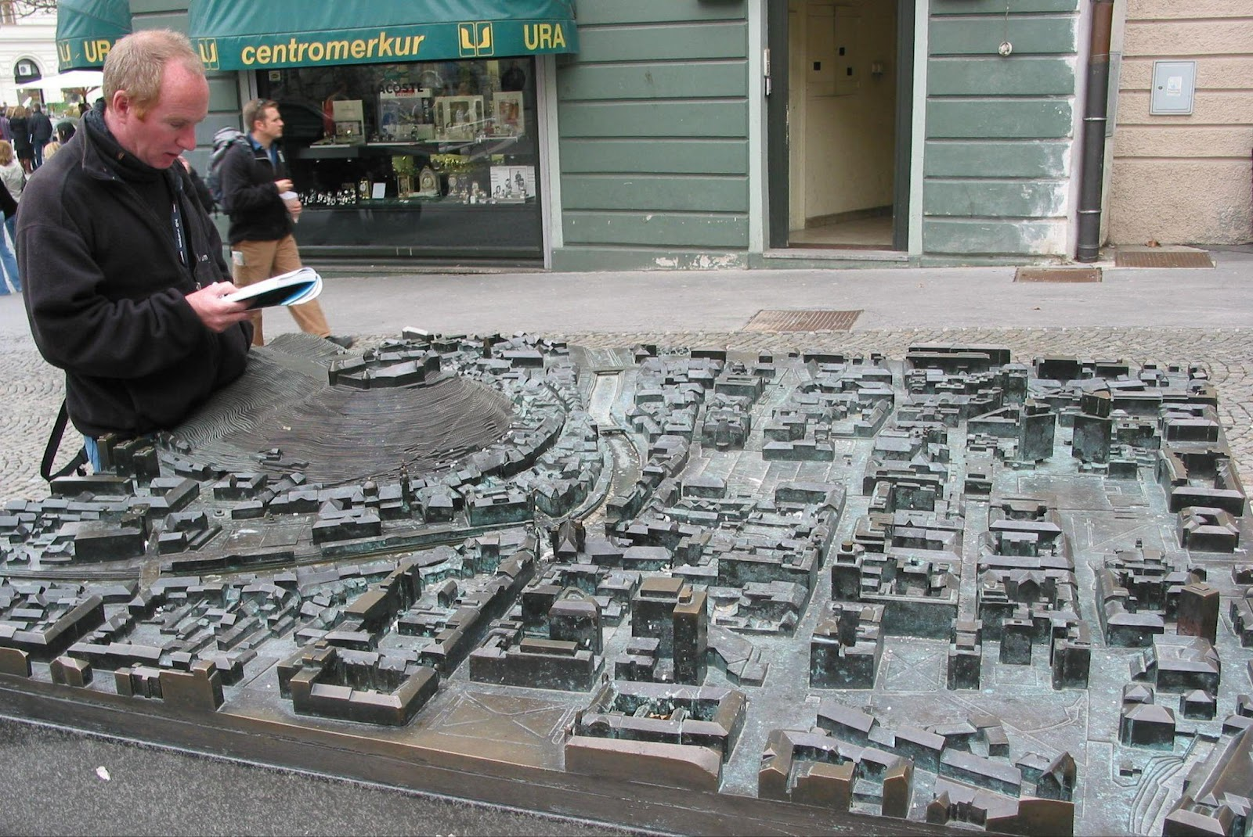
Module 1: Cities for People
Unit 5: Citizen’s participation
Cities are, above all, the people who live in them. Without people cities are ruins.
As has been mentioned in the previous units of this module, and will be developed in subsequent modules of the course, the building of climate resilience of cities must have human being at its center, living in harmony with biodiversity.
The decision and implementation of urban climate adaptation and mitigation measures must respect citizens' right to the city and to the place, which are fundamental elements of political and social democracy.
This is a political process in which citizens have the right and duty to participate, at the deliberative and governing levels, through the mechanisms of representative democracy and all other possible forms, more or less direct.

Slide 39
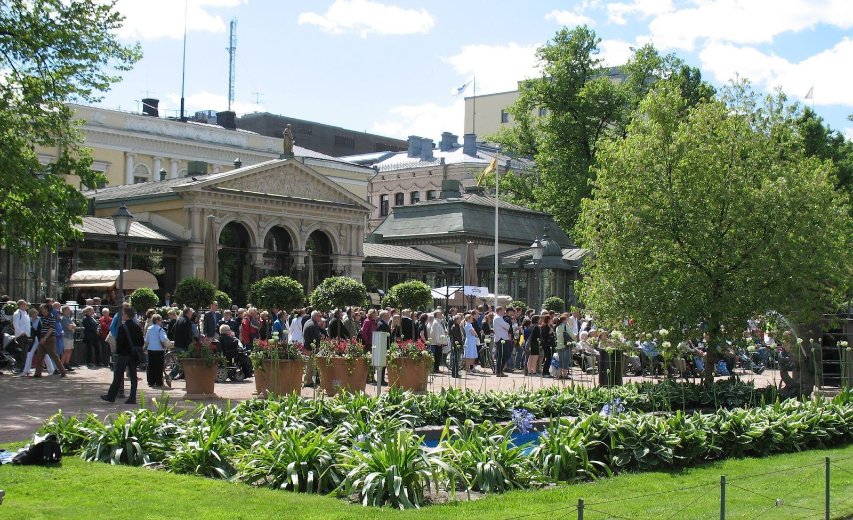
Module 1: Cities for People
Unit 5: Citizen’s participation
Section 1. Local participation
Engaging citizens in the life of their city starts with active participation in their residence community (streets, neighborhoods, etc.), work (companies, factories, etc.) or services (transport, schools, health centers, etc.).
Analyzing existing common problems with neighbors and other interested people and developing possible solutions is the first fundamental step. This can be done in informal community groups, as exist in many places, and then present their conclusions to local decision-makers.
Due to their proximity, local political authorities are generally more sensitive to community proposals and demands. If they are unable to address them, they can always raise the issue with the appropriate higher political body and press for a solution.

Slide 40
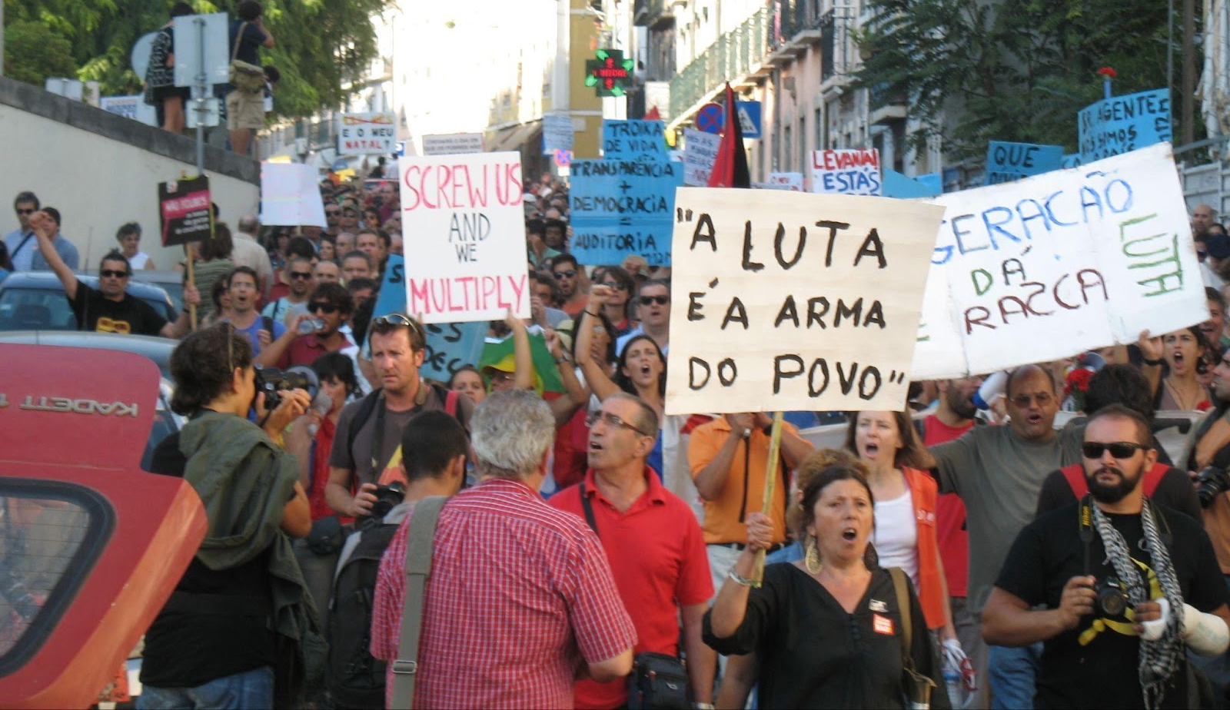
Public demonstration
Module 1: Cities for People
Unit 5: Citizen’s participation
Section 2. Participation in political-administrative bodies
Citizens' participation in the political and administrative bodies of representative democracy is mainly through the elected representatives, who generally belong to political party lists. This participation is limited and often fails to meet the expectations of the electorate, as it does not respond adequately to their needs and aspirations.
In some countries it is possible for citizens to occasionally participate directly in assemblies of political-administrative bodies, although without deliberative ties. This takes various forms, depending on the constitutional and legislative architecture of the country.
In other countries, randomly selected groups of citizens may be invited to participate in the definition of public policies, particularly in the field of urban planning. In its 2021 report 'Eight ways to institutionalize deliberative democracy', the OECD reported that 101 of these practices had taken place in a few countries since 2019 - an obviously small number.
The mechanisms of participatory democracy are non-existent or very limited in most countries, removing citizens from the deliberative and governmental spheres and relegating their participation to protesting.
The threat of climate change has led to huge public demonstrations of protest and demands, due to the lack of action by the various political powers and the worsening effects perceived and felt by the population. The undeniable reality is that more and more citizens are suffering and dying as a result of the climate crisis.

Slide 41
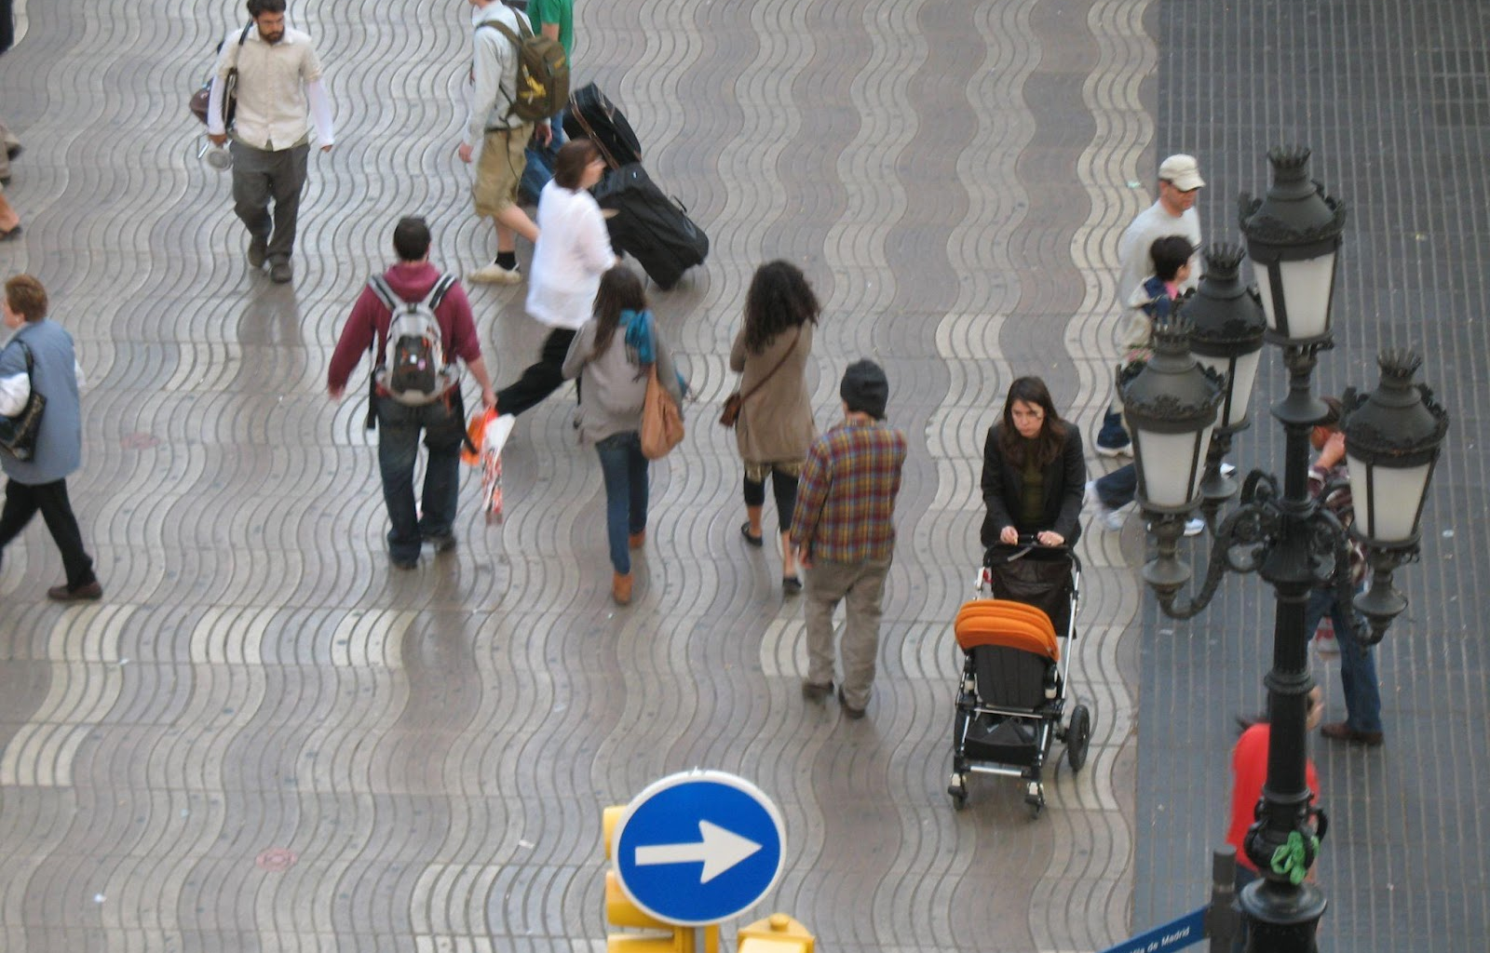
Module 1: Cities for People
Unit 5: Citizen’s participation
Section 3. Continuous participation in defining and monitoring evolution
Cities are major sources of pollution, but they also have a critical mass potentially capable of discovering and implementing innovative and effective climate action measures.
Many of the few adaptation and mitigation measures adopted by political and economic powers are due to the persistent attention to problems and search for solutions by citizens and civil society organizations.
Citizen participation is not limited to defining policies.to be effective, it must extend to monitoring the implementation of public policies, seeking to contribute to their adaptation and to achieving better results.
In many situations, it is the intervention of organized citizens that ensures
that climate action measures also contribute to social inclusion, with poverty reduction, better employment and quality services.

Slide 42
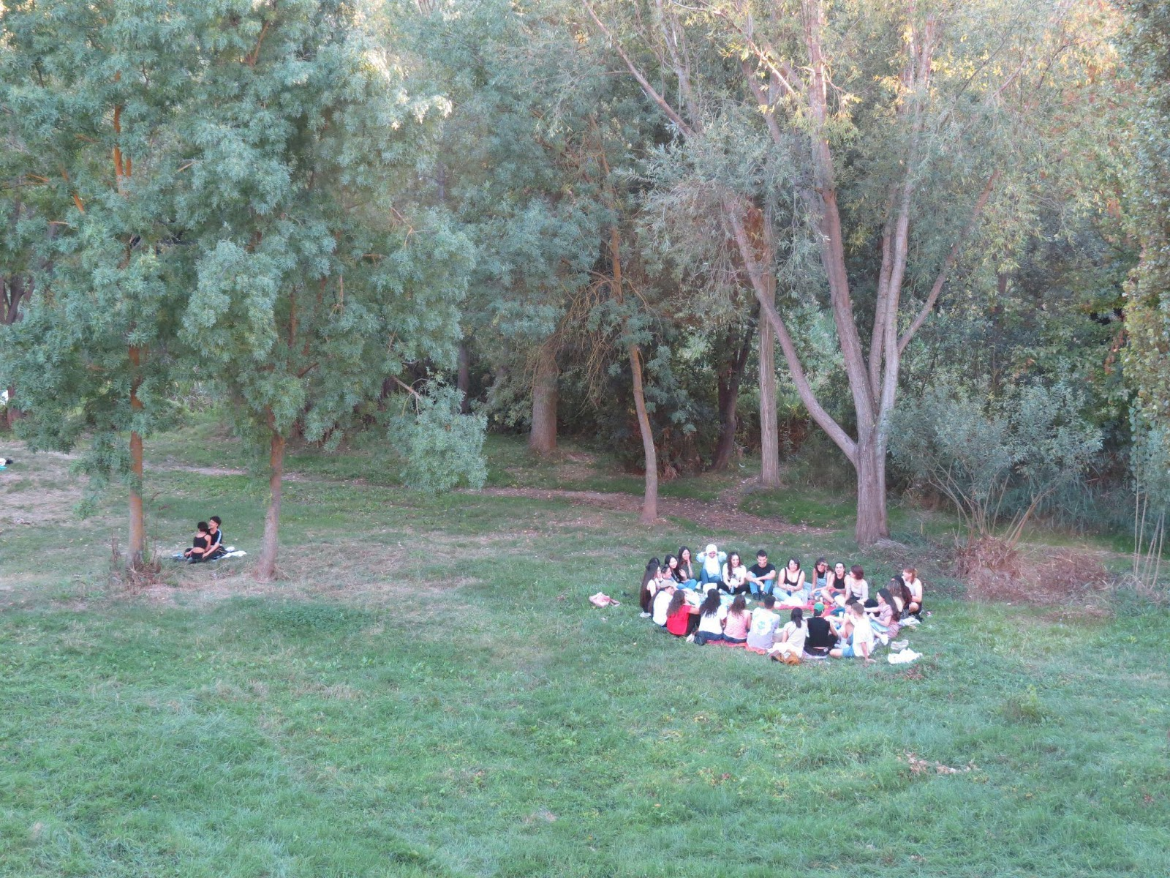
Module 1: Cities for People
Unit 5: Citizen’s participation
Section 4. Citizenship and community
Citizenship is a two-way link between the individual and the state, often broken by the state.
It is up to the individual, the citizen, to try in every way to take an active part in building a democratic society that resists the climate threat, with cities that are not a threat to the environmental catastrophe. This participation includes both individual and collective praxis.
The climate threat is multi-sectoral, multi-dimensional and multilateral, with interrelated and mutually reinforced dimensions. Climate resilience requires a huge effort of cooperation and collaboration at different scales, from local to global.
Citizens have the right to live on a healthy planet, free from the threat of climate change, and they have the right to demand action from public
authorities. At the same time, they have an individual and community duty to protect and preserve the environment for future generations. That is, to their children and their children's children.

Slide 43
Module 1: Cities for People
Unit 5: Citizen’s participation
Do’s and don’ts
Organize forms of community participation
Actively putting pressure on policy makers
Monitoring public policies
4. Promoting sustainable practices in everyday life
5. Promoting individual and collective environmental education
Don’t ignore local problems
Don’t stop proposing solutions to elected politicians
3. Don’t ignore long-term environmental impacts
4. Don’t isolate yourself from the community
5. Don’t centralize actions in closed groups

Slide 44
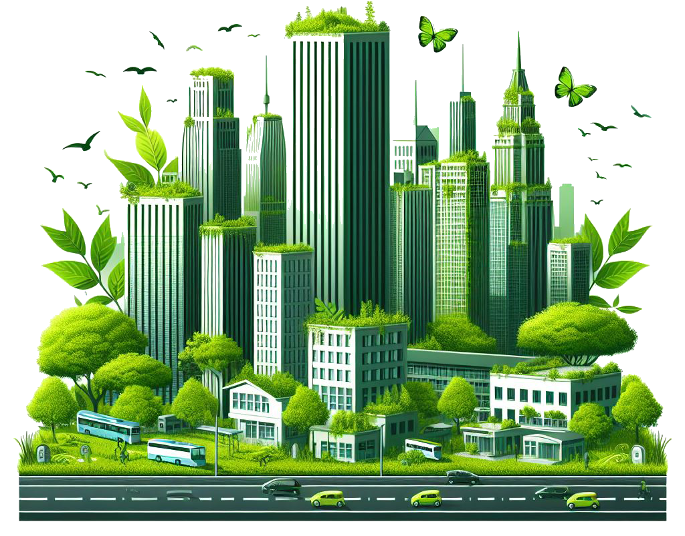
Summing up
Understanding the ecosystem of cities and metropolitan areas and the environmental impacts of their various elements is essential for citizens to become aware of the severity of the climate emergency we live in and to adopt responsible attitudes and behaviours that contribute to climate resilience.
The market economy is based on an incessant cycle of production and consumption, a spiral of infinite growth, which extracts finite resources from the planet and causes unbearable pollution for living beings. Cities and their metropolitan areas are the main location of this destructive production and consumption cycle, which kills.
Citizens have the right and duty to participate in the definition and implementation of policies for their city and their country, through the mechanisms of representative democracy and other possible forms, both individual and collective. This participation is fundamental to ensure the future of the planet and humanity.
In 2020, cities concentrated 56.2% of the world's population, in 2030 it will be 60.4%, and in 2050 around 70%. The future of the planet depends on the future of cities, which consume about 75% of all energy produced and emit more than 60% of greenhouse gases.

Slide 45
Thank you!
Partner: EDU.IN

