Slide 1
Waste
Partner: IWS

Slide 2
Objectives & Goals
At the end of this module you will be able to:
Understand the concept of waste and its key elements
Recognize the importance of managing and protecting the environment
Establish and maintain a positive attitude reusing and recycling
Understand the challenges of circular economy
Apply strategies for clear, concise and responsible circular economy
Manage the environmental impact and avoid urban waste reusing and recycling

Slide 3
Index
Unit 1: Introduction: Basics of urban waste management
Section 1: Overview of Urban Waste Management
Section 2: Importance of sustainable practices
Section 3: Challenges in Urban Waste Management
Section 4: Do’s and don’ts
Unit 2: Recycling and Reuse: transforming waste into resources
Section 1: The concept of Recycling and Reuse
Section 2: Benefits of Recycling and Reuse
Section 3: Challenges and Future Directions
Section 4: Do’s and don’ts

Slide 4
Unit 3: Circular economy and waste
Section 1: Understanding the Circular Economy
Section 2: The role of waste in a circular economy
Section 3: Challenges and opportunities for transitioning to a circular economy
Section 4: Do’s and don’ts
Unit 4: Community involvement and behavior change
Section 1: The importance of Community Involvement
Section 2: Strategies for encouraging behaviour change
Section 3: Overcoming barriers to participation
Section 4: Do’s and don’ts
Unit 5: Environmental and health impacts of urban waste
Section 1: Environmental impacts of urban waste
Section 2: Health impacts of urban waste
Section 3: Strategies for mitigating environmental and health impacts
Section 4: Do’s and don’ts

Slide 5
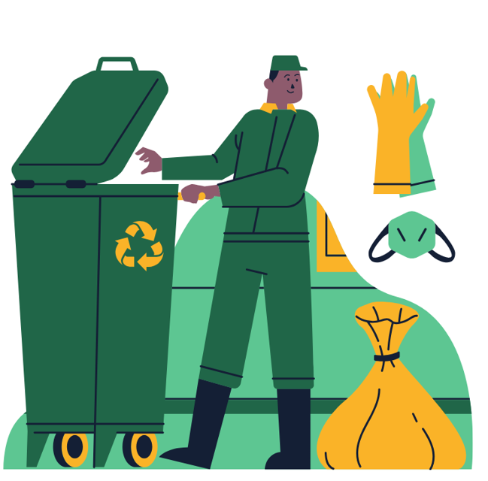
1. Introduction: Basics of urban waste management
Overview of Urban Waste Management
Urban waste management refers to the systematic collection, transportation, processing, recycling, and disposal of waste generated in urban areas. As cities continue to grow and populations increase, the volume of waste produced also rises significantly. Effective waste management is crucial for maintaining public health, protecting the environment, and promoting sustainable urban development.
As a concerned citizens living in an urban environment, We have become increasingly aware of the various types of waste we generate and the implications they have for our community and the environment. Understanding these different types of urban waste is crucial for effective management practices and for fostering a more sustainable future.

Slide 6
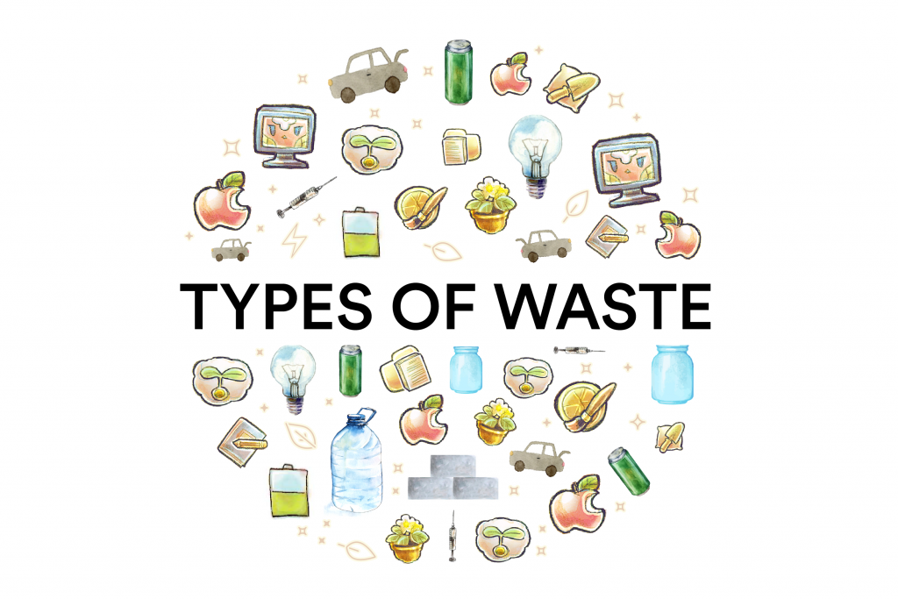
1. Introduction: Basics of urban waste management
Overview of Urban Waste Management
Municipal Solid Waste (MSW) is perhaps the most familiar type of waste to us. It includes everyday items that we discard, such as packaging, food scraps, and household items. One of the key characteristics of municipal solid waste is its composition, which can vary significantly depending on the season and local habits. For instance, during the festive season, we might see an increase in packaging waste. Effective management of municipal solid waste involves promoting recycling and composting initiatives, as well as encouraging residents to reduce their waste generation through practices like reusing and repairing items.
Hazardous Waste is another critical category that requires our attention. This type of waste includes materials that are dangerous to human health or the environment, such as batteries, chemicals, and certain electronic waste. Improper disposal of hazardous waste can lead to severe environmental contamination and health risks. Therefore, it is essential for local authorities to provide clear guidelines on how to dispose of these materials safely, often through designated collection points or special disposal events.

Slide 7
1. Introduction: Basics of urban waste management
Overview of Urban Waste Management
Organic Waste is increasingly recognised for its potential benefits if managed correctly. This category includes food scraps, garden waste, and other biodegradable materials. Many local councils are now implementing organic waste collection schemes, encouraging residents to separate their food waste from general rubbish. This not only reduces the amount of waste sent to landfills but also contributes to creating nutrient-rich compost that can be used in gardens and parks.
In conclusion, as urban dwellers, we have a responsibility to understand the types of waste we produce and their implications for management practices. By actively participating in recycling programs, properly disposing of hazardous materials, and embracing organic waste initiatives, we can contribute to a cleaner, healthier environment. It’s essential for us to stay informed and engaged in these practices, as they play a significant role in shaping the sustainability of our communities

Slide 8
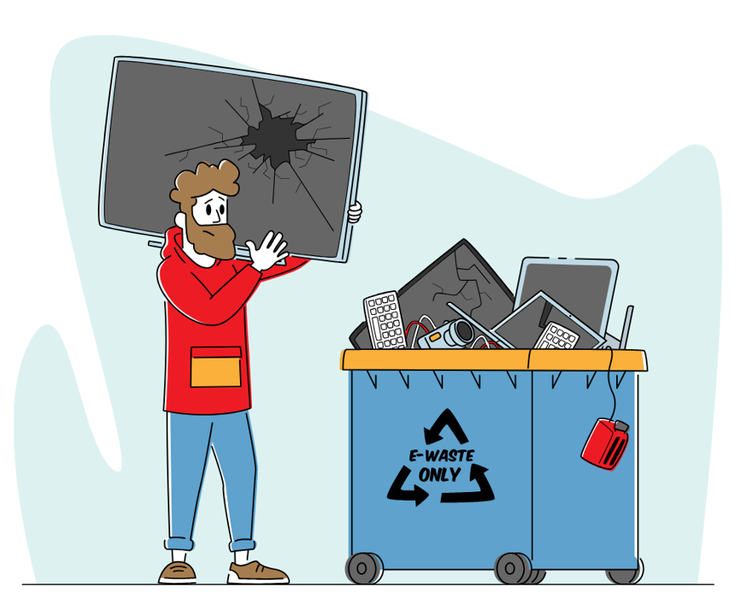
1. Introduction: Basics of urban waste management
Importance of sustainable practices
Sustainable waste management practices are essential in addressing the challenges posed by urbanisation and climate change. Traditional methods of waste disposal, such as landfilling and incineration, can lead to environmental degradation and resource depletion. In contrast, sustainable approaches focus on reducing waste generation at source, promoting recycling and composting, and encouraging responsible consumption patterns among citizens.
As a concerned citizens living in an increasingly urbanised environment, we have come to realise the pressing need for sustainable practices that not only address our waste management challenges but also contribute positively to our community and the planet.
At its core, the circular economy is about rethinking our traditional linear model of production and consumption, which typically follows a 'take-make-dispose' pattern. Instead, it advocates for a system where resources are kept in use for as long as possible, waste is minimised, and materials are recycled or repurposed at the end of their life cycle. This shift in perspective is crucial for urban areas, where waste generation is often at its highest.

Slide 9
1. Introduction: Basics of urban waste management
Importance of sustainable practices
One practical application of these principles in urban waste management is through enhanced recycling programmes. Local councils can invest in better infrastructure to facilitate the sorting and processing of recyclable materials. By providing residents with clear guidelines on what can be recycled and ensuring that recycling bins are accessible and well-maintained, we can significantly increase the amount of material diverted from landfills. Moreover, educational campaigns can empower citizens to make informed choices about their consumption habits, encouraging them to opt for products with minimal packaging or those made from recycled materials.
Another vital aspect of the circular economy is promoting composting as a means to manage organic waste. Cities can implement community composting initiatives that allow residents to contribute their food scraps and garden waste. This not only reduces the volume of waste sent to landfill but also produces nutrient-rich compost that can be used to enrich local soil, supporting urban gardening and enhancing biodiversity.

Slide 10
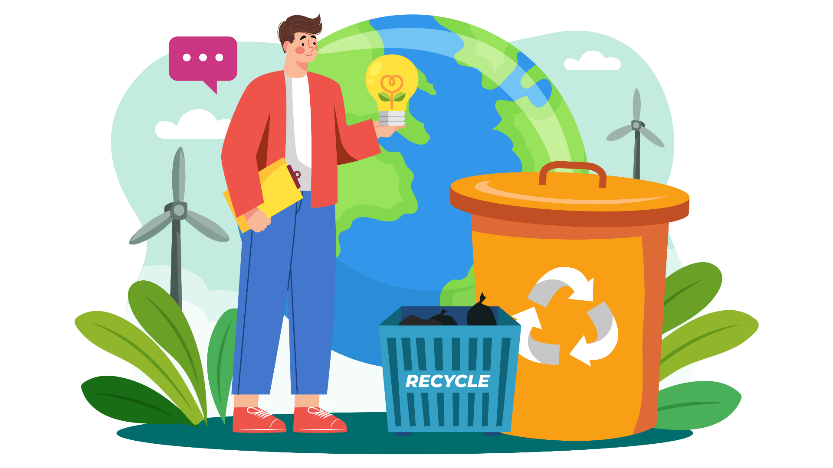
1. Introduction: Basics of urban waste management
Importance of sustainable practices
Furthermore, businesses play a crucial role in this transition. By adopting sustainable practices such as designing products for longevity and ease of repair, companies can reduce waste at its source. Initiatives like take-back schemes encourage consumers to return products at the end of their life cycle, allowing manufacturers to reclaim valuable materials for reuse.
Lastly, collaboration between local governments, businesses, and communities is essential for fostering a circular economy. By creating partnerships that focus on innovative solutions—such as sharing platforms for tools or community repair workshops—we can build a culture of resourcefulness that benefits everyone involved.

Slide 11
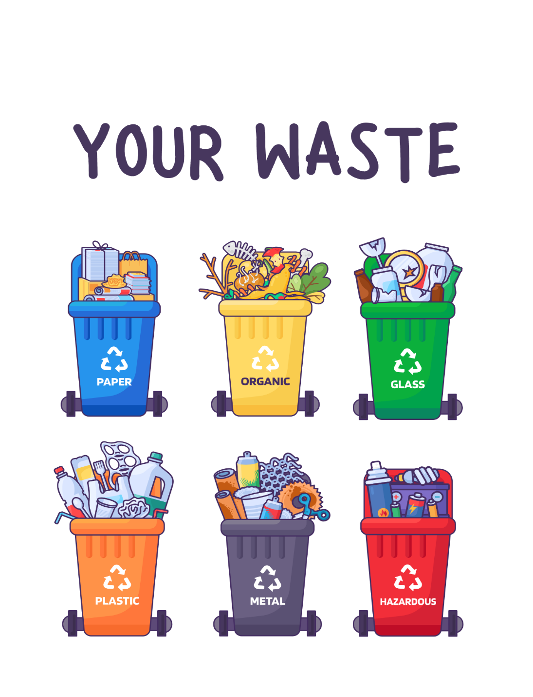
1. Introduction: Basics of urban waste management
Challenges in Urban Waste Management
Despite advancements in technology and policy frameworks, urban waste management faces numerous challenges. These include inadequate infrastructure, limited funding, lack of public awareness, and regulatory hurdles.
As residents of a bustling urban area, we have witnessed first-hand the myriad challenges that our city faces in managing waste effectively. The rapid growth of our population, coupled with increasing consumerism, has led to an overwhelming amount of waste generated daily. This situation not only strains our waste management systems but also poses significant environmental and social challenges. By addressing these issues head-on and fostering community engagement, we can develop practical solutions that enhance the effectiveness of urban waste management.

Slide 12
1. Introduction: Basics of urban waste management
Challenges in Urban Waste Management
One of the primary challenges is the sheer volume of waste produced in urban areas. Many cities struggle to keep up with the demand for efficient collection and disposal services. To tackle this issue, local authorities could implement more frequent collection schedules in high-density areas and invest in smart waste management technologies. For instance, using sensors in bins to monitor fill levels can optimise collection routes and reduce unnecessary trips.
Another significant challenge is the lack of awareness and participation among residents regarding proper waste disposal practices. Many people remain unaware of what can be recycled or composted, leading to contamination in recycling streams and increased landfill use. To address this, educational campaigns are essential. Local councils could organise workshops and community events that inform citizens about waste segregation, recycling benefits, and composting techniques.

Slide 13
1. Introduction: Basics of urban waste management
Challenges in Urban Waste Management
Moreover, fostering a sense of community ownership over waste management can significantly enhance participation rates. Initiatives such as neighbourhood clean-up days or 'adopt-a-bin' programmes encourage residents to take pride in their surroundings while actively participating in keeping their environment clean.
The issue of electronic waste (e-waste) is another pressing concern in urban settings. To combat this problem, cities could establish designated e-waste collection points or organise periodic e-waste recycling events where residents can safely dispose of their old electronics. Partnering with local businesses for these initiatives can also promote responsible consumption by encouraging repairs or refurbishments instead of outright disposal

Slide 14
1. Introduction: Basics of urban waste management
Do’s and don’ts
1. Educate Yourself and Others: Understand the basics of urban waste management and share this knowledge with your community. Awareness is key! 2. Promote Recycling: Encourage recycling practices in your household and community. Make sure to separate recyclables from general waste. 3. Support Sustainable Practices: Advocate for and participate in sustainable waste management practices, such as composting and reducing single-use plastics. 4. Engage with Local Initiatives: Get involved with local waste management programs or community clean-up events to help improve your environment. 5. Report Issues: If you notice illegal dumping or overflowing bins, report it to your local council to ensure proper action is taken.
1. Avoid Littering: Never throw waste on the ground. Always use designated bins to keep your community clean. 2. Don’t Contaminate Recycling: Avoid placing non-recyclable items in recycling bins, as this can spoil entire batches of recyclables. 3. Don’t Ignore Local Regulations: Be aware of and adhere to your local waste management regulations to avoid fines and contribute positively to your community. 4. Don’t Overlook Hazardous Waste: Never dispose of hazardous materials (like batteries or chemicals) in regular waste. Follow proper disposal guidelines. 5. Don’t Be Complacent: Don’t assume that someone else will take care of waste management. Every individual has a role to play in maintaining a sustainable environment.

Slide 15
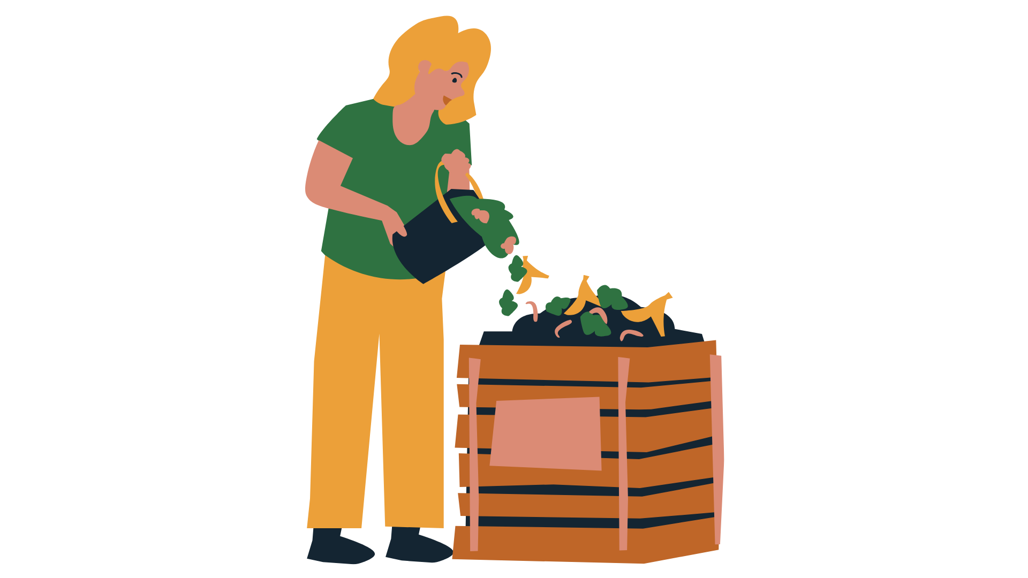
2. Recycling and Reuse: transforming waste into resources
The concept of Recycling and Reuse
Recycling and reuse are fundamental components of sustainable waste management that aim to divert materials from landfills and reduce the consumption of new resources. Recycling involves processing used materials to create new products, thereby conserving natural resources and energy while minimising environmental impact. Reuse, on the other hand, refers to finding new ways to use items without significant alteration, extending their lifespan and reducing the need for new purchases.
Recycling, in essence, involves the collection and processing of materials that would otherwise be discarded as waste. This can include everything from paper and glass to plastics and metals. The process typically begins with the segregation of recyclable materials from general waste, followed by their transportation to recycling facilities. Here, they undergo various treatments—cleaning, shredding, and melting—before being transformed into raw materials that can be used to manufacture new products.

Slide 16
2. Recycling and Reuse: transforming waste into resources
The concept of Recycling and Reuse
On the other hand, reuse is about finding new ways to utilise items without altering their form significantly. This could mean repurposing glass jars as storage containers or donating old clothes to charity shops rather than throwing them away. Both practices play a pivotal role in reducing the volume of waste we generate and conserving valuable resources.
The benefits of recycling and reuse extend far beyond mere waste reduction. By diverting materials from landfills, we not only minimise environmental pollution but also conserve energy and reduce greenhouse gas emissions associated with the production of new goods. Moreover, engaging in these practices fosters a sense of community responsibility.

Slide 17
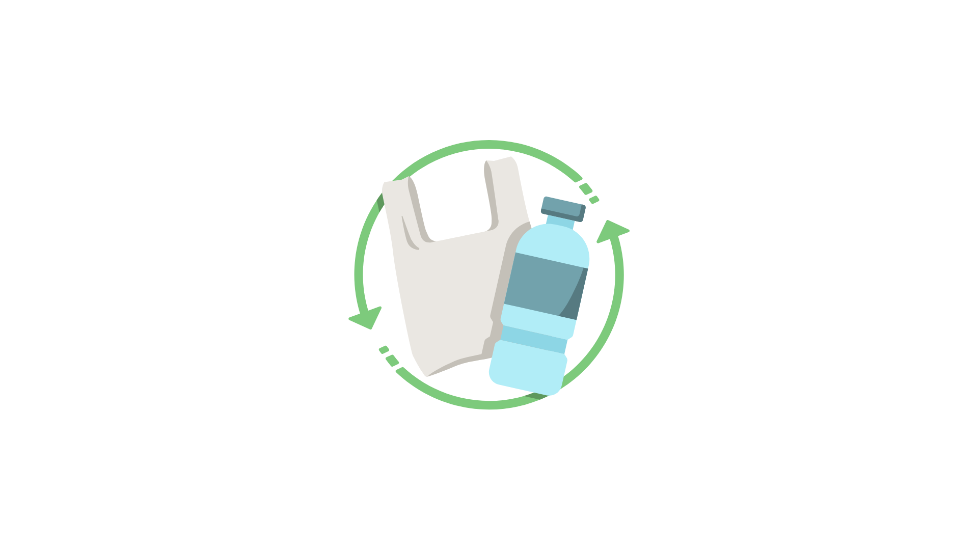
2. Recycling and Reuse: transforming waste into resources
The concept of Recycling and Reuse
In promoting a circular economy—a model where resources are kept in use for as long as possible—we can significantly alter our consumption patterns. This approach contrasts sharply with the traditional linear economy, which follows a 'take-make-dispose' model. In a circular economy, products are designed with their entire lifecycle in mind, ensuring that they can be reused or recycled at the end of their life.
Living in these vibrant cities offers numerous opportunities to engage with recycling initiatives. Local councils often provide accessible recycling bins throughout neighbourhoods, while community workshops teach residents how to upcycle everyday items creatively.
In conclusion, as we navigate through our daily lives in an urban environment, we are increasingly aware of how integral recycling and reuse are to our collective well-being. By embracing these practices and supporting a circular economy, we not only protect our planet but also enhance our community's resilience against the challenges posed by waste and resource depletion.

Slide 18
2. Recycling and Reuse: transforming waste into resources
Benefits of Recycling and Reuse
The advantages of recycling and reuse extend beyond mere waste reduction; they encompass economic, environmental, and social benefits. Economically, recycling can create jobs in collection, sorting, processing, and manufacturing industries while saving costs associated with waste disposal. Environmentally, it helps conserve natural resources, reduces greenhouse gas emissions, and decreases pollution associated with raw material extraction and processing. Socially, promoting recycling initiatives can foster community engagement and awareness about sustainability practices.

Slide 19
2. Recycling and Reuse: transforming waste into resources
Benefits of Recycling and Reuse
We are citizens living in the heart of vibrant cities, so we have witnessed first-hand the transformative power of recycling and reuse initiatives. These practices not only benefit our environment but also enrich our community in numerous ways. Allow us to delve into the benefits of recycling and reuse, supported by examples of successful programmes that have turned waste into valuable resources.
One of the most significant advantages of recycling is its ability to conserve natural resources. For instance, when we recycle paper, we reduce the need for deforestation, which is crucial for maintaining biodiversity and combating climate change. A notable example is the city's "Paper for Trees" initiative, where residents are encouraged to recycle their paper products. For every tonne of paper collected, local authorities plant trees in urban areas, enhancing green spaces while promoting responsible waste management.

Slide 20
2. Recycling and Reuse: transforming waste into resources
Benefits of Recycling and Reuse
Another key benefit is the reduction of landfill waste. Our city has implemented a comprehensive recycling programme that includes separate bins for plastics, metals, glass, and organic waste. This initiative has led to a remarkable decrease in landfill contributions—by over 30% in just a few years. The success of this programme can be attributed to community engagement campaigns that educate residents on proper recycling practices and the importance of reducing waste.
Recycling also plays a vital role in energy conservation. The process of recycling materials often requires less energy than producing new items from raw materials. For example, recycling aluminium saves up to 95% of the energy needed to create new aluminium from bauxite ore. In our city, an innovative partnership with local businesses has resulted in a "Cans for Energy" scheme, where residents are incentivised to recycle aluminium cans. The collected cans are processed at a nearby facility that converts them into energy-efficient products, demonstrating how recycling can lead to sustainable energy solutions.

Slide 21
2. Recycling and Reuse: transforming waste into resources
Benefits of Recycling and Reuse
Moreover, reuse initiatives foster creativity and community spirit. One such initiative is the "Swap Shop," where residents can bring unwanted items—clothing, books, toys—and exchange them for something new-to-them. This not only reduces waste but also promotes social interaction and strengthens community ties. The Swap Shop has become a beloved monthly event in our neighbourhood, showcasing how reuse can be both practical and enjoyable.
Additionally, many local artists and entrepreneurs have embraced upcycling—transforming discarded materials into unique art pieces or functional items. A prime example is a local artist who creates stunning furniture from reclaimed wood and metal scraps. Their work not only highlights the potential hidden within what many consider waste but also supports local economies by attracting customers interested in sustainable products.

Slide 22
2. Recycling and Reuse: transforming waste into resources
Challenges and Future Directions
Despite the clear benefits of recycling and reuse, several challenges hinder their widespread adoption. These include contamination of recyclable materials, lack of public awareness or participation, insufficient infrastructure for collection and processing, and economic barriers that make recycling less competitive than landfill disposal in some regions. Additionally, global market fluctuations can impact the viability of recycling programmes.
One of the primary challenges is contamination in recycling streams. Many residents are unsure about what can and cannot be recycled, leading to items being placed in the wrong bins. This contamination not only complicates the sorting process but also increases costs for recycling facilities. To address this issue, advanced sorting technologies are being developed. For instance, some facilities are now employing artificial intelligence and machine learning algorithms to identify and separate recyclable materials more efficiently.

Slide 23
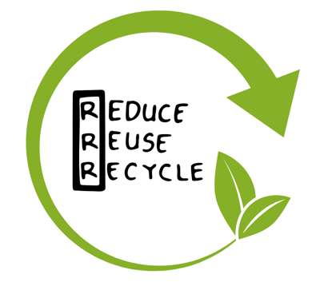
2. Recycling and Reuse: transforming waste into resources
Challenges and Future Directions
Community-based initiatives also play a crucial role in overcoming recycling challenges. In our city, local organisations have launched educational campaigns aimed at raising awareness about proper recycling practices. Workshops and events encourage residents to learn about the importance of reducing waste and how to recycle effectively. One particularly successful initiative is the "Recycling Champions" programme, where volunteers are trained to assist their neighbours in understanding recycling guidelines. This grassroots approach not only empowers individuals but also fosters a sense of community responsibility towards waste management.
Exploring circular economy models at a larger scale could provide insights into how cities can manage resources more sustainably. By collaborating with universities and research institutions, we can develop new technologies and strategies that ensure waste is not merely discarded but transformed into valuable resources.

Slide 24
2. Recycling and Reuse: transforming waste into resources
Do’s and don’ts
1. Educate Yourself: Familiarise yourself with local recycling guidelines to ensure you’re sorting your waste correctly. 2. Clean Your Recyclables: Rinse out containers before recycling them to avoid contamination. 3. Reuse Whenever Possible: Look for ways to repurpose items instead of throwing them away. For example, glass jars can be used for storage. 4. Support Recycled Products: Choose products made from recycled materials to encourage the market for recycled goods. 5. Participate in Community Initiatives: Join local recycling programmes or clean-up events to contribute to your community.
1. Don’t Contaminate Recycling Bins: Avoid placing non-recyclable items in recycling bins, as this can spoil the entire batch. 2. Don’t Ignore Labels: Pay attention to recycling symbols and instructions on packaging to ensure proper disposal. 3. Don’t Hoard Unused Items: While it’s great to reuse, holding onto items you’ll never use can lead to clutter. Be selective about what you keep. 4. Don’t Assume All Plastics Are Recyclable: Not all plastics can be recycled, so check local guidelines before disposing of them. 5. Don’t Forget About Composting: Organic waste can often be composted instead of being thrown away, so consider this option for food scraps.

Slide 25
3. Circular economy and waste
Understanding the Circular Economy
The circular economy is an alternative economic model that seeks to redefine growth by focusing on positive society-wide benefits. Unlike the traditional linear economy, which follows a 'take-make-dispose' pattern, the circular economy aims to close the loop of product lifecycles through greater resource efficiency. This involves designing products for longevity, repairability, and recyclability, thereby minimising waste generation.
At its core, it revolves around the principles of sustainable design, resource recovery, and systems thinking, all of which are essential for fostering a more resilient and sustainable economic framework.
Sustainable design is the foundation of the circular economy. It encourages the creation of products that are not only functional but also environmentally friendly. This means considering the entire lifecycle of a product, from the sourcing of materials to its eventual disposal. By prioritising durability, reparability, and recyclability, designers can significantly reduce waste and minimise the environmental impact of their creations.

Slide 26
3. Circular economy and waste
Understanding the Circular Economy
Resource recovery is another critical aspect of the circular economy. Instead of viewing waste as a by-product, it is reimagined as a valuable resource. This involves implementing processes that allow materials to be reclaimed, reused, or recycled, thereby closing the loop on production cycles. By recovering resources, we can reduce the demand for virgin materials, conserve natural resources, and decrease energy consumption, all of which contribute to a healthier planet.
Systems thinking plays a vital role in the circular economy by encouraging a holistic view of economic and environmental interactions. It recognises that all components of an economy are interconnected and that changes in one area can have far-reaching effects on others. By adopting a system thinking approach, businesses and policymakers can identify opportunities for collaboration and innovation, leading to more effective solutions that benefit both the economy and the environment.
In conclusion, the principles of the circular economy—sustainable design, resource recovery, and systems thinking—are crucial for creating a more resilient and sustainable economic framework. By embracing these principles, we can pave the way for a future where resources are used more efficiently, waste is minimised, and our planet is protected for generations to come.

Slide 27
3. Circular economy and waste
The role of waste in a circular economy
In a circular economy, waste is not seen as an end product but rather as a valuable resource that can be reintegrated into production processes. This paradigm shift encourages businesses and consumers to rethink their relationship with materials and products.
Waste management in the context of a circular economy is a fascinating and highly relevant topic today. Here are some strategies and successful examples:
1. Recycling and Reuse: Many companies are implementing recycling systems that allow for the recovery of materials from products at the end of their life cycle. A great example is Patagonia, which has launched its "Worn Wear" programme, where customers can return used clothing to be repaired and resold. This not only reduces waste but also fosters a culture of sustainability among consumers.

Slide 28
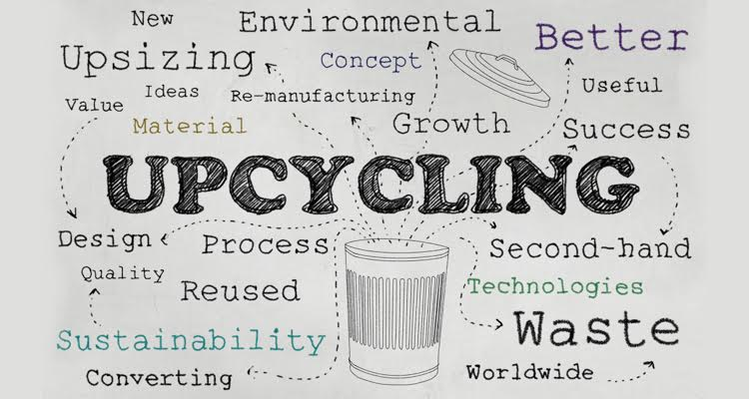
3. Circular economy and waste
The role of waste in a circular economy
2. Upcycling: This strategy involves transforming waste into higher-value products. TerraCycle is a company that specialises in this, collecting hard-to-recycle waste and turning it into new products, such as furniture or building materials. Its innovative approach has enabled many brands to collaborate in reducing their waste footprint.
3. Design for Decomposition: Some companies are adopting a design approach that facilitates the decomposition of their products at the end of their life cycle. Ecovative Design uses mycelium (the root system of fungi) to create biodegradable packaging that can decompose naturally, rather than contributing to plastic pollution.

Slide 29
3. Circular economy and waste
The role of waste in a circular economy
4. Service Economy: Instead of selling products, some companies are offering services. For example, Philips has implemented a "lighting as a service" model, where customers pay for the use of lighting rather than purchasing light bulbs. This allows them to retain ownership of the products and manage their life cycle more efficiently.
5. Collaborations and Networks: Creating networks between companies to share resources and waste is another effective strategy. A notable case is Industrial Symbiosis in Kalundborg, Denmark, where several industries collaborate to exchange by-products and resources, thereby reducing waste and optimising resource use.

Slide 30
3. Circular economy and waste
Challenges and opportunities for transitioning to a circular economy
Transitioning from a linear to a circular economy presents both challenges and opportunities for businesses, policymakers, and society at large. Key challenges include overcoming existing infrastructure limitations, changing consumer behaviour, and addressing regulatory barriers that may hinder innovation. However, there are also significant opportunities for economic growth through the development of new business models that prioritise sustainability and resource efficiency.
Transitioning to a circular economy presents a myriad of challenges that require careful examination and strategic planning. At its core, the circular economy aims to redefine traditional production and consumption patterns by promoting the continual use of resources, thereby minimising waste. However, achieving this vision is fraught with obstacles that must be addressed to facilitate a successful transition.

Slide 31
3. Circular economy and waste
Challenges and opportunities for transitioning to a circular economy
One significant challenge is the existing linear economic model, which is deeply entrenched in many industries. This model prioritises short-term profits over long-term sustainability, making it difficult for businesses to shift their focus towards circular practices. Additionally, there is often a lack of awareness and understanding among stakeholders about the benefits of a circular economy, which can hinder buy-in and commitment to change.
Another challenge lies in the technological and infrastructural requirements needed to support circular practices. For instance, effective recycling systems and waste management technologies are essential for recovering materials from end-of-life products. However, many regions lack the necessary infrastructure or investment to develop these systems adequately. Furthermore, the complexity of supply chains can complicate efforts to implement circular practices, as companies may struggle to trace materials and ensure they are being reused effectively.

Slide 32
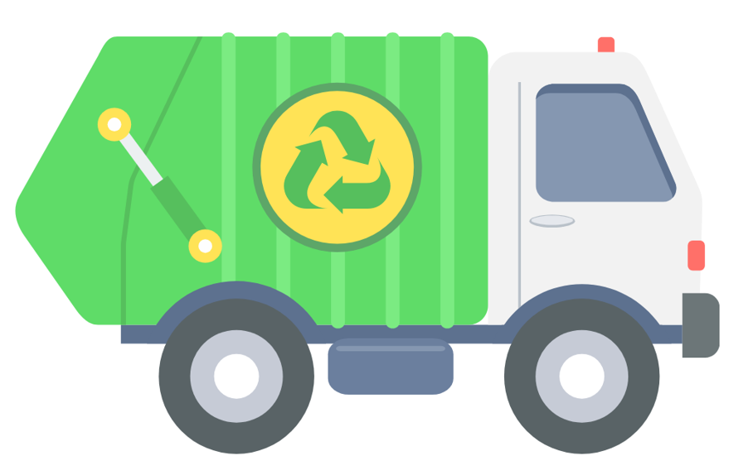
3. Circular economy and waste
Challenges and opportunities for transitioning to a circular economy
To facilitate the transition to a circular economy, several potential pathways can be identified. Firstly, fostering collaboration among stakeholders—governments, businesses, and communities—is crucial for driving systemic change. Governments can play a pivotal role by creating policies that incentivise sustainable practices and support research into innovative technologies. For example, tax breaks for companies that adopt circular models or grants for developing recycling facilities can encourage investment in sustainable solutions.
Businesses must also take proactive steps by re-evaluating their product designs and supply chains. Emphasising durability, reparability, and recyclability in product development can significantly reduce waste. Communities play an equally important role in this transition. By raising awareness about the importance of sustainable practices and encouraging local initiatives—such as community recycling programmes or repair workshops—communities can foster a culture of sustainability that supports circular economy principles.

Slide 33
3. Circular economy and waste
Challenges and opportunities for transitioning to a circular economy
In conclusion, while transitioning to a circular economy presents numerous challenges—from entrenched linear models to infrastructural limitations—the potential pathways for facilitating this transition are promising. By emphasising collaboration among governments, businesses, and communities, we can drive systemic change towards more sustainable waste management practices. This collective effort not only addresses environmental concerns but also opens up new opportunities for innovation and economic growth in an increasingly resource-constrained world.

Slide 34
3. Circular economy and waste
Do’s and don’ts
Educate Yourself and Others: Stay informed about the principles of the circular economy and share this knowledge with your community.
Reduce Waste: Aim to minimise waste generation by choosing products with less packaging and opting for reusable items.
Recycle Properly: Familiarise yourself with local recycling guidelines to ensure that materials are disposed of correctly.
Support Sustainable Brands: Choose to buy from companies that prioritise sustainability and circular practices in their operations.
Repair and Reuse: Before discarding items, consider whether they can be repaired or repurposed for another use.
Don’t Ignore Labels: Avoid disregarding product labels that provide information on recyclability or sustainable sourcing.
Don’t Contaminate Recycling Bins: Never place non-recyclable items in recycling bins, as this can spoil entire batches of recyclable materials.
Don’t Overconsume: Resist the temptation to buy more than you need; focus on quality over quantity.
Don’t Discard Electronics Improperly: Avoid throwing away electronic waste; instead, seek out proper e-waste recycling facilities.
Don’t Rely Solely on Recycling: Understand that recycling is just one part of the solution; reducing consumption is equally important.

Slide 35
4. Community involvement and behavior change
The importance of Community Involvement
Community involvement is crucial for fostering a sense of ownership and responsibility among residents regarding local issues, including waste management, environmental conservation, and public health. Engaging communities in decision-making processes not only empowers individuals but also enhances the effectiveness of initiatives aimed at promoting sustainable practices.
Participatory planning is an approach that actively involves community members in decision-making processes regarding waste management and environmental policies. This method not only empowers residents but also ensures that their voices are heard in shaping initiatives that affect their lives. For instance, the city of Bristol in the UK has implemented participatory budgeting schemes where citizens can propose and vote on projects aimed at reducing waste. This inclusive approach has led to innovative solutions tailored to the specific needs of the community, such as community composting initiatives and local recycling drives.

Slide 36
4. Community involvement and behavior change
The importance of Community Involvement
Volunteer programmes are another effective means of engaging communities in waste reduction efforts. These programmes often bring together individuals who share a common goal of promoting sustainability. A notable example is the "Clean Up Australia Day" initiative, which encourages volunteers to participate in clean-up events across the country. This annual event not only raises awareness about littering and waste but also fosters a sense of camaraderie among participants. The tangible results—such as cleaner parks and beaches—serve as a powerful reminder of what can be achieved through collective action.

Slide 37
4. Community involvement and behavior change
The importance of Community Involvement
Local advocacy groups also play a crucial role in galvanising community support for waste reduction initiatives. These organisations often work to educate residents about sustainable practices while lobbying for policy changes at the municipal level. One successful case study is the "Zero Waste Scotland" initiative, which aims to engage communities in reducing waste through education and support for local projects. By providing resources and guidance, Zero Waste Scotland has empowered numerous communities to implement their own waste reduction strategies, resulting in significant decreases in landfill contributions.
Moreover, community gardens exemplify how collective action can lead to positive outcomes while simultaneously addressing food waste issues. In many urban areas, community members have come together to create shared gardens where they grow fruits and vegetables. These gardens not only provide fresh produce but also reduce food waste by encouraging people to utilise surplus harvests through sharing or preserving excess crops.

Slide 38
4. Community involvement and behavior change
Strategies for encouraging behaviour change
Changing individual and collective behaviours is essential for achieving sustainability goals. Effective strategies for encouraging behaviour change often involve education, awareness-raising campaigns, and incentives that motivate people to adopt more sustainable practices.
Addressing waste management effectively requires a multifaceted approach to behaviour change. Various strategies can be employed to encourage individuals and communities to adopt more sustainable practices, including social marketing techniques, nudges that influence decision-making, and the significant role of peer influence in shaping habits. Furthermore, tailoring messages to resonate with specific community values and cultural contexts is crucial for enhancing the impact of these initiatives.

Slide 39
4. Community involvement and behavior change
Strategies for encouraging behaviour change
Social marketing techniques are designed to promote positive behaviours by applying marketing principles to social issues. This approach involves understanding the target audience's needs, preferences, and motivations, allowing for the development of campaigns that resonate deeply with them. For instance, campaigns that highlight the environmental benefits of recycling or composting can be particularly effective when they include relatable narratives or local success stories. An example of this is the "Love Food Hate Waste" campaign in the UK, which utilises engaging messaging and practical tips to reduce food waste. By framing the issue in a way that connects with people's everyday experiences, such campaigns can inspire meaningful changes in behaviour.

Slide 40
4. Community involvement and behavior change
Strategies for encouraging behaviour change
Nudges are subtle interventions that guide individuals towards making better choices without restricting their freedom of choice. These can take many forms, such as changing the default options in waste disposal systems or providing clear signage that encourages recycling. For example, placing recycling bins next to general waste bins with clear labels can significantly increase recycling rates by making it easier for individuals to make the right choice. Research has shown that small changes in the environment can lead to substantial shifts in behaviour, demonstrating the power of nudges in promoting sustainable practices.
Peer influence also plays a critical role in shaping habits and behaviours related to waste management. People are often motivated by their social circles; thus, when friends or family members adopt sustainable practices, others are likely to follow suit. Community-led initiatives that encourage group participation—such as neighbourhood clean-up events or shared composting projects—can harness this peer influence effectively. By creating a sense of community around sustainability efforts, individuals may feel more compelled to engage in similar behaviours.

Slide 41
4. Community involvement and behavior change
Strategies for encouraging behaviour change
Importantly, tailoring messages to align with specific community values and cultural contexts enhances their effectiveness. Different communities may have unique perspectives on waste management based on their cultural backgrounds or local experiences. For instance, a campaign aimed at reducing plastic use might emphasise environmental conservation for one community while focusing on health benefits for another. Understanding these nuances allows for more targeted messaging that resonates with residents' beliefs and priorities.

Slide 42
4. Community involvement and behavior change
Overcoming barriers to participation
Identifying barriers to participation in behaviour change is crucial for developing effective strategies that encourage sustainable practices within communities. These barriers can be multifaceted, encompassing social, economic, and psychological factors that hinder individuals from engaging in desired behaviours.
One significant barrier to participation is a lack of awareness or understanding of the issues at hand. Many individuals may not fully grasp the impact of their behaviours on waste generation or environmental sustainability. To address this, educational initiatives should be implemented that provide clear, accessible information about the benefits of behaviour change. Workshops, community seminars, and informational campaigns can help demystify complex topics and empower residents with knowledge

Slide 43
4. Community involvement and behavior change
Overcoming barriers to participation
Another barrier is socio-economic constraints. Individuals from lower-income backgrounds may face challenges such as limited access to resources or time constraints that prevent them from participating in behaviour change initiatives. To overcome this barrier, stakeholders should consider implementing support systems that provide resources such as subsidised compost bins or free recycling materials. Furthermore, creating flexible programmes that accommodate varying schedules can encourage participation from those who may otherwise feel excluded due to work or family commitments.
Cultural differences can also pose a barrier to engagement in behaviour change efforts. Communities are often composed of diverse populations with varying beliefs and values regarding sustainability. To foster inclusivity, it is essential to tailor messages and initiatives to resonate with specific cultural contexts. Engaging community leaders and representatives from different cultural backgrounds in the planning process can ensure that initiatives are culturally sensitive and relevant. This collaborative approach not only enhances buy-in but also fosters a sense of ownership among community members.

Slide 44
4. Community involvement and behavior change
Overcoming barriers to participation
Psychological barriers, such as fear of failure or scepticism about the effectiveness of individual actions, can further inhibit participation. Many people may feel overwhelmed by the scale of environmental issues and believe their contributions will have little impact. To counteract this mindset, it is vital to emphasise collective action and highlight how small changes can lead to significant outcomes when adopted by many individuals. Campaigns that celebrate community achievements—such as reductions in waste or increases in recycling rates—can help build confidence and motivate others to join in.

Slide 45
4. Community involvement and behavior change
Do’s and don’ts
Engage with Your Community: Attend local meetings, events, or workshops to understand community needs and how you can contribute.
Promote Open Communication: Encourage dialogue within your community by creating platforms for sharing ideas and feedback.
Lead by Example: Demonstrate positive behaviours that you wish to see in others, such as sustainable practices or volunteerism.
Collaborate with Local Organisations: Partner with schools, charities, or local businesses to amplify your efforts and reach a wider audience.
Provide Resources and Information: Share educational materials that inform community members about the benefits of participation and behaviour change.
Don’t Dismiss Concerns: Avoid ignoring or belittling the concerns of community members; listen actively to their perspectives.
Don’t Use Jargon: Refrain from using technical language that may alienate or confuse people; keep communication clear and accessible.
Don’t Force Participation: Avoid coercing individuals into participating; instead, encourage voluntary involvement through positive reinforcement.
Don’t Overlook Diversity: Don’t assume that one approach fits all; recognise the diverse backgrounds and needs of community members when designing initiatives.
Don’t Neglect Follow-Up: After events or initiatives, don’t forget to follow up with participants to gather feedback and maintain engagement.

Slide 46
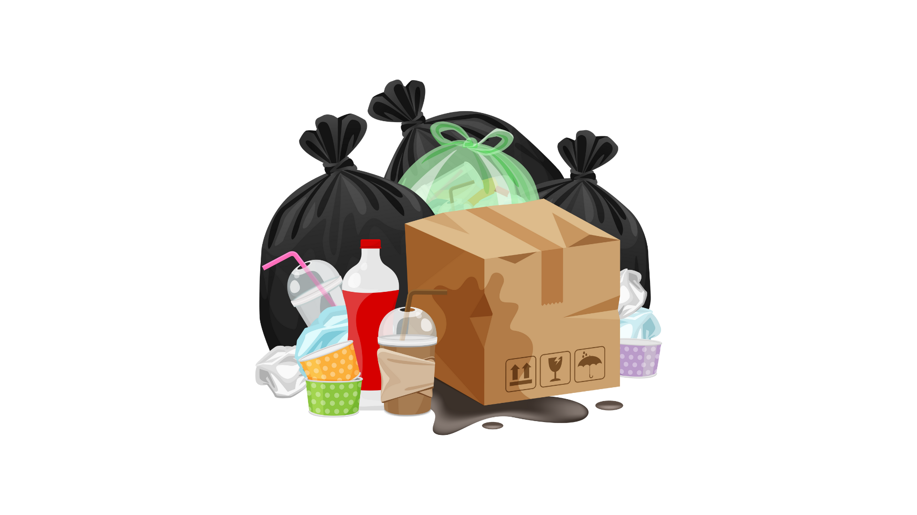
5. Environmental and health impacts of urban waste
Environmental impacts of urban waste
Urban waste management poses significant environmental challenges that can affect air, water, and soil quality.
One of the most immediate consequences of urban waste is habitat destruction. Landfills and waste disposal sites often encroach upon natural habitats, leading to the degradation of ecosystems that are vital for numerous species. The conversion of green spaces into waste management facilities not only displaces wildlife but also disrupts ecological balance, resulting in a decline in native flora and fauna.
Biodiversity loss is another critical concern associated with urban waste. This loss has far-reaching implications, as diverse ecosystems are essential for maintaining ecological resilience and providing essential services such as pollination, water purification, and climate regulation.

Slide 47
5. Environmental and health impacts of urban waste
Environmental impacts of urban waste
Plastic pollution is perhaps one of the most visible and alarming impacts of urban waste. The proliferation of single-use plastics has resulted in vast quantities of plastic debris accumulating in urban areas.
To mitigate these environmental impacts, sustainable waste management practices are crucial. Implementing strategies such as recycling, composting, and reducing single-use plastics can significantly decrease the volume of waste generated in urban areas.
Moreover, integrating green infrastructure into urban planning can help restore habitats and enhance biodiversity. Creating parks, green roofs, and community gardens not only provides spaces for recreation but also supports local wildlife and improves air quality.

Slide 48
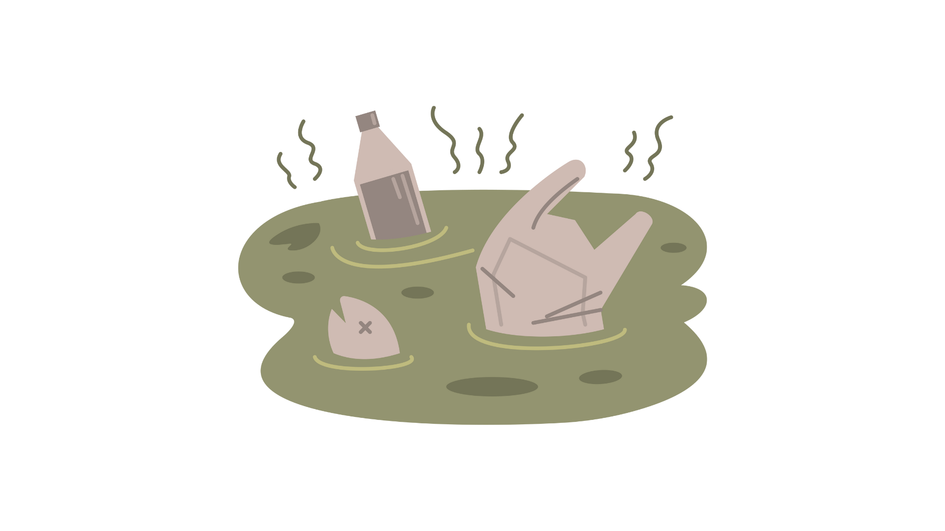
5. Environmental and health impacts of urban waste
Health impacts of urban waste
The health implications of urban waste are profound and multifaceted. Poor waste management can lead to the proliferation of disease vectors such as rats and mosquitoes, which thrive in uncollected rubbish and can transmit diseases like dengue fever and leptospirosis. Furthermore, exposure to hazardous materials found in electronic waste or improperly disposed chemicals can result in serious health issues for communities living near waste sites.
Direct health impacts associated with urban waste include exposure to hazardous materials and pathogens found in improperly managed waste. For instance, individuals living near landfills or waste disposal sites may be at risk of respiratory problems due to airborne pollutants released during the decomposition of organic matter. Additionally, the presence of toxic substances in waste can lead to skin irritations, infections, and other health complications for those who come into contact with contaminated materials.

Slide 49
5. Environmental and health impacts of urban waste
Health impacts of urban waste
Indirectly, urban waste contributes to broader environmental issues that can have serious health implications. Poor waste management practices often result in water pollution, as leachate from landfills can contaminate local water sources. This poses a particular risk to communities relying on these sources for drinking water, leading to gastrointestinal diseases and other waterborne illnesses. Furthermore, the accumulation of waste can create breeding grounds for disease-carrying vectors such as mosquitoes, increasing the likelihood of outbreaks of diseases like dengue fever and Zika virus.
Vulnerable populations are disproportionately affected by these health impacts. Low-income communities and marginalised groups often reside in close proximity to waste disposal sites and may lack access to adequate healthcare services. This exacerbates their susceptibility to the negative health effects associated with urban waste. Children, the elderly, and individuals with pre-existing health conditions are particularly at risk, as they may have heightened sensitivities to environmental hazards.
Public health initiatives play a crucial role in addressing these challenges through education and improved waste management strategies. Raising awareness about the health risks associated with urban waste is essential for empowering communities to take action. Educational campaigns can inform residents about proper waste disposal methods, recycling practices, and the importance of reducing single-use plastics.

Slide 50
5. Environmental and health impacts of urban waste
Strategies for mitigating environmental and health impacts
To address the environmental and health impacts of urban waste effectively, cities must adopt comprehensive waste management strategies that prioritise sustainability and community well-being.
Mitigating the impacts of urban waste is essential for fostering healthier environments and ensuring sustainable living conditions in cities. Various approaches can be employed to address the challenges posed by waste generation, including source reduction initiatives, recycling and composting programmes, and stricter regulations on hazardous waste disposal. Each of these strategies plays a crucial role in minimising waste and its associated environmental and health impacts.
One effective approach is reducing waste generation through source reduction initiatives. This involves encouraging individuals and businesses to minimise the amount of waste they produce at the outset. Strategies may include promoting the use of reusable products, encouraging bulk purchasing to reduce packaging waste, and advocating for sustainable design practices that prioritise longevity and recyclability. By addressing waste at its source, communities can significantly decrease the volume of materials that ultimately end up in landfills.

Slide 51
5. Environmental and health impacts of urban waste
Strategies for mitigating environmental and health impacts
Promoting recycling and composting programmes is another vital strategy for mitigating urban waste impacts. Effective recycling initiatives can divert significant amounts of material from landfills, transforming what would otherwise be waste into valuable resources. Composting organic waste not only reduces landfill contributions but also enriches soil health, supporting local agriculture and gardening efforts. Cities can enhance these programmes by providing accessible collection services, educational resources about proper sorting techniques, and incentives for participation.
Implementing stricter regulations on hazardous waste disposal is critical for protecting public health and the environment. Governments must establish clear guidelines for the safe handling, storage, and disposal of hazardous materials to prevent contamination of soil and water sources. Regular inspections and enforcement of these regulations are necessary to ensure compliance among businesses and industries that generate hazardous waste. Additionally, public awareness campaigns can inform residents about the dangers associated with improper disposal practices.

Slide 52
5. Environmental and health impacts of urban waste
Strategies for mitigating environmental and health impacts
Community engagement is paramount in developing local solutions tailored to specific needs and contexts. Involving residents in decision-making processes fosters a sense of ownership over local initiatives and encourages active participation in sustainability efforts. Community workshops, focus groups, and outreach programmes can help identify unique challenges faced by different neighbourhoods while generating innovative ideas for addressing them.
Collaboration among government agencies, businesses, and residents is essential for creating comprehensive strategies that effectively tackle urban waste issues. By working together, stakeholders can share resources, knowledge, and best practices to develop solutions that are both practical and impactful. For instance, partnerships between local governments and businesses can lead to the establishment of community recycling centres or educational campaigns aimed at reducing single-use plastics.

Slide 53
5. Environmental and health impacts of urban waste
Do’s and don’ts
Conduct Regular Waste Audits: Assess the types and quantities of waste generated in your area to identify key issues and areas for improvement.
Promote Waste Reduction Initiatives: Encourage practices such as composting, recycling, and reusing materials within your community to minimise waste generation.
Educate on Proper Disposal Methods: Provide information on how to dispose of hazardous waste safely, including electronics, chemicals, and medical waste.
Advocate for Green Spaces: Support the creation and maintenance of parks and green areas that can help absorb pollutants and improve air quality.
Engage with Local Authorities: Work with local government to develop policies aimed at reducing urban waste and its associated impacts on health and the environment.
Don’t Ignore Illegal Dumping: Avoid turning a blind eye to illegal dumping; report it to local authorities to ensure proper action is taken.
Don’t Overlook Community Health Risks: Refrain from dismissing the potential health risks associated with poor waste management; raise awareness about these issues.
Don’t Rely Solely on Landfills: Avoid depending exclusively on landfills for waste disposal; explore alternative methods such as recycling and composting.
Don’t Neglect Public Awareness Campaigns: Don’t underestimate the importance of educating the public about the impacts of urban waste; effective communication is key.
Don’t Disregard Feedback: Avoid ignoring community feedback regarding waste management practices; listen to residents’ concerns and suggestions for improvement.

Slide 54
Summing up
Understanding Urban Waste Management
Transitioning to a Circular Economy
Urban waste management encompasses collection, processing, recycling, and disposal practices essential for sustainable urban development and public health. As cities grow, waste volume increases, highlighting the need for efficient waste handling strategies.
The circular economy aims to reduce waste through sustainable product design, resource recovery, and systems thinking. This model supports long-term sustainability by reimagining waste as valuable resources.
Promoting Recycling and Reuse
Community Involvement in Waste Management
Recycling and reuse reduce landfill waste and conserve resources, enhancing environmental sustainability. This process involves repurposing materials to extend their lifespan and foster community engagement in waste reduction.
Community participation is vital for waste management success, fostering behavior change and sustainable practices. Engagement initiatives like clean-up events and recycling programs empower citizens to actively contribute to environmental conservation

Slide 55
Thank you!
Partner: IWS

